Slide 1
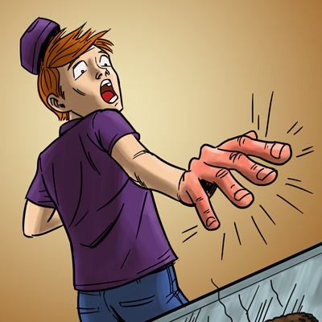
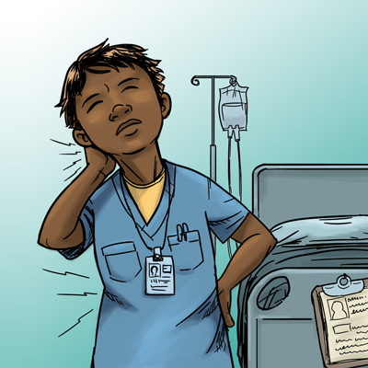
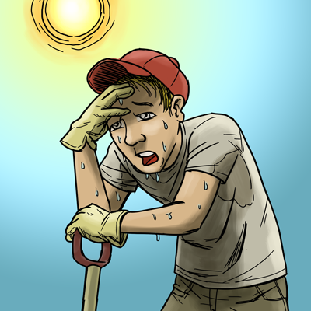
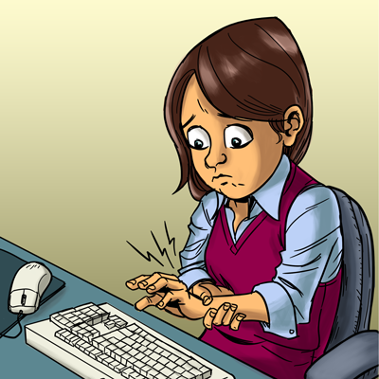
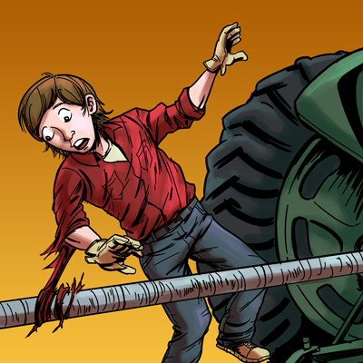


A Safety & Health Curriculum
For Young Workers
DEPARTMENT OF HEALTH AND HUMAN SERVICES
Centers for Disease Control and Prevention
National Institute for Occupational Safety and Health

Slide 2
Acknowledgements
The Young Worker Safety Resource Center is funded under grant number SH22240SH1 from the Occupational Safety and Health Administration, U.S. Department of Labor.
Portions of the Youth @ Work—Talking Safety curriculum were also funded by the National Institute for Occupational Safety and Health, Centers for Disease Control.
This presentation does not necessarily reflect the views or policies of the U.S. Department of Labor, nor does mention of trade names, commercial products, or organizations imply endorsement by the U.S. Government.

Slide 3



Why Job Health and Safety Skills are Needed

Slide 4
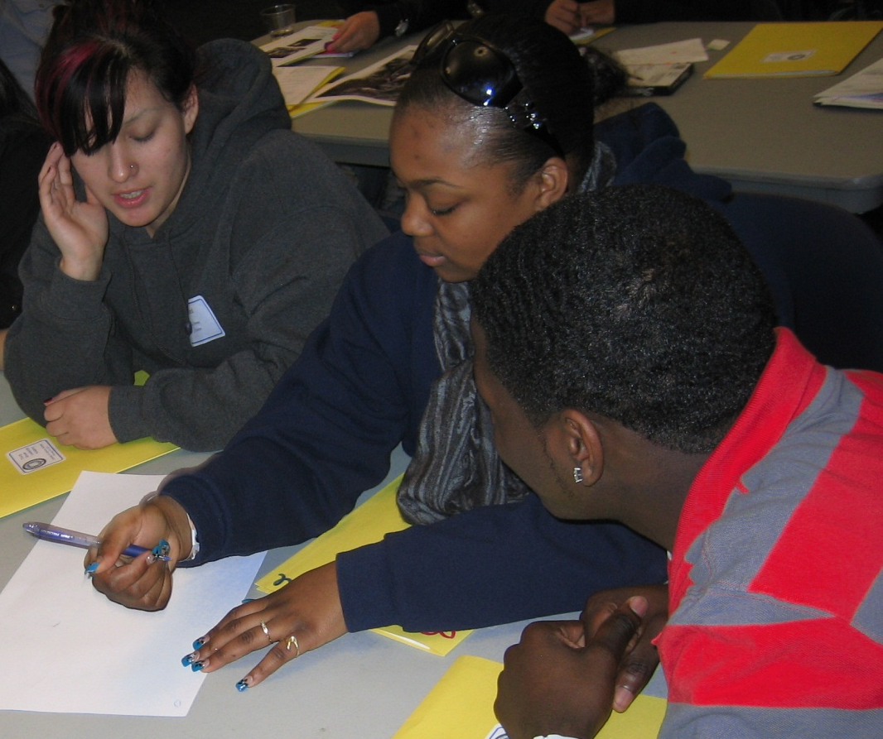
Career Ready Skills Include
Job Health and Safety Skills
Critical thinking and problem solving
Communication and collaboration
Creativity and innovation

Slide 5
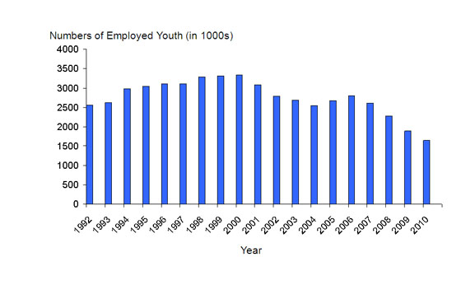
Number of 15-17 Year Olds Employed

Slide 6

Where Teens Work
% of total workers, aged 15-17, per industry
*Includes restaurants
Based on national data, and may vary by state. Working teens under age 14 not represented. Youth farm workers not represented.
Source: NIOSH / CDC 2009 (www.cdc.gov/niosh/topics/youth/chartpackage.html)

Slide 7
Where Teens are Injured on the Job
% of total workers, aged 15-17, per industry
*Includes restaurants.
These data are for injuries that require at least one day away from work. They do not include youth who work on small farms, work for government agencies, or are self-employed.
Source: NIOSH / CDC 2009 (www.cdc.gov/niosh/topics/youth/chartpackage.html)

Slide 8
Teen Worker Injury Statistics
Approximately 1.6 million teens (aged 15–17) in the United States work. About 50% of 10th graders and 75% of 12th graders have jobs.
Many youths are injured on the job.
On average, each year
    59,800 workers younger than 18 are sent to the ER for job-related injuries, but actual injury statistics are much higher.
    37 workers younger than 18 die on the job.
  Young workers are twice as likely to be injured than adult workers.
NIOSH 2010 www.cdc.gov/niosh/topics/youth/chartpackage.html
www.cdc.gov/mmwr/preview/mmwrhtml/mm5915a2.htm

Slide 9

Why are Young Workers Injured at High Rates?
[insert video clip here]

Slide 10
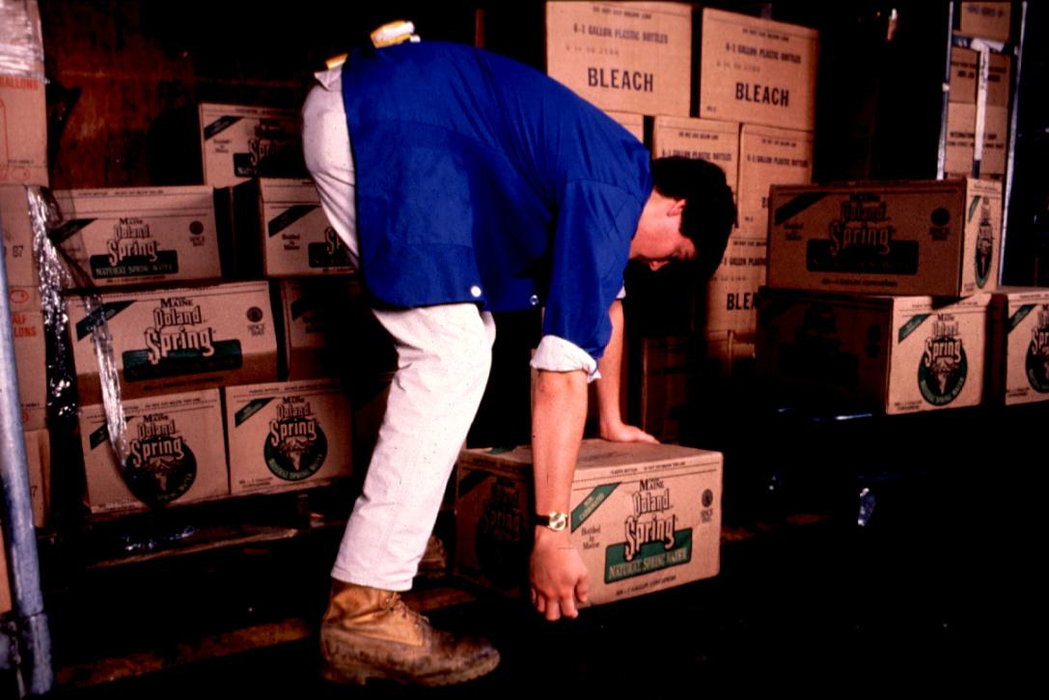
Why are Young Workers Injured at High Rates?
Hazards on the job
Inexperienced
Developmental
factors
Some working in
violation of CLLs
Lack of training &
supervision.

Slide 11
What are the Basic Occupational Safety and Health Skills?
Youth
@
Work
Young workers should be able to:
Identify hazards in any workplace
Know how hazards can be controlled
Know what to do in an emergency
Know their rights and responsibilities
Speak up effectively when a problem arises.

Slide 12

The Youth @ Work: Talking SafetyCurriculum
Teaches the basic skills
Uses highly participatory activities such as games, small group hands-on activities, and role plays
Includes adapted activities for teaching youth with cognitive or learning disabilities
Evaluated by NIOSH
State-specific versions at http://www.cdc.gov/niosh/talkingsafety/

Slide 13
Each Lesson Includes:
Learning Objectives
Detailed teaching instructions
Powerpoint slides if needed
Student handouts

Slide 14

Quiz
Video
Stories
Discussion
Learning Objectives
Determine how much they already know about job safety and their legal rights.
Describe the impact work injuries can have on a young person’s life.
Identify the major messages in a video on teen job safety.
Define the word “hazard” and identify possible health and safety hazards in the workplaces shown in the video.

Slide 15
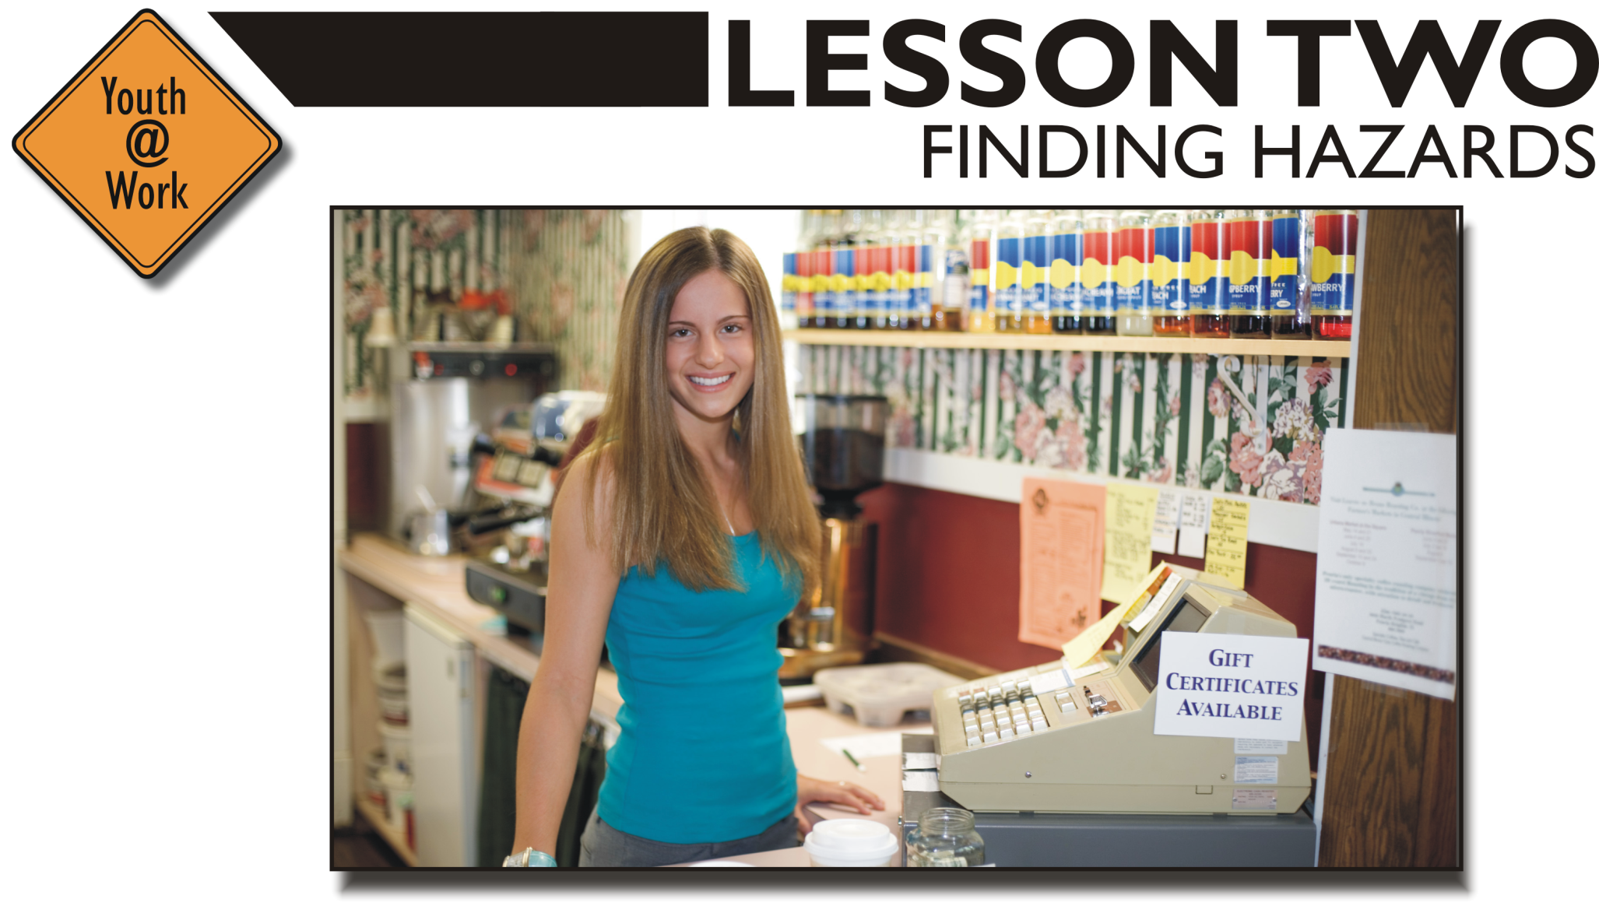
Hazard mapping
Find the hazards in the picture
Hunting for hazards
Learning Objectives
Identify a variety of health and safety hazards found at typical worksites that employ young people.
Locate various types of hazards in an actual workplace.
Explain how to get information about chemical hazards.

Slide 16
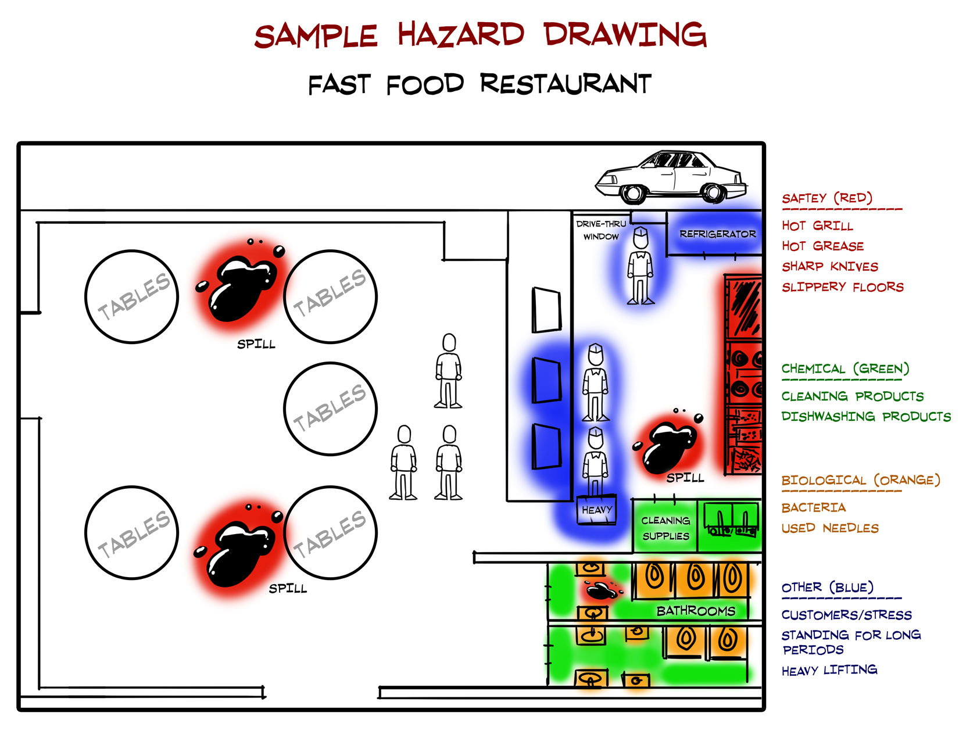
Hazard Mapping Activity

Slide 17
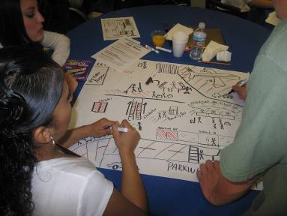
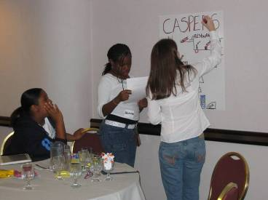
Learning to Recognize Hazards

Slide 18
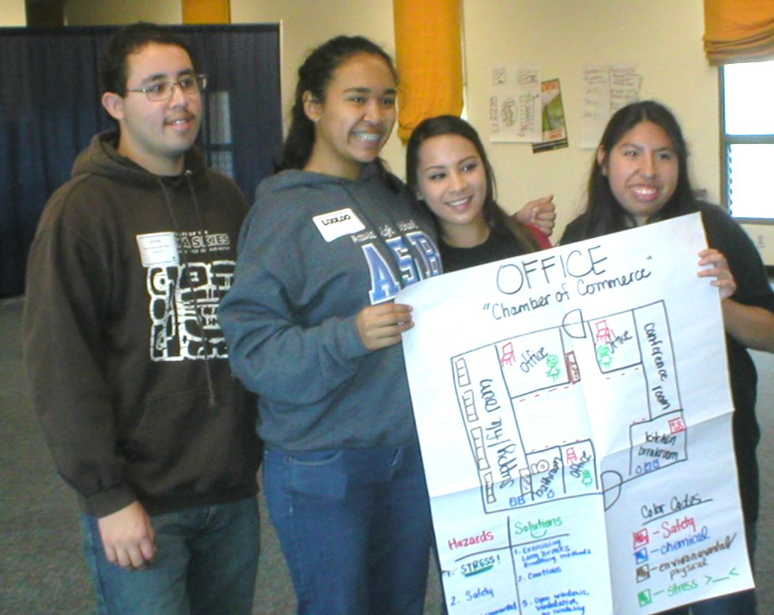
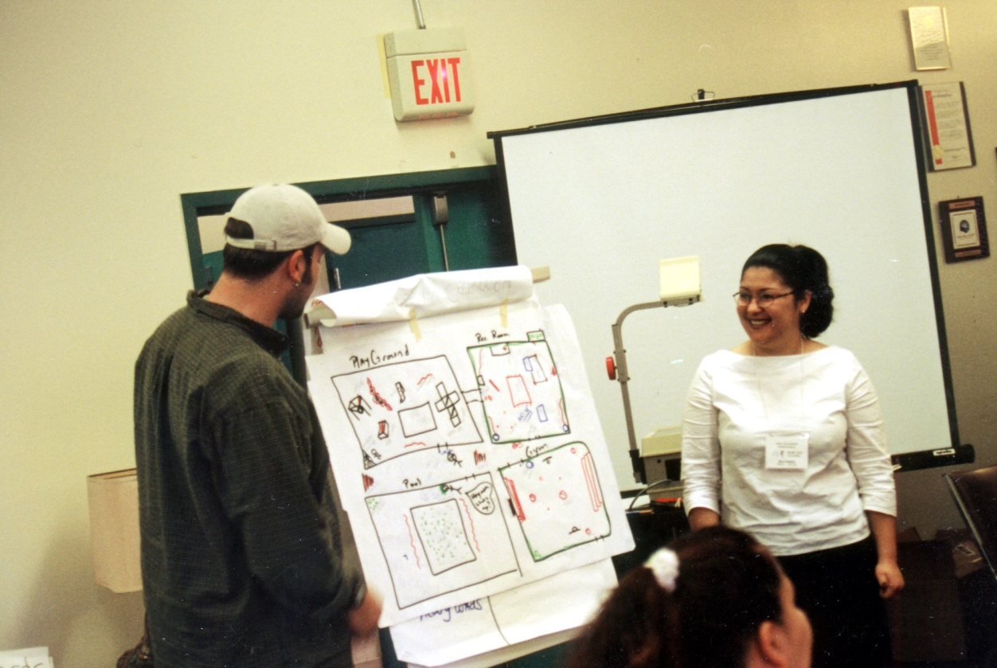
Sharing the Hazard Maps

Slide 19
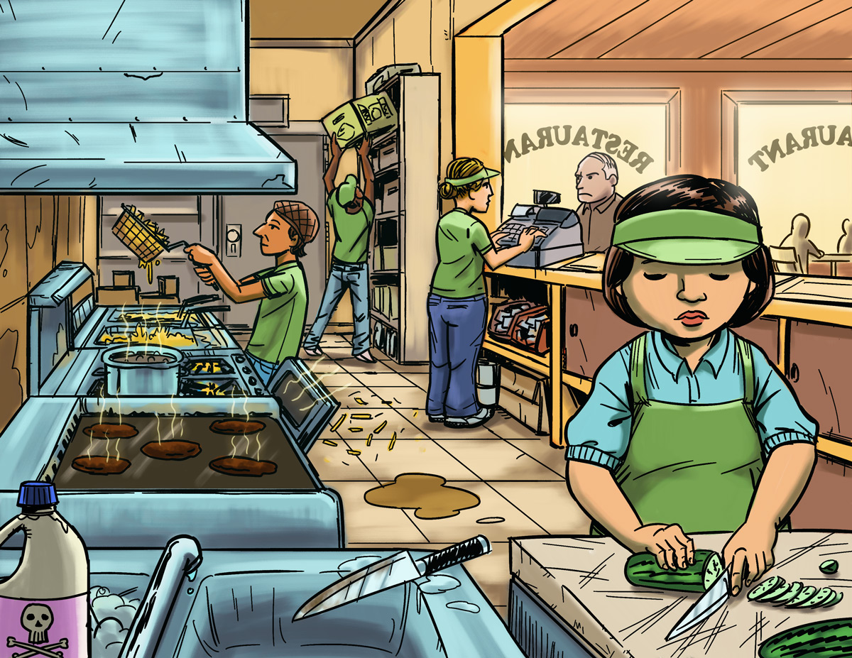
Find The Hazards: Fast Food Restaurant
a
Illustrated Workplaces

Slide 20
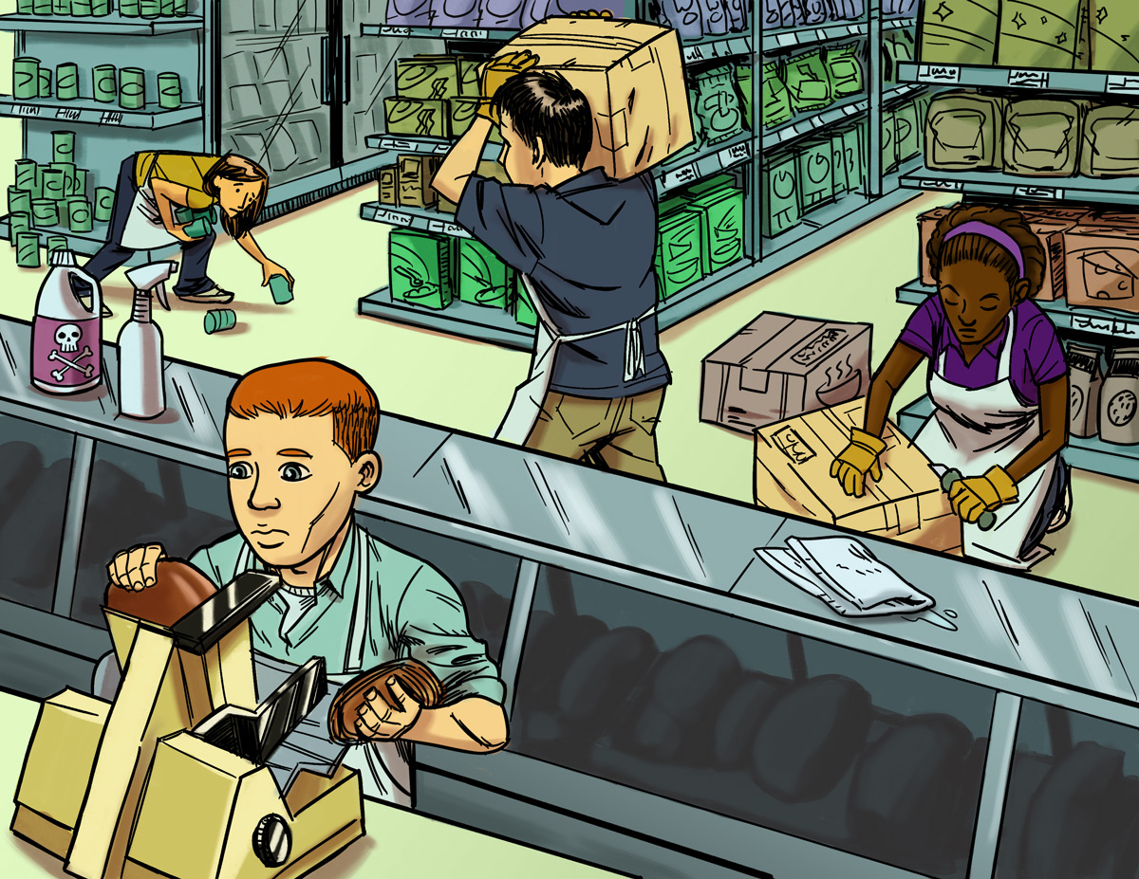
Find The Hazards: Grocery Store
a
Illustrated Workplaces

Slide 21
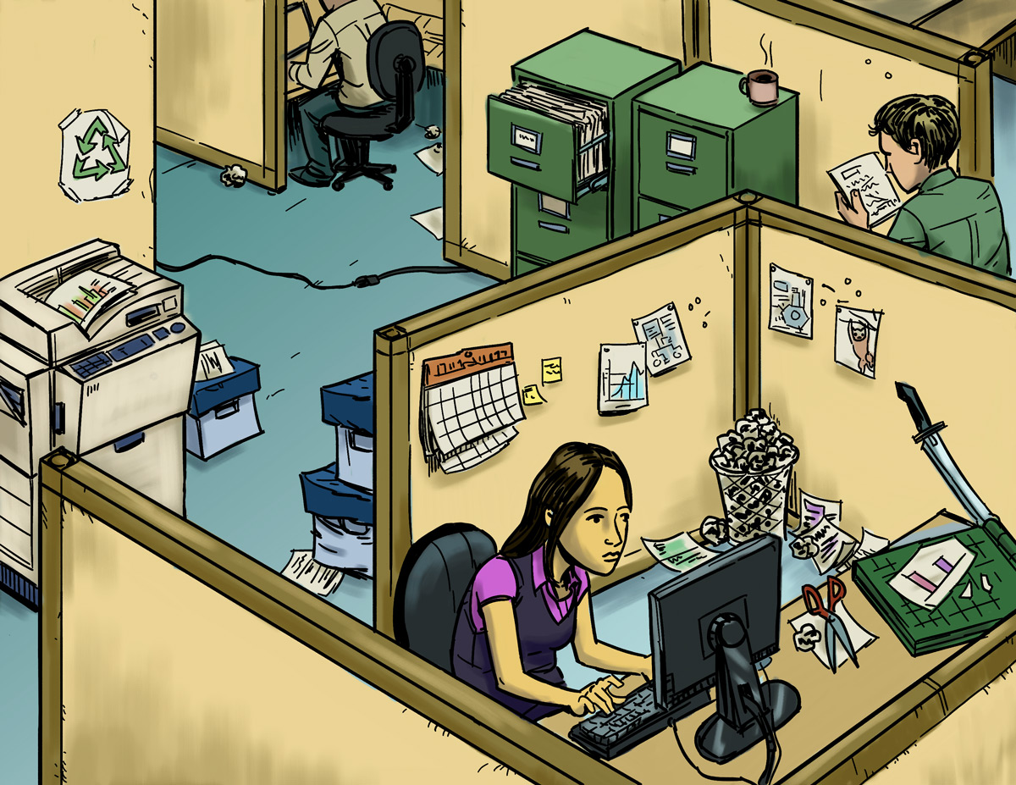
Find The Hazards: Office
a
Illustrated Workplaces

Slide 22
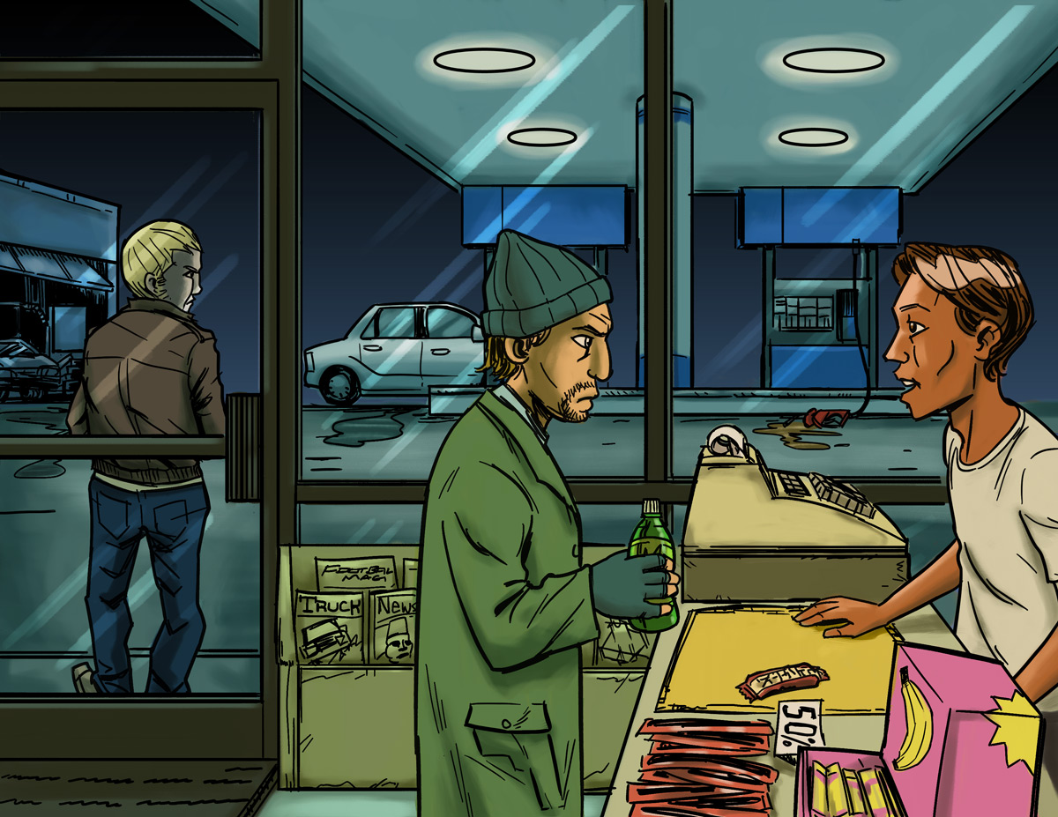
Find The Hazards: Gas Station
a
Illustrated Workplaces

Slide 23
Finding Hazards: Key Points
Every job has health and safety hazards
You should always be aware of these hazards
Find out about chemicals at work by checking labels, readings MSDSs, and getting training.

Slide 24
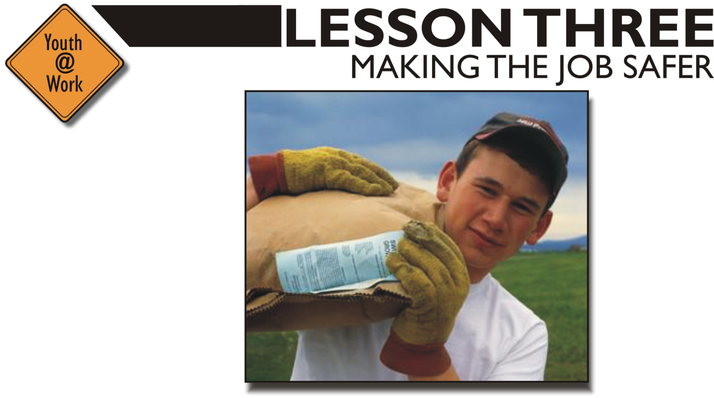
Mini-lecture/Q&A
Safety Pyramid Game
Health and Safety Info Search
Learning Objectives
Describe the three main ways to reduce or eliminate hazards at work.
Explain which methods are most effective in controlling hazards.
Identify and describe at least three different sources of information on specific hazards, their health effects, and methods for controlling them.
Demonstrate the ability to find information to help address a specific hazard.

Slide 25
Controlling Hazards
a
Remove
the Hazard
$2000
(for example, use safer
chemicals, use a machine guard)
Improve Work
Policies & Procedures
$1000
(for example, conduct training,
assign enough people to do the job)
Wear Personal Protective Equipment (PPE)
$500
(for example, wear gloves, use a respirator)

Slide 26
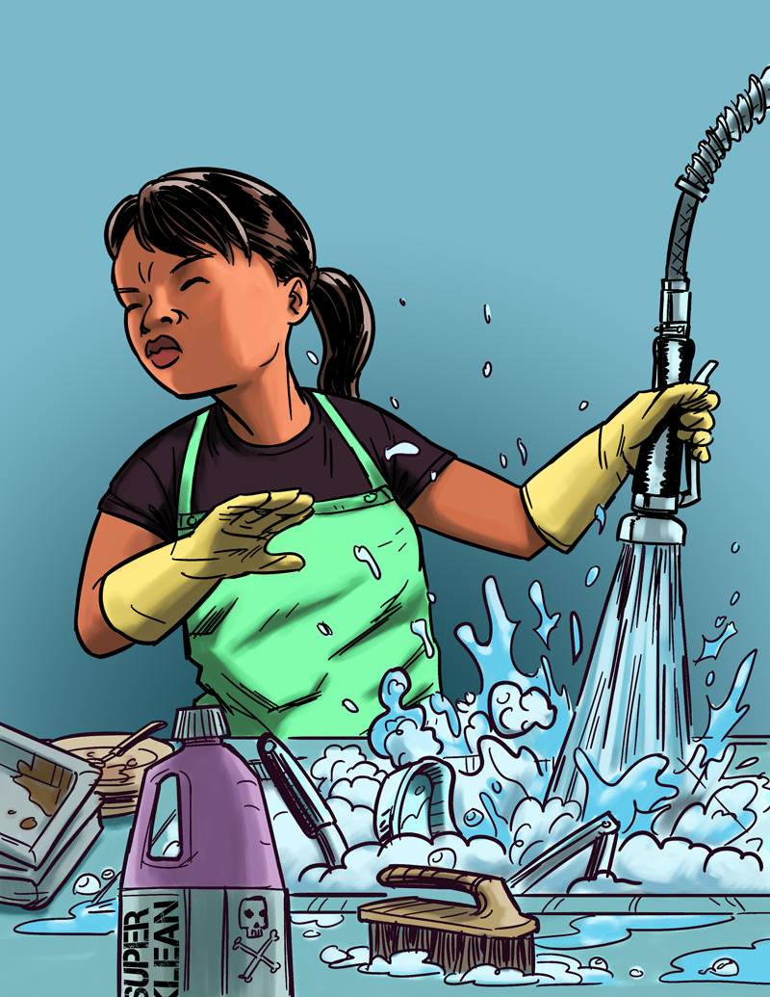
Eliminating or Reducing Hazards
Jasmin’s Story
Job: Hospital dishwasher
Hazard: Chemical dishwashing solution
Injury: Chemical burn to the eye
$25,000 Safety Pyramid Game

Slide 27
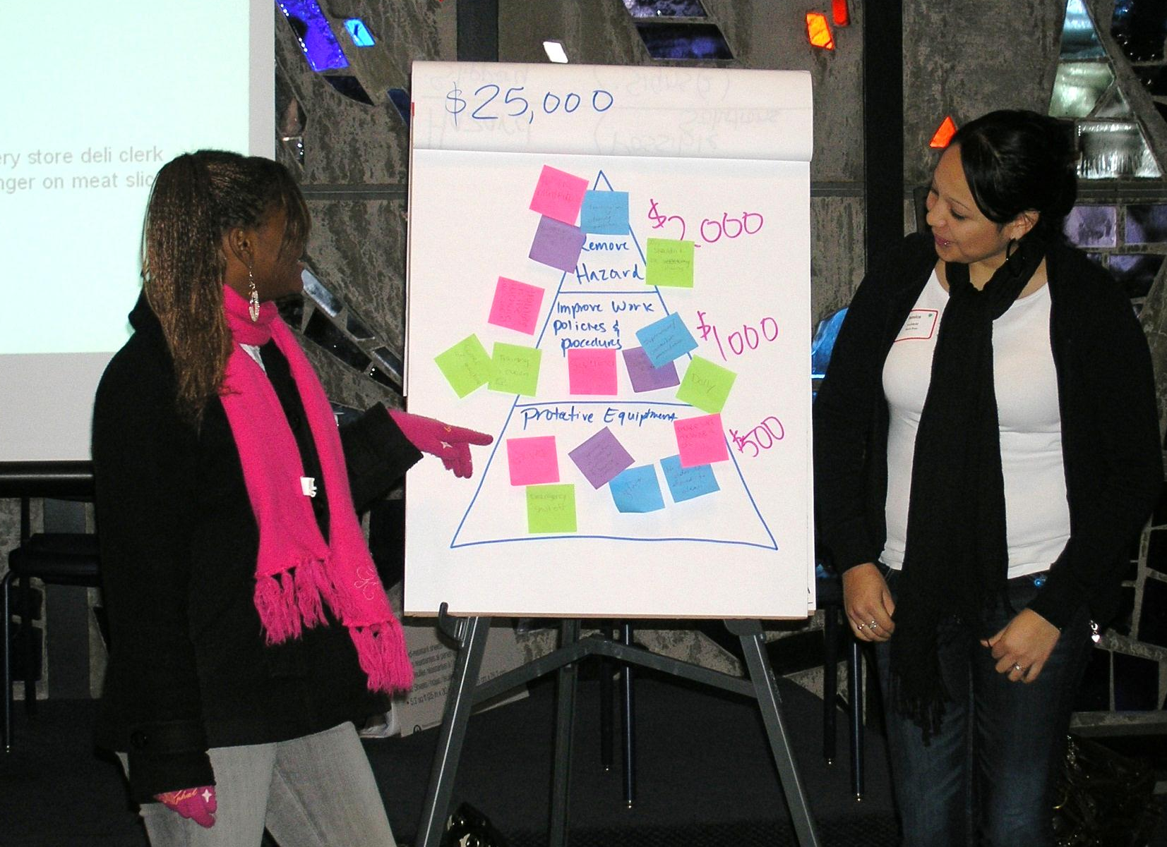
Playing the $25,000
Safety Pyramid Game

Slide 28
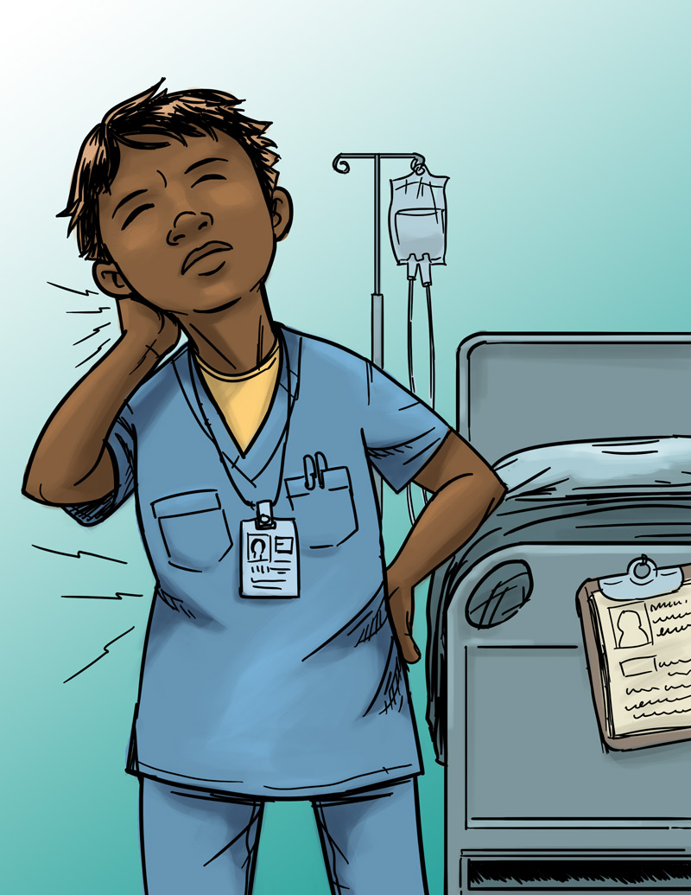
Eliminating or Reducing Hazards
Jada’s Story
Job: Nursing aide
Hazard: Heavy lifting
Injury: Back, neck, and shoulder pain
$25,000 Safety Pyramid Game

Slide 29
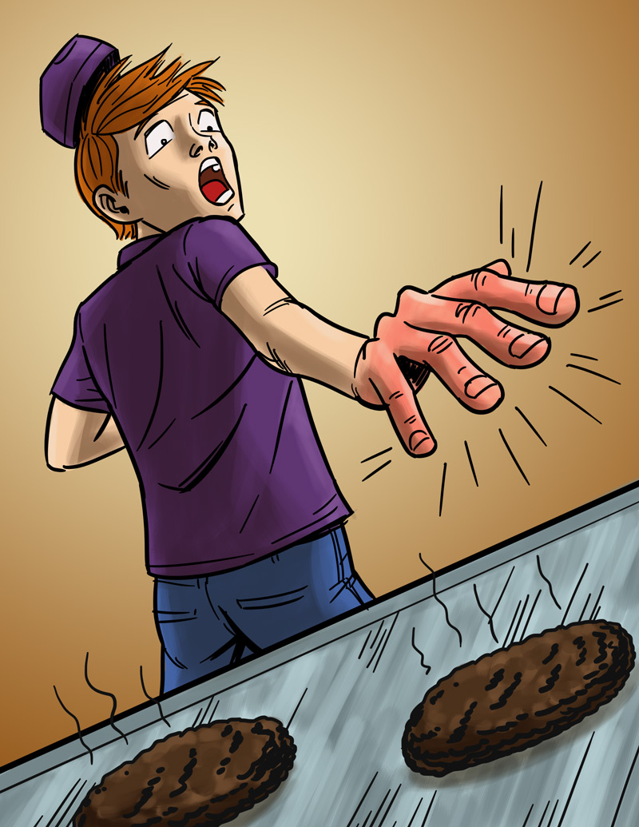
Eliminating or Reducing Hazards
Will’s Story
Job: Fast food worker
Hazard: Hot grill
Injury: Burned hand
$25,000 Safety Pyramid Game

Slide 30
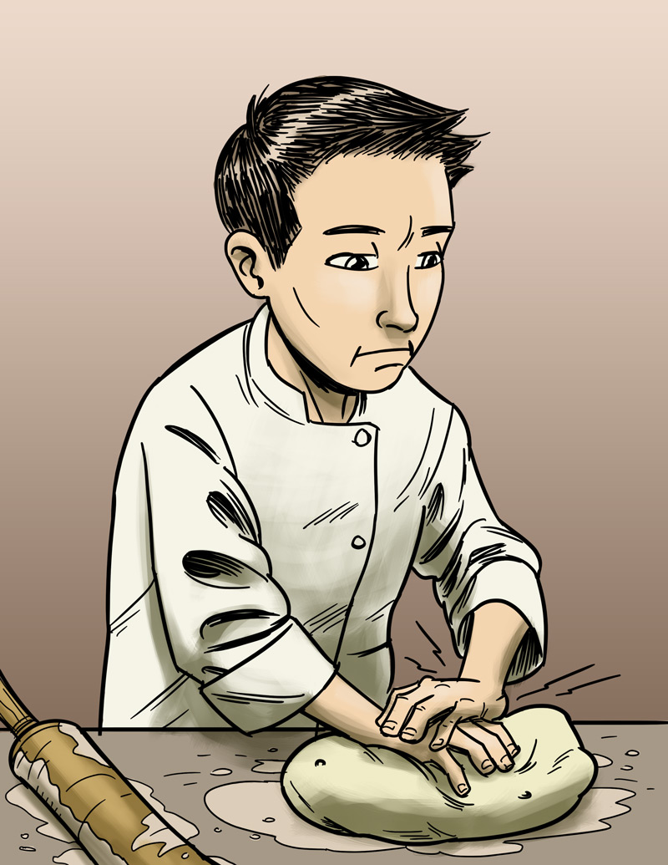
Eliminating or Reducing Hazards
James’s Story
Job: Pizza shop employee
Hazard: Repetitive motion
Injury: Hand, back injury
$25,000 Safety Pyramid Game

Slide 31
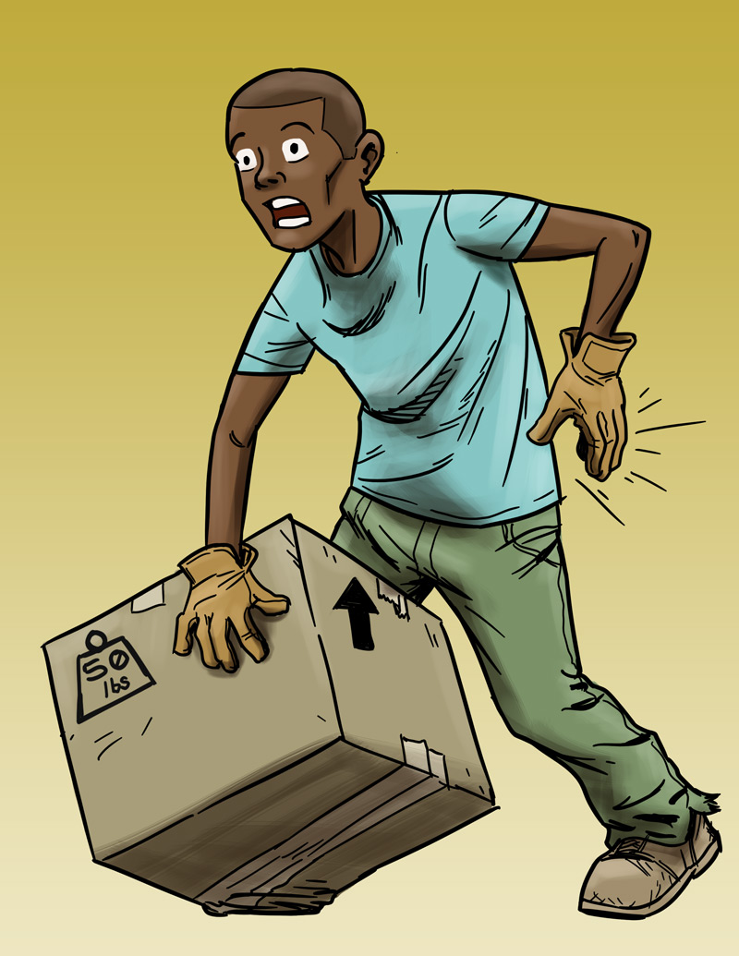
Eliminating or Reducing Hazards
Andre’s Story
Job: Grocery store clerk
Hazard: Lifting heavy boxes
Injury: Back strain
$25,000 Safety Pyramid Game

Slide 32
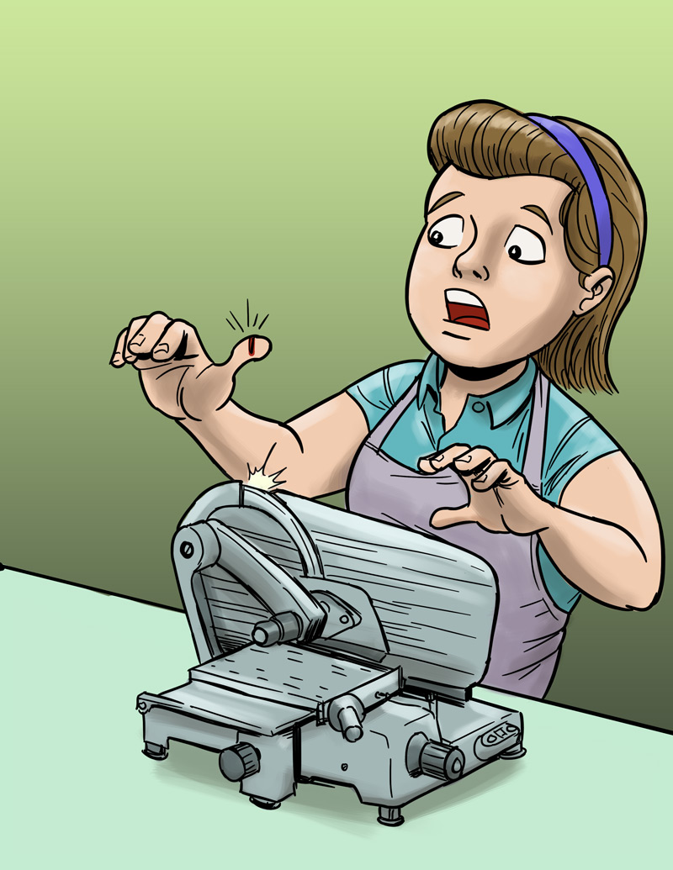
Eliminating or Reducing Hazards
Molly’s Story
Job: Grocery store deli clerk
Hazard: Meat slicer
Injury: Cut finger
$25,000 Safety Pyramid Game

Slide 33
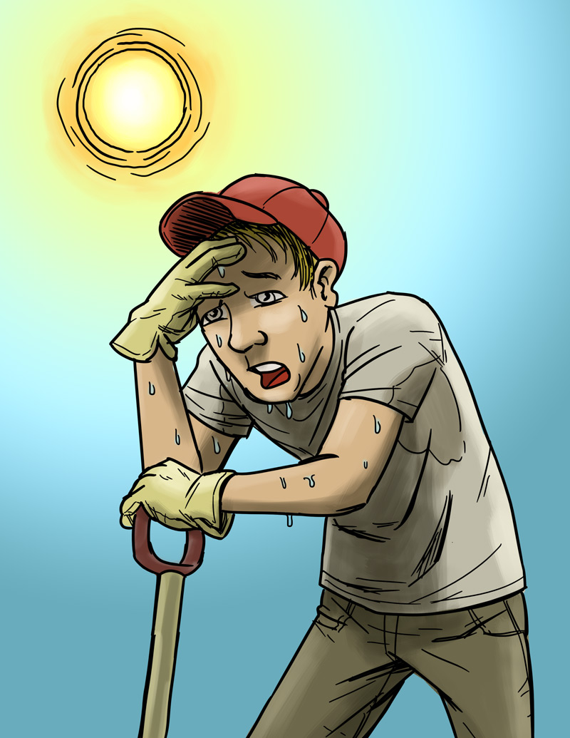
Eliminating or Reducing Hazards
Chris’s Story
Job: City public works employee
Hazard: Excessive heat
Injury: Heat stroke
$25,000 Safety Pyramid Game

Slide 34
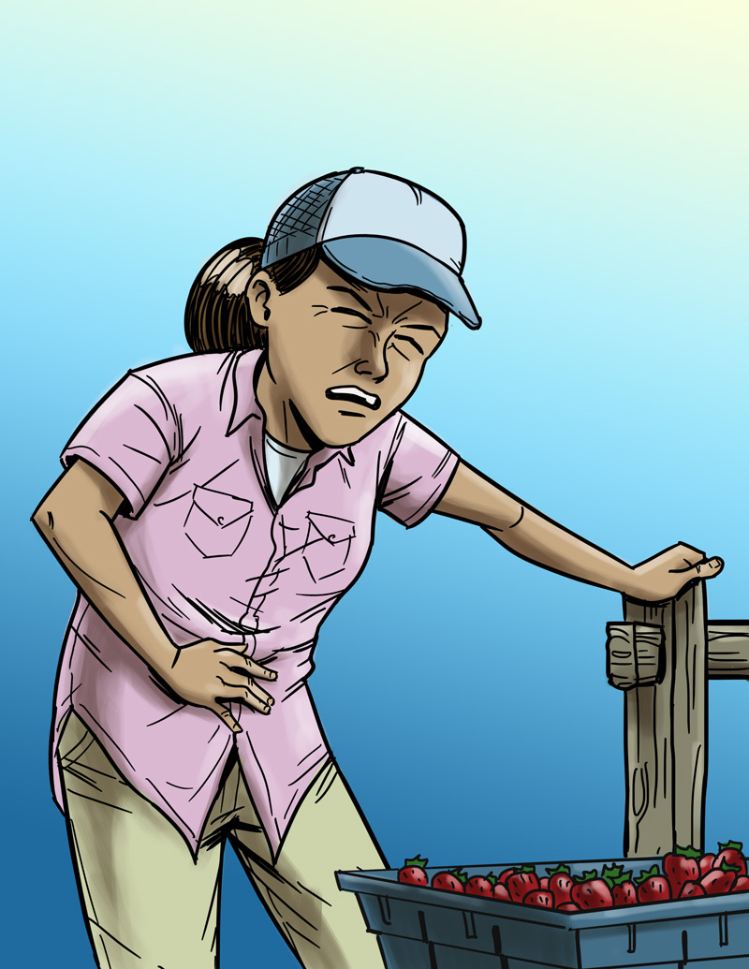
Eliminating or Reducing Hazards
Maria’s Story
Job: Farm worker
Hazard: Pesticide/chemical exposure
Injury: Illness due to poisoning
$25,000 Safety Pyramid Game

Slide 35
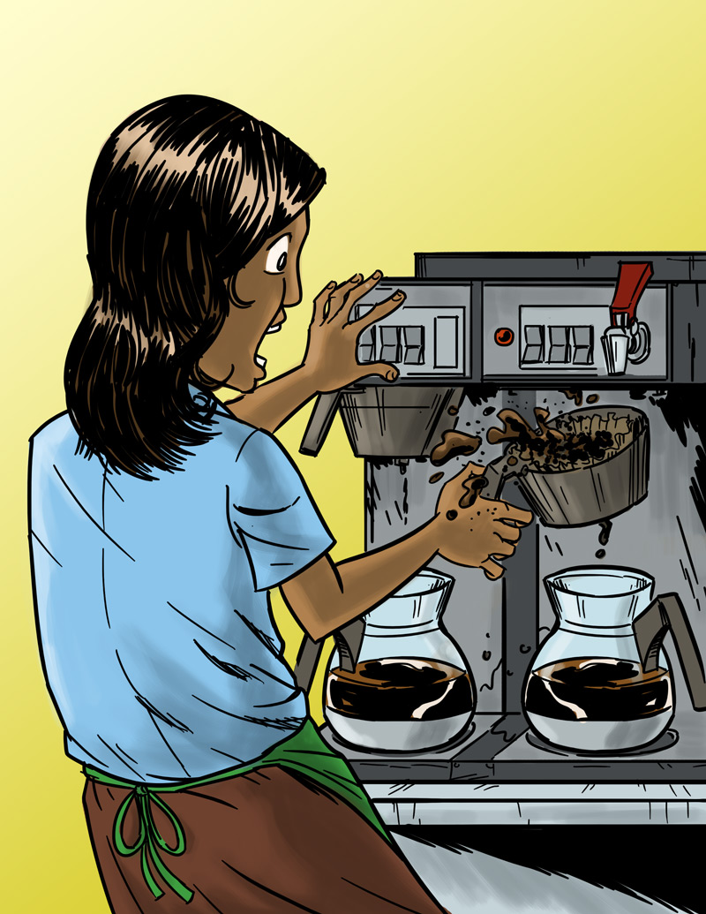
Eliminating or Reducing Hazards
Anita’s Story
Job: Barista
Hazard: Hot liquids
Injury: Burn
$25,000 Safety Pyramid Game

Slide 36
Making the Job Safer: Key Points
OSHA requires employers to provide a safe workplace.
It’s best to get rid of a hazard completely, if possible.
If your employer can’t get rid of the hazard, there are usually many ways to protect you from it.

Slide 37

Disaster Blaster game
Small group case studies from the news
Learning Objectives
List at least eight types of emergencies that can occur in a workplace.
Explain what to do in at least three kinds of emergencies.
Identify important information employers should provide about how to respond to workplace emergencies.

Slide 38
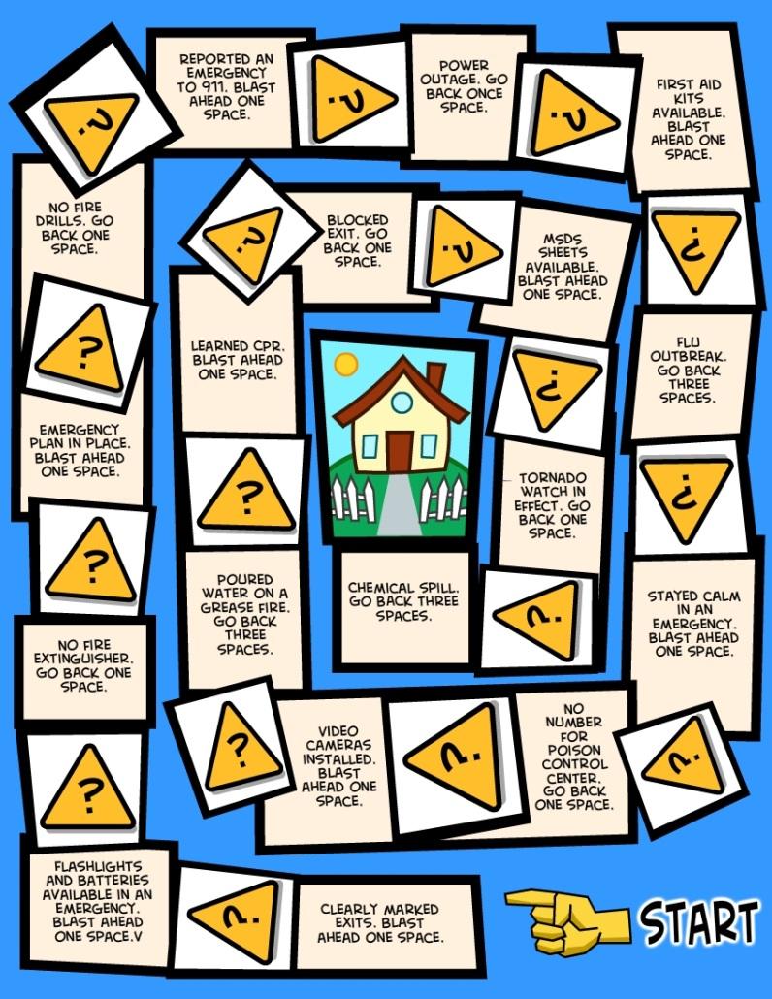

Emergencies at Work
Disaster Blaster Game

Slide 39
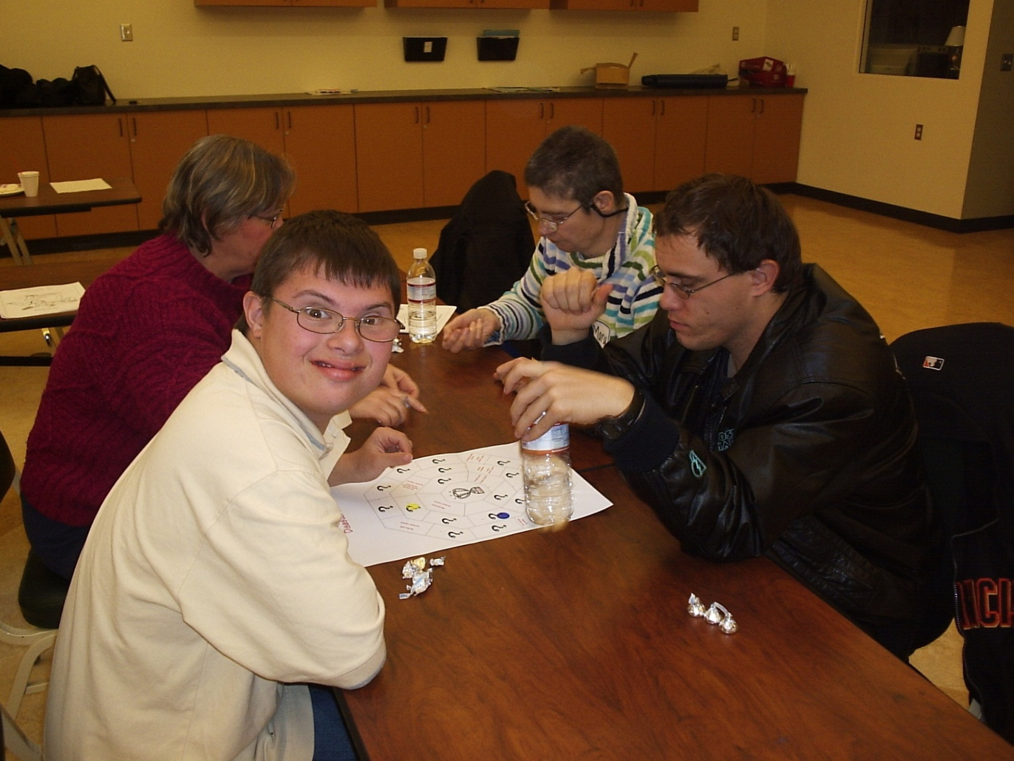
Playing the Disaster Blaster Game

Slide 40
Emergencies at Work: Key Points
Every workplace should have an emergency action plan
The plan should cover:
  What to do in different emergencies
  Where shelters and meeting places are
  Evacuation routes
  Emergency equipment and alert systems
  Who’s in charge
  Procedures to follow when someone is injured
The workplace should have practice drills
Workers should be trained on everything in the plan.

Slide 41

Jeopardy Game
Bingo Game
Learning Objectives
Describe the legal limitations on tasks that teens may do on the job, and on the hours they may work.
Identify two health and safety rights that teens have on the job.
Identify the government agencies that enforce labor and job safety laws.

Slide 42
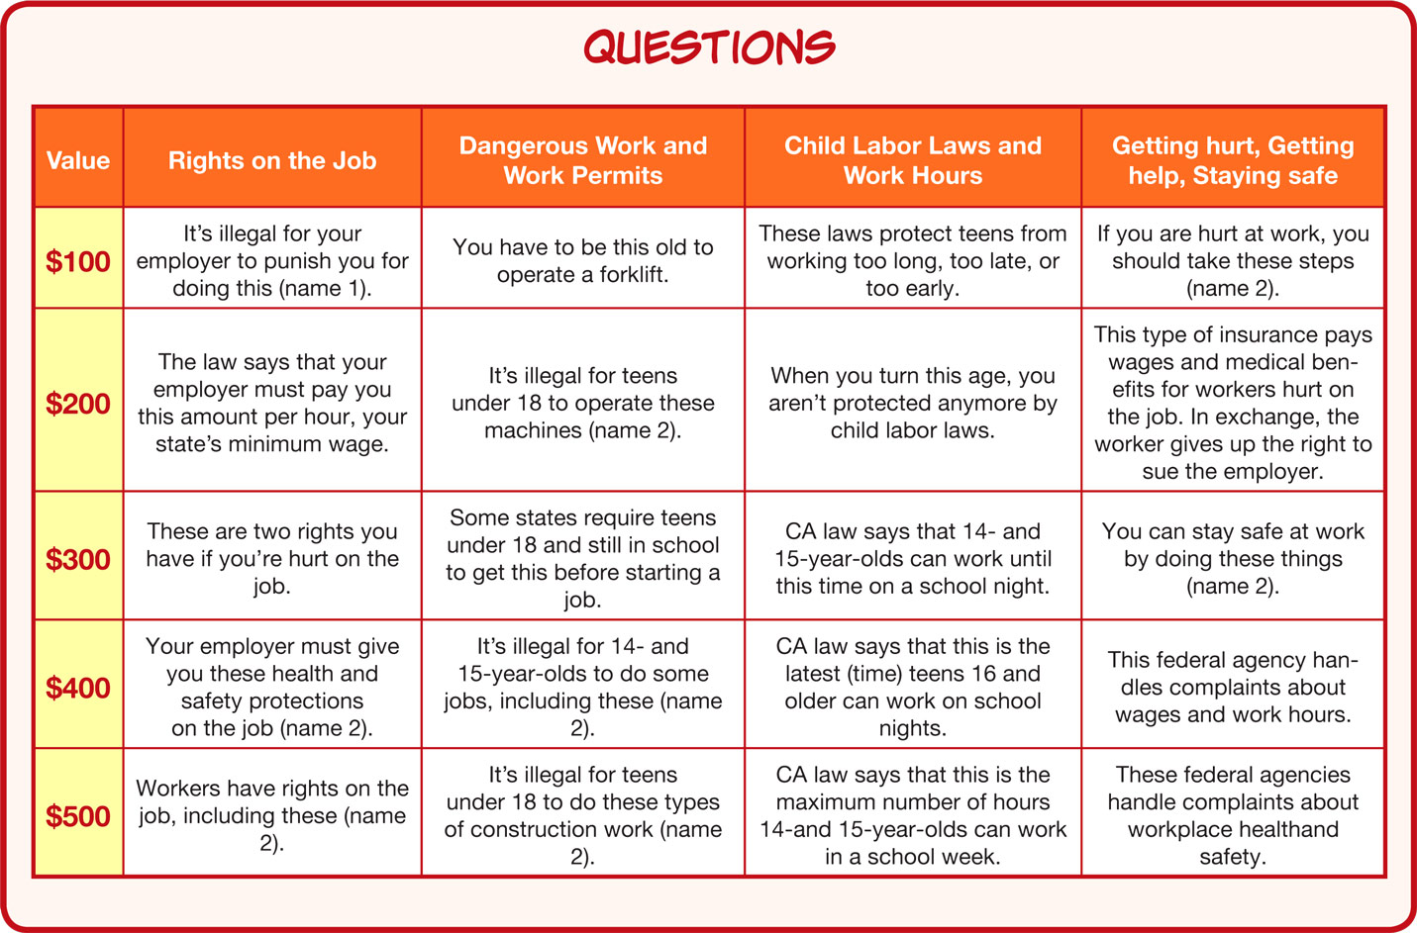
Know Your Rights: Quiz Game

Slide 43
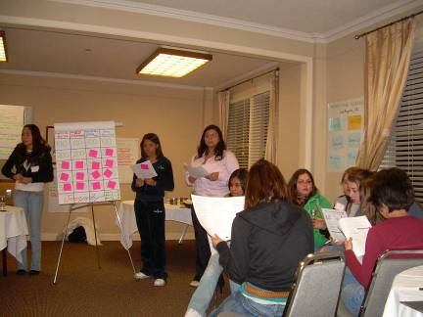
Playing the Quiz Game

Slide 44
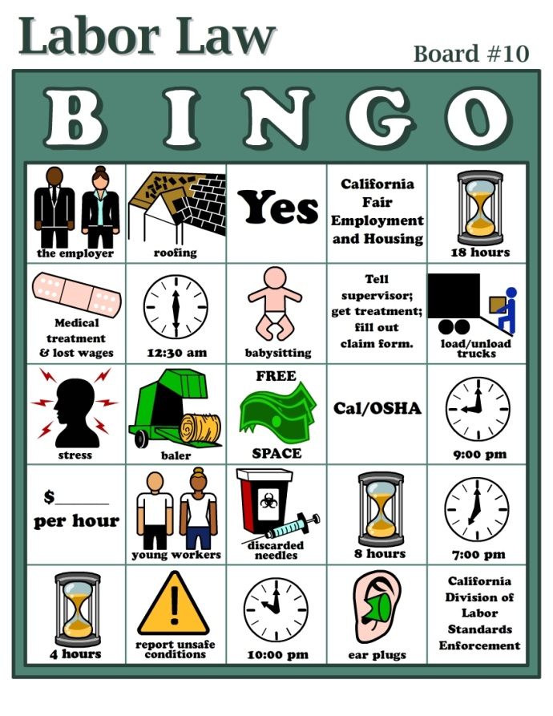
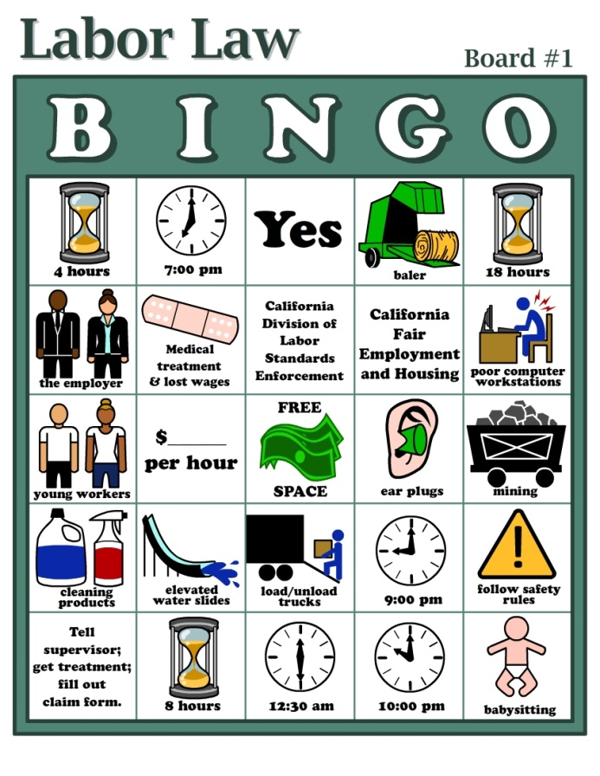
Know Your Rights
State Labor Law Bingo Game

Slide 45
Know Your Rights: Key Points
Federal and state labor laws:
  Set minimum age for some tasks
  Protect teens from working too long, too late or too early
OSHA says every employer must provide:
  A safe workplace
  Safety training on certain hazards
  Safety equipment
By law, your employer is not allowed to fire or punish you for reporting a safety problem.

Slide 46

Learning Objectives
Apply safety and child labor laws to “real life” situations.
List three ways to get information and help on health and safety problems.
Discuss several appropriate ways to approach supervisors about problems.

Slide 47
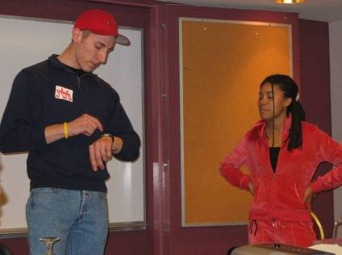
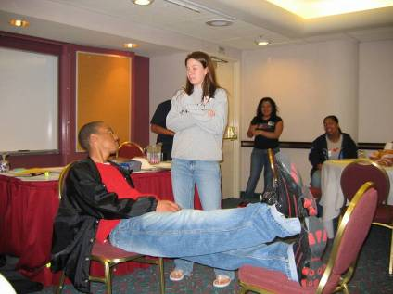
Role Play: How to Speak Up

Slide 48
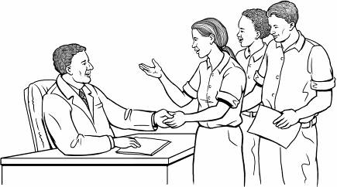
Handling Workplace Safety Problems
Steps in Problem Solving
Define the problem
Get advice
Choose your goals
Know your rights
Decide the best way to talk to the supervisor
If necessary, contact an outside agency
for help.

Slide 49

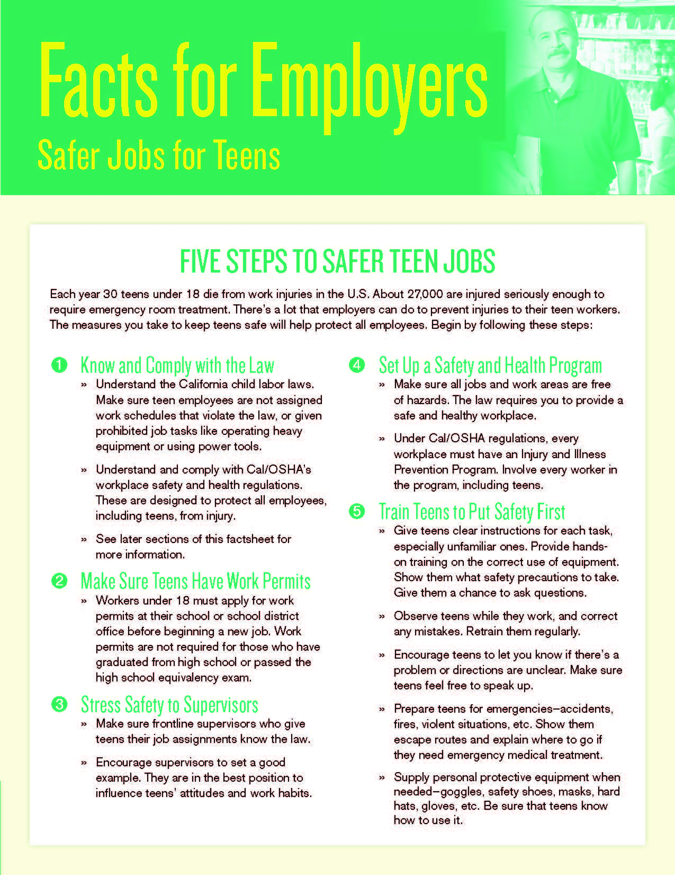
Building Partnerships to Protect Youth
Outreach to Employers
Provide information to employers about labor laws
Discuss on-site health and safety training for youth
Report and follow-up on unsafe conditions.
Notes:
Also
industry specific fact sheets for young workers
Auto Repair
Construction
Field Work
Hotel Cleaning
Restaurants
Retail
3 industry- specific resource packets (restaurants, janitorial, dairy farmers)

Slide 50

One-stop health and safety info for Employers

Slide 51

If you hire employees under age 18…..

Slide 52



Safe Jobs for Youth Month
Poster contest/distribution
Video PSA played in movie theaters (DLSE)
Teaching packets
Press conference with Labor Commissioner, Dept. of Ed, DOL, LOSH, LOHP, and YWLA youth
YWLA community activities

Slide 53
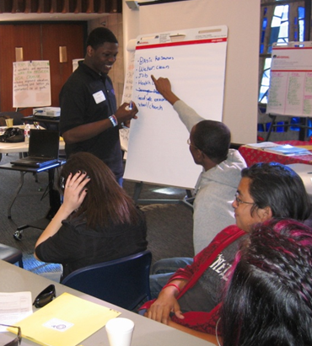
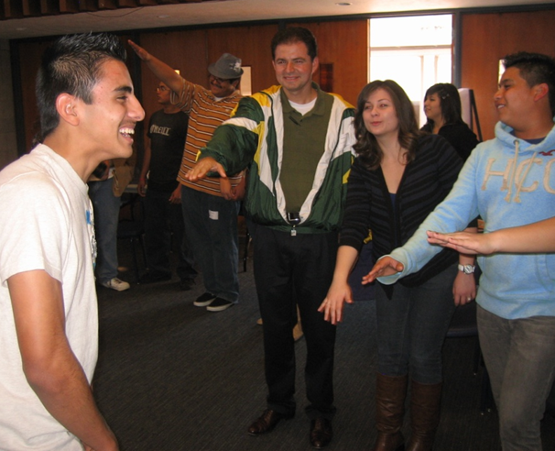
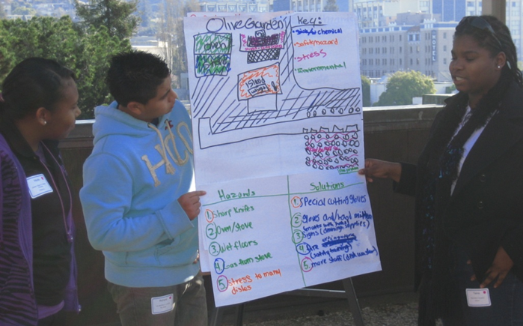
Young Worker Leadership Academy
2.5 days
Health and safety training
Learning about public policy
Practice planning and conducting educational activities
Youth mentors return from previous years

Slide 54
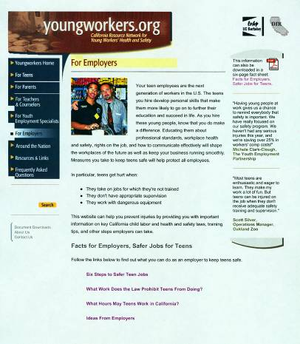
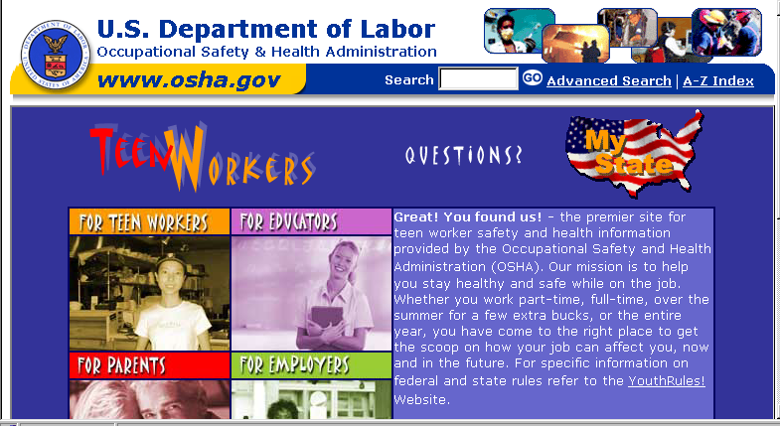
Resources for More Information
Websites
Young Worker Safety Resource Center www.youngworkers.org
U.S. OSHA
www.osha.gov/SLTC/teenworkers
U.S. Department of Labor/Wage & Hour
www.youthrules.dol.gov

Slide 55
Resources for More Information
National Institute for Occupational Safety and Health
www.cdc.gov/niosh
1-800-232-4636
National Young Worker Resource Center
Labor Occupational Health Program
University of California Berkeley
2223 Fulton Street, 4th floor, Berkeley, CA 94720-5120
tel: 510-642-5507; fax: 510-643-5698
  dbush@berkeley.edu
  www.youngworkers.org
Youth
@
Work

