Slide 1

Putting Professional Development to Work for the Team
Mary Zwieg
Academy Coordinator
Chemistry Teacher
Ruth Kwake
HEAL Counselor
HOSA Advisor
Notes:
Introductions
HEAL just completed 6th year as academy.
Serves grades 9-12, have about 280 students
Students in pure classes for English, science & math
Thriving HOSA Chapter
Strong connections through Regional Partnership of industry & education

Slide 2

Academies teach students to believe in their dreams.....as a result, they take their education seriously

Slide 3

About Us
Community and Public Health Academy
4 year program
275 students in the academy
CPA academy
HSMT academy
At least 50% of students are “at risk”
Pure classes including some honors level courses

Slide 4

WHY DID WE NEED PD DAYS?
New team members
Increase rigor and relevance
Move towards Common Core
Big Goals for New Integrated Projects
Improve Academics with New Curriculum
Balance staff time and cost
There is NEVER enough time
Notes:
Have had some transitions to work through, so wanted to be sure we were focused and progressing.
Our prep time meetings, every 2 weeks are used to address student concerns, manage activities and coordinate academy wide issues. Grade level teams meet in between on their own projects/lessons.

Slide 5
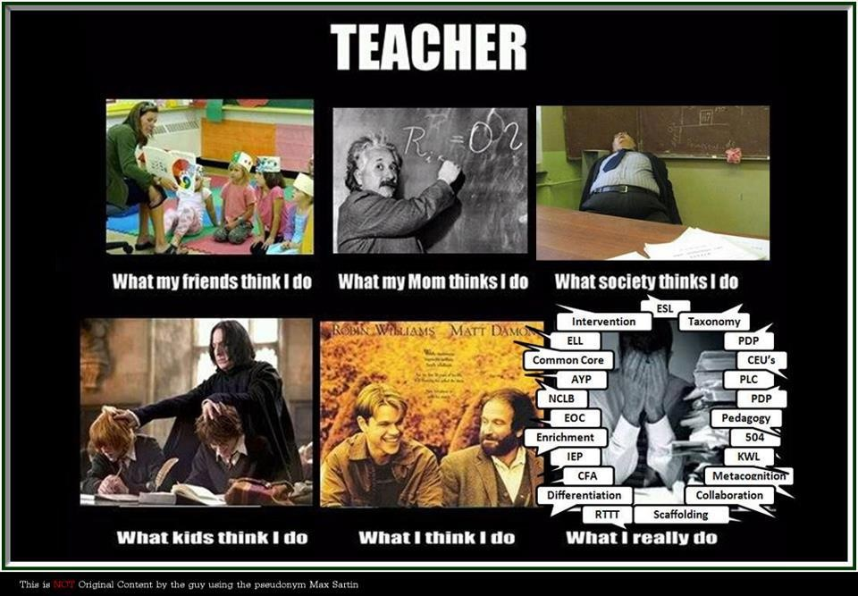
Notes:
Strong team of committed teachers and guidance counselor with a focus on student success.

Slide 7


Logistics
Two days of curriculum development were school days and teachers used subs to cover their classes
  To get away from the day to day interruptions of school, we used off-campus facilities provided by PSTA
In order to minimize days out of the classroom, we decided to meet on one Saturday
  Teachers were paid stipends
  On campus so we had access to our site resources
Notes:
Focused time with specific goals.
Saturdays on campus are quiet, use of library & proximity to our classrooms was helpful.
But we needed school days away from campus and our local teacher association headquarters was convenient and comfortable working space.

Slide 8
Professional Development Day #1
Build a Bond as team with new members
Review the Strategic Plan, the budget, and integration of CTE with Academics.
Subject area groups chose CTE Foundation Standards for those subjects
Time in subject area groups helped teachers connect subject standards with CTE standards
Time in grade level groups created focus for the integrated projects for the year.
Notes:
We wanted everyone on team to understand the criteria/guidelines and strategies developed under HSEI & CPA grants…what drives us.
New team members meant they needed to learn to work together, especially those who weren’t familiar with CTE standards.
Also felt our students needed to be more familiar with CTE standards & how they drive instruction.
Began grade level brainstorming

Slide 9
CTE STANDARDS
Anchor Standard 4.0-Technology
Use existing and emerging technology to investigate, research, and produce products and services, including new information, as required in the Health Science and Medical Technology sector workplace environment.
Anchor Standard 3.0 – Career Planning and Management: Integrate multiple sources of career information from diverse formats to make informed career decisions, solve problems, and manage personal career plans.
Anchor Standard 9.0 – Leadership and Teamwork
Work with peers to promote divergent and creative perspectives, effective leadership, group dynamics, team and individual decision making, benefits of workforce diversity and conflict resolution as practiced in the Cal-HOSA career technical student organization.
Anchor Standard 11.0 – Demonstration and Application.
Demonstrate and apply the knowledge and skills contained in the Health Science and Medical Technology anchor standards, pathway standards, and performance indicators in classroom, laboratory, and workplace settings, and through the Cal-HOSA career technical student organization.
Notes:
Samples of what we use to post in classrooms alongside the academic standards which are posted per our district/site requirements

Slide 10

Professional Development Day #2
9th grade team refined Career Project & discussed options for new project which would involved all 3 Academic areas + HEAL.
10th grade team reviewed timeline & developed a curriculum for the food handler’s certificate & discussed new epidemiology project. Added components to include math.
11 grade team brainstormed for new project to involve English, Anatomy & HEAL
12th grade refined Health Issue Research Project to improve collaborative components & create better alignment with ERWC standards.
Notes:
Putting the pieces together
Summarize projects created.
Handouts & electronic copies available.

Slide 11
Professional Development
Day #3
Math teachers revised Integrated Math Course
11th grade group developed Organ Transplant project, set rubrics & timeline for project
9th grade began outlining pilot for Autism Project
10th grade put together outline for Epidemiology Project around “Masque of the Red Death” including lessons in Geometry and Algebra II.
12th grade team refined rubric for grading research papers and oral presentations.
Notes:
In depth work, with written project details

Slide 12


Puzzle Pieces
What are the pieces of your ideal professional development plan
Each piece can represent one part of the puzzle (logistics, goals, financing, etc.)
All the pieces need to fit together

Slide 13
The lessons
9th Grade
  Career Exploration
  Autism
10th Grade
  Salton Sea
  Investigation: Infectious Disease
11th Grade
  Organ Transplants and Medical Ethics
12th Grade
  Addiction Project
  Health Research Project
Notes:
We have samples, both paper & electronic to share with you.
Happy to share via email or other communication.

Slide 14
9th Grade Career Exploration
Students Research a career in health or environmental health career field
Professional Interview day
  15- 20 industry partners come to school
  Students interview the partners about their careers in a round table
Students prepare an oral presentation using HOSA guidelines for Career Health Display
Integration between English and HEAL elective class
Students participate in a Pharmacist for the Day curriculum (COSI)

Slide 15
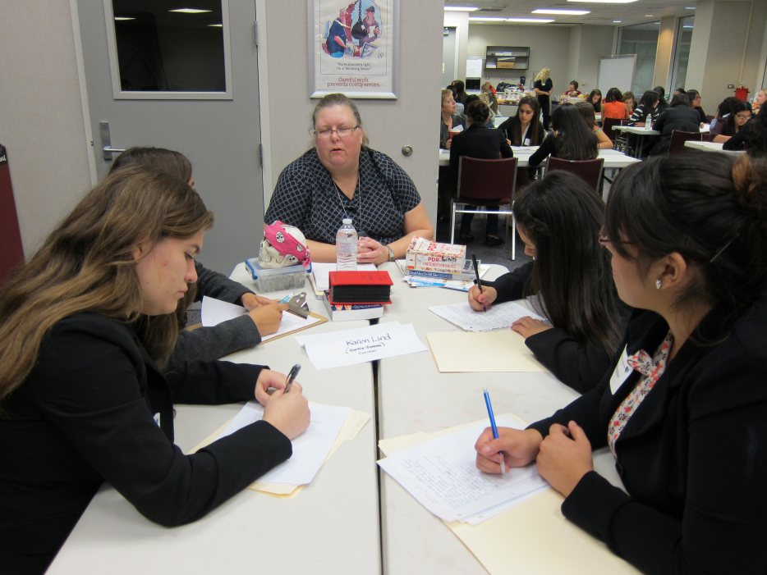
68 Students; 21 Professionals (Pictured here: County Coroner with Freshman HEAL students)

Slide 16

Freshman Autism Project
Read The Curious Incident of the Dog in the Nighttime
Biology learns about genetic disorders
HEAL elective covers how developmental disorders affect children and families
Community service with local chapter

Slide 17
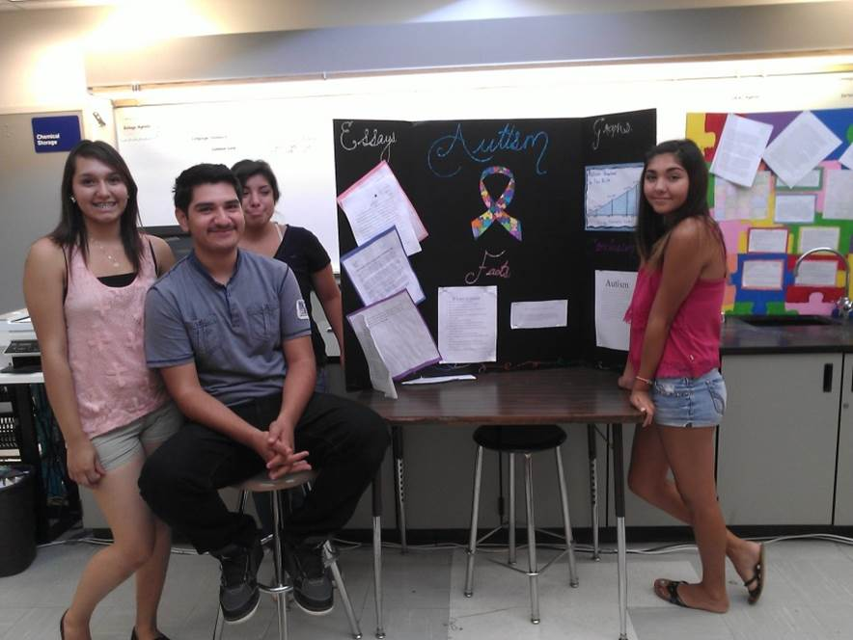
Freshman Final product - Autism project
Notes:
New freshman project
There is video of junior project, but have to bring that later. We can make it available if anyone wants to see it.

Slide 18
Sophomore Salton Sea Project
Students study the environmental health impacts of the Salton Sea in their HEAL elective
Chemistry students learn to do water tests
Students visit the Salton Sea
English class supports writing and oral presentations for the forum
The project culminates with the Salton Sea forum to education and industry partners

Slide 19
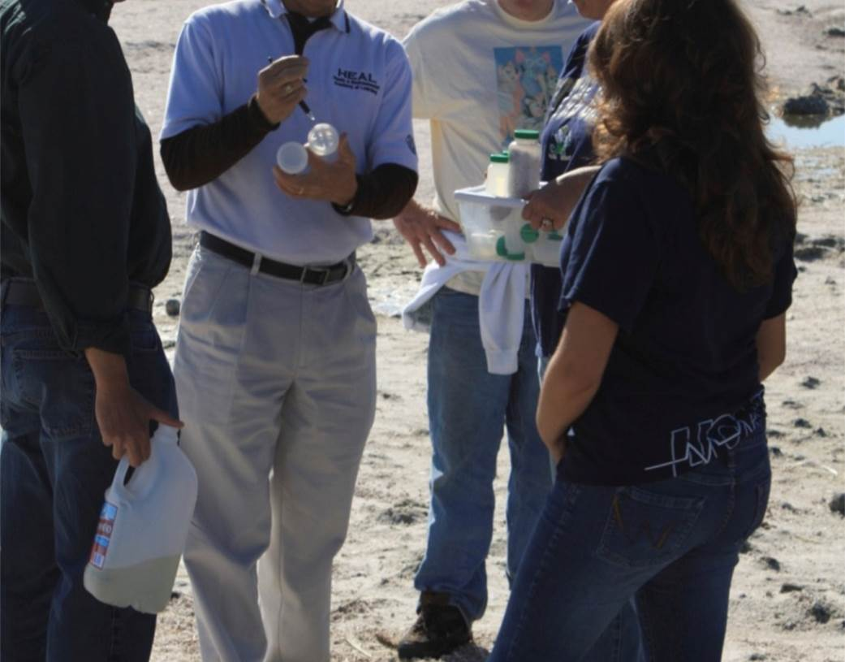

Slide 20
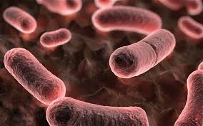
Sophomore Investigation
Infectious Diseases
English reads Masque of the Red Death
HEAL elective class covers disease transmission, including vector born diseases
Math teaches exponential growth and decay to illustrate the epidemiology of disease

Slide 21
Junior Kidney Transplant and Medical Ethics
Junior HEAL students take a field trip to the BODIES exhibit
Anatomy students dissect a cat and study the anatomy and physiology of the renal system
English students prepare oral arguments and create a mock organ procurement committee session
HEAL elective class studies medical terminology, watches a live kidney transplant and reviews statistical data on organ transplant success rates

Slide 22
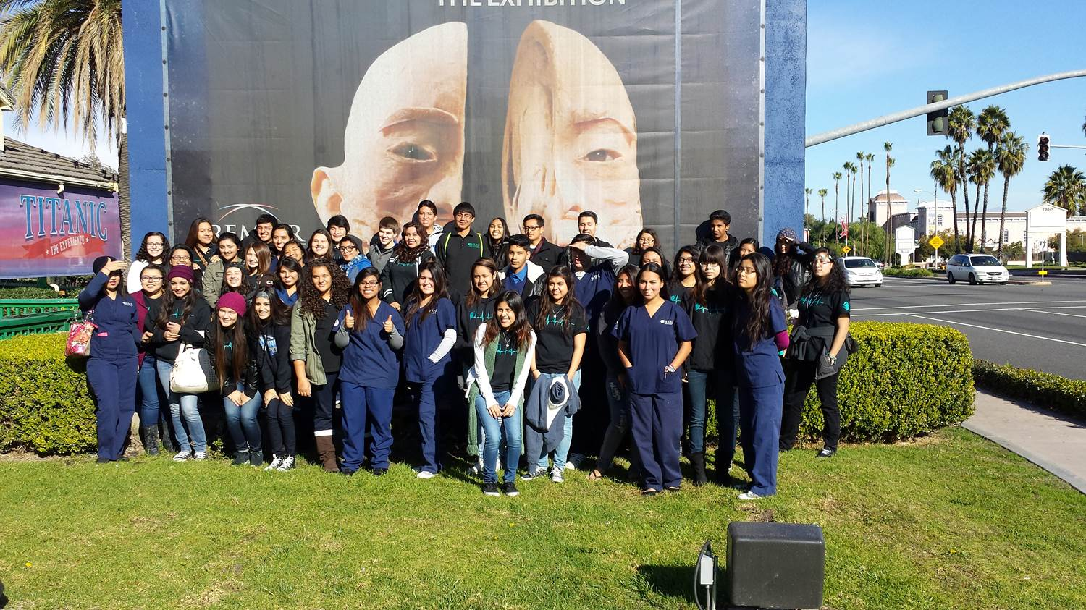

Slide 23
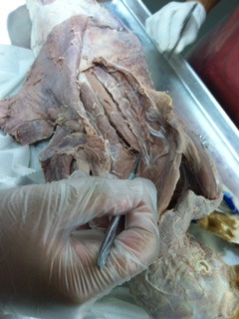

Slide 24
Senior
Addiction Project
English read The Glass Castle
Mind Maps
HEAL elective researched different addictive behavior disorder and presented to the class
Guest speakers from a local recovery center

Slide 25
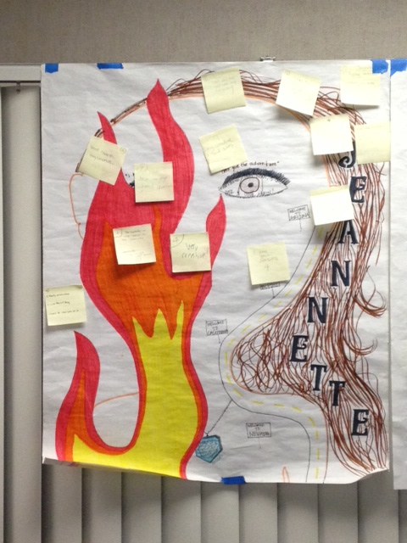
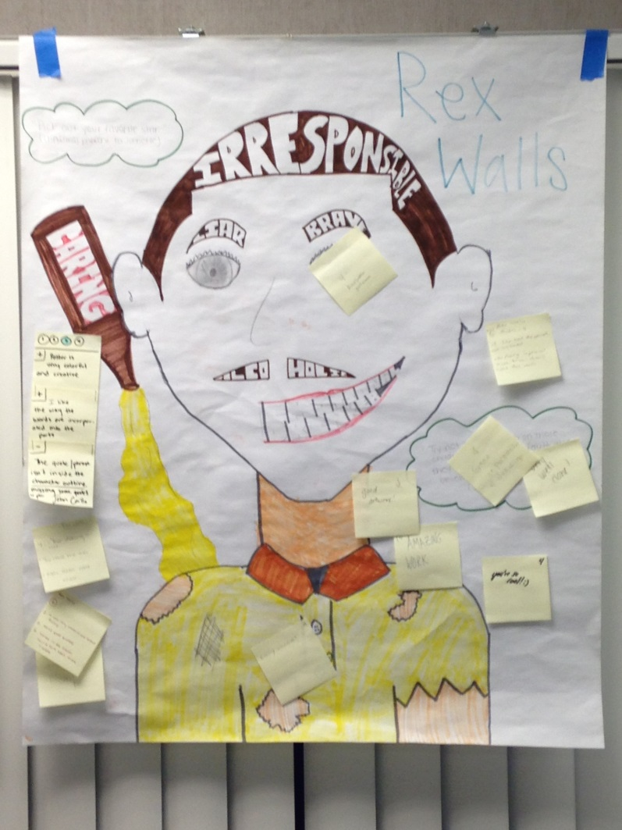
Mind Maps

Slide 26
Health Research Project
HEAL elective has students select a health issue that directly impacts our community
Students research the issue, including interviewing a local industry professional
Students write a research paper based on CSU Expository Reading and Writing standards (English IV)
Students give an oral presentation with technology to their peers.

Slide 27
New Curriculum
Integrated Math for Health Careers
Intro to Health and Environmental Science (update of 9th grade elective course)
Allied and Environmental Health Science Concepts and Careers (update of 10th grade elective course)
Serve Safe food handlers curriculum for certification (10th grade elective course)
Created an Honors by demonstration curriculum for Anatomy
Notes:
We have been using a district & A-G approved course called Integrated Math II for 11th & 12th graders, to support students that are not ready for algebra II or who have taken it as juniors and struggled with concepts. We decided to incorporate concepts from a COD class called Intro to Med Dosage Calculations which was being offered as a concurrent class on our campus. We have also incorporated test prep & practice for the COD assessment test & the CSU ELM assessment test. Working with our colleagues from PSHS health academy, we decided to develop an Integrated Math for Health Careers which incorporates all those components & we’ll be working with COD to create a dual enrollment agreement so our students will get COD credit.
9th grade course needed update: semester long health class for district was cancelled, so semester HEAL 9 could be upgraded to full year; incorporate components of health class, include new elements from HOSA and from our district participation in the Clinton Health Initiative and work with Health Corps.
10th grade course retains focus on environmental health issues, including research on local issues around Salton Sea, plus inclusion of broad range of allied health careers guest speakers & HOSA leadership activities.

Slide 28
Other accomplishments
New Website
Google Docs training for staff
Remind101 training

Slide 29
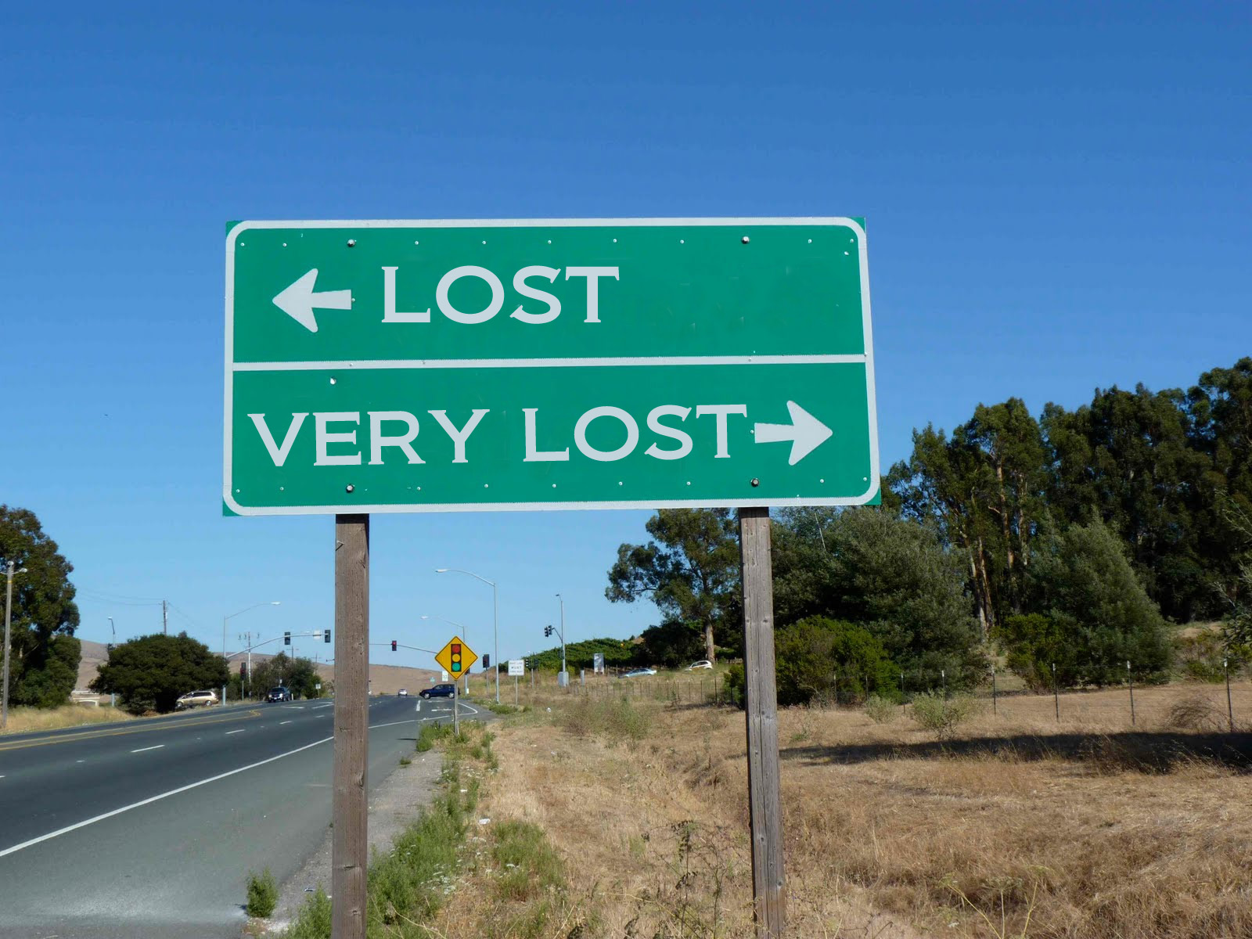
Where do we go from here?

Slide 30
Putting Professional Development to Work for the Team
We were so successful with four days of Professional Development last year that we decided to cut back to 3 days per year in the future.
We hope to incorporate teacher externships and will work on this for the future
Bring middle school staff in to work on integrated lessons and activities
Notes:
There are always new ideas, new input from our industry & education partners, and ways to improve as we learn more about how things work and manage the changes coming with Common Core.

