Slide 1
Mentor Program
Parent Orientation 2013

Slide 2
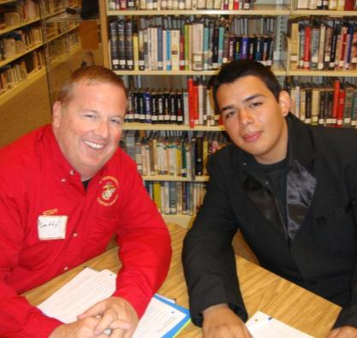
I. Overview & Objectives
One-year program
Mentor volunteers from business industry and community
Professional role model
Learn about “real world”
Everyone who is successful can point to at least one mentor

Slide 3
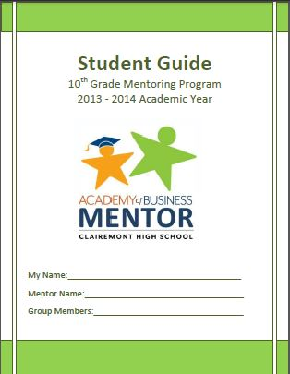
Mentor Meeting Days – Students Bring:
Guide Booklet comes to every meeting!
Dressed to Impress!!

Slide 4
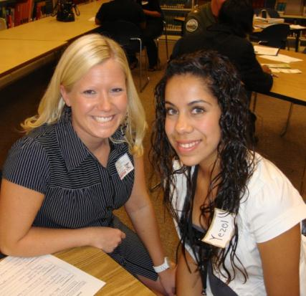
The Mentors
Who are the mentors?
Where did they come from?
Criteria to mentor?
What does a mentor do?
How are they matched to students?

Slide 5
Comparing Mentor Programs
10TH GRADE
11TH GRADE
Group mentoring, 3:1
Focus on skills for success, good habits, academics
Group dynamic at meetings
Some meetings longer
Educational fieldtrip
Jump to Meetings For 10th Grade
One-on-one mentoring
Focus on goals, future, career-exploration & training
Personal dynamic at meetings
Job Shadow Fieldtrip
Community Service Project
Jump to Meetings For 11th Grade

Slide 6
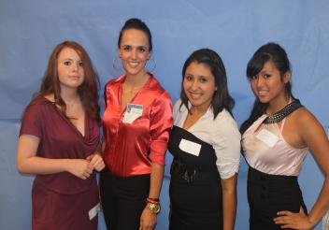
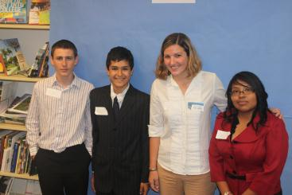
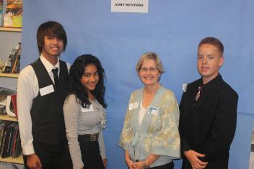
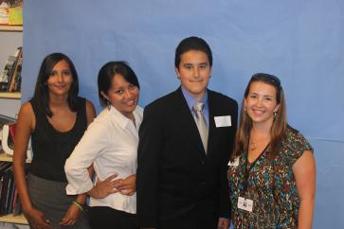
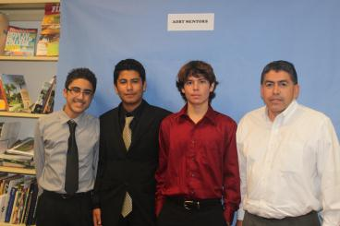
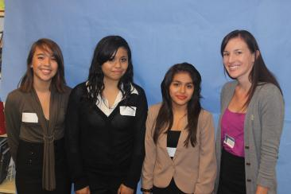
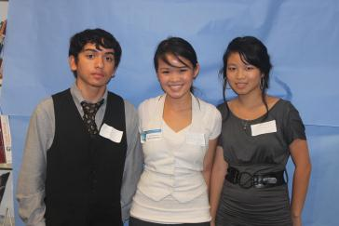
AOB 10th Grade Mentor Program
*Group Mentoring, 3:1
*Focus on Motivation

Slide 7
Scheduled Meetings – 10th Grade Program
MONTH | MEETING TOPIC | SCHEDULED DATE /TIME | LOCATION
Sept. | Mentor-Student Group Meeting 1: Introductions & Ice Breakers | Thur, Sept. 26, 2013 1:00 – 2:15 pm | Clairemont High Library
Oct. | Mentor-Student Group Meeting 2: Team Building, Goal Setting & Individual Check-Ins* | Thur, Oct. 24, 2013 1:00 – 3:00pm* | Clairemont High Library
Nov. | Mentor-Student Group Meeting 3: Mentor Team "Business" Olympics | Thur., Nov. 21, 2013 1:00 – 2:15 pm | Location chosen by mentor & students
Dec. | Mentor-Student Group Meeting 4: A Good Habit: Time Management | Thurs, Dec. 29, 2013 1:00 – 2:15 pm | Clairemont High Library
Jan. | Mentor-Student Group Meeting 5: Personal Business Plan & Academic Reflection | Thur, Jan. 14, 2013 1:00 – 2:15 pm | Clairemont High Library
Feb. | Mentor-Student Group Meeting 6: Group Mock Job Interviews & Check-Ins* | Thur., Feb. 20, 2014 1:00 – 3:00 pm* | Clairemont High Library
Mar. | Mentor-Student Group Meeting 7: Educational Group Fieldtrip Day | Choose day in March (not: 13th, 14th, 18th, 19th) Exact timeTBD by mentor | Clairemont High Gymnasium
Apr. | Mentor-Student Group Meeting 8: College Forum & Debrief | Thur, Apr. 17, 2014 1:00 – 2:15 pm | Clairemont High Library
May | Mentor-Student Group Meeting 9: Affirmations, Closing & Luncheon | Thurs, May 15, 2014 1:00 – 2:15 pm | Clairemont High Library
June | Mentor- Student Group Meeting 10: Performance Review of Personal Business Plan | Thur., Jun 12, 2014 9:30 am - 11:30 am | Clairemont High Library
Page

Slide 8
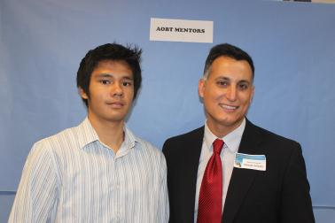
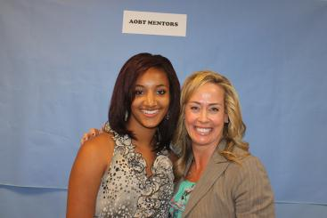
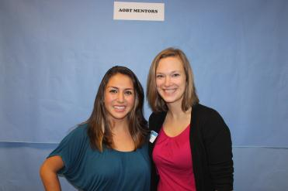
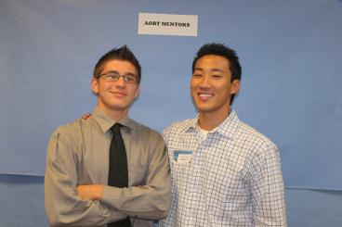
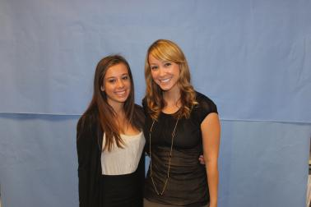
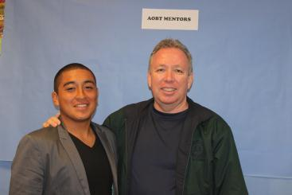
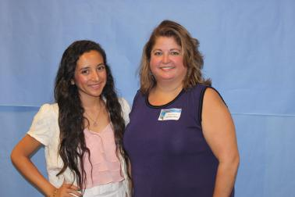
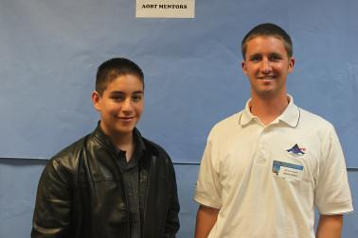
AOB 11th Grade Mentor Program
*One-on-One Mentoring
*Career Focus

Slide 9
Scheduled Meetings – 11th Grade Program
MONTH | MEETING TOPIC | SCHEDULED DATE /T | LOCATION
September | Mentor-Student Meeting 1: Intro, Ice Breakers, Self-Esteem & Goal Review | Thur., Sept. 26, 2013 12:00 pm – 1:15 pm | Clairemont High Library
October | Mentor-Student Meeting 2: Roadmap Mentor Interviews & Student Roadmaps | Thur., Oct. 24, 2013 12:00 – 1:15 pm | Clairemont High Library
November | Mentor-Student Meeting 3: Mentor "Business" Olympics | Thur., Nov. 21, 2013 12:00 – 1:15 pm | Clairemont High Outdoor soccer field
December | Mentor-Student Meeting 4: Job Shadow Fieldtrip Day | Choose day between Dec. 4 - Dec. 19 | Mentor's workplace or alternate location
January | Mentor-Student Meeting 5: Semester Reflection | Thur., Jan 16, 2014 12:00 – 1:15 pm | Clairemont High Library
February | Mentor-Student Meeting 6: Resume & Interview Techniques | Thur., Feb. 20, 2014 12:00 – 1:15 pm | Clairemont High Library
March | Mentor-Student Meeting 7: Future Planning | Thur., Mar. 20, 2014 12:00 – 1:15 pm | Clairemont High Library
April | Mentor-Student Meeting 8: Community Service Project FieldTrip | Fri., Apr. 17, 2014* | Off-campus fieldtrip;
May | Mentor-Student Meeting 9: Luncheon & Recognition | Thur., May 15, 2014 12:00 – 1:15 pm | Clairemont High Library

Slide 10
AOB Mentorship Program 2013-14
Student & Parent Participation Agreement
Read over
Students initial & sign
Parents initial and sign

Slide 11
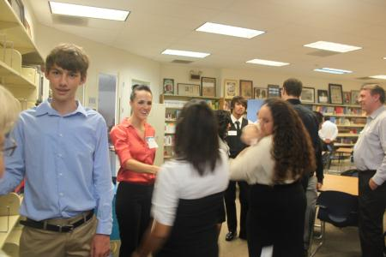
10th Grade Mentoring
Meeting 1: Introduction Personalities & Commonalities
Match Up Activity
Meet Your Mentor
Two-Minute Intros
Things We Have In Common
September

Slide 12
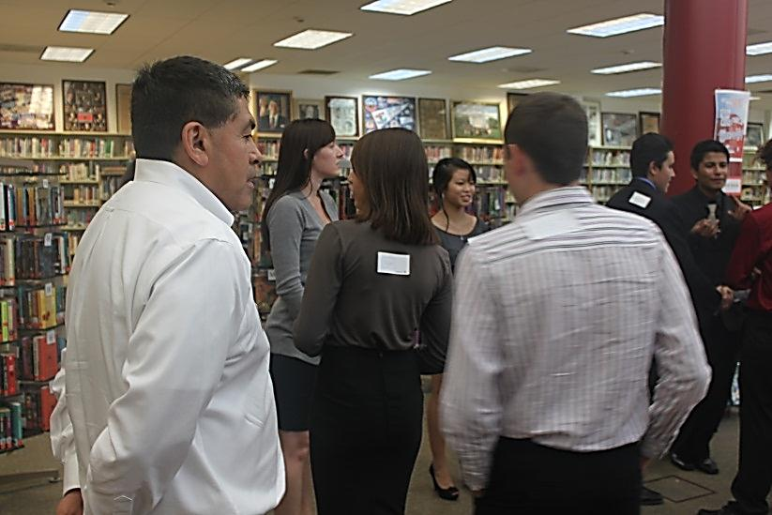
Guessing Groups Match Up
Theme on Mentor’s Back
Group #
(Mentor): Disney Characters
(student 1): Mickey Mouse
(student 2): Donald Duck
(student 3): Goofy
Topics/ Characters/ etc. on students’ backs
For 10th Grade Mentors Only

Slide 13
11th Grade Mentoring
Meeting 1: Introductions
Ice Breakers & Self-Esteem
Mentor Match-Up Activity
Mentor-Student Introductions
Get to Know Each Other
Self-Esteem Activity
September

Slide 14
Unique Fact Card Match Up
Your Mentor Info:
Mentor Name: __________________________________________________
Job Title:_______________________________________________________
Company/Organization:___________________________________________
Heard about AOBT from:___________________________________________
Unique Fact:_____________________________________________________
_______________________________________________________________
_______________________________________________________________
_______________________________________________________________
-Do NOT write your name on this
Write First and Last Name
Stick note to back of your index card
(see your profile)
-Be creative, original, specific
-Something interesting to break ice
-Example: I was bit by the state fish while snorkeling
on the Big Island of Hawaii.
For 11th Grade Mentors Only

Slide 15
10th Grade Mentoring
Meeting 2: Success, SMART Goals & Check-Ins
Secrets of Success Activity
Setting Goals the SMART Way
SMART Goals Action Plan Check-Ins
October

Slide 16
11th Grade Mentoring
Meeting 2: Roadmap Interview & SMART Goals
October
Mentor Roadmap: Student Interviews of Mentors
Student Roadmap: Setting SMART Goals
SMART Goal Action Plan

Slide 17
10th Grade Mentoring
Meeting 3:
Mentor Team Building Olympics
Fun team-building games
Mentor-student groups competing
Directed by staff
Dress comfortably
Not strenuous!
November

Slide 18
11th Grade Mentoring
Meeting 3:
Team-Building Olympics
November
Team Building Games
Tentatively Plan Job Shadow Fieldtrip

Slide 19
10th Grade Mentoring
Meeting 4: Time Management
Ice Breaker: My Pictures
How Do I Spend My Time? Activity
Backward Planning Activity
December

Slide 20
11th Grade Mentoring
Meeting 4:
Job Shadow Fieldtrip
Choose one day during two-week window
Mentor takes student to worksite (or alternate location)
Arrange logistics & transportation (Mentor Vehicle Form)
Student fills out Job Shadow Career Sheet
December

Slide 21
10th Grade Mentoring
Meeting 5:
Academic Reflection & Personal Business Plan
January
Ice-Breaker: Skittles Conversations
Catch-Up Time
Academic Reflection on Semester
Share Personal Business Plans

Slide 22
11th Grade Mentoring
Meeting 5:
Academic Reflection
January
Brain Teaser Competitions
Catch-Up Time
Academic Reflection on Semester

Slide 23
10th Grade Mentoring
Meeting 6:
Practice Job Interviews & Check-Ins
February
Ice Breaker: What I Wanted to Be When I Grew Up
Interview Tips
Practice Group Job Interview
Check-Ins: Feedback on Job App & Interview

Slide 24
11th Grade Mentoring
Meeting 6:
Resume & Interview Techniques
February
Catch-up and Updates
Review & Revise Resume
Interview Preparation & Practice

Slide 25
10th Grade Mentoring
Meeting 7:
Educational Group Fieldtrip
Choose one day during March
Choose a location related to college and/or career
Coordinate and schedule logistics with group
Arrange transportation (Mentor Vehicle Form)
Inform coordinator of details
March
Page

Slide 26
11th Grade Mentoring
Meeting 7:
Future Planning
Update on Student Goals
Future Plans Worksheet
College, Testing
Using Spring & Summer Breaks
Letter of Reference
March

Slide 27
10th Grade Mentoring
Meeting 8:
College Forum & Debrief
College Forum: Mentors as a panel
Discussion of Post-Secondary Academics
Set up for College Quest
April

Slide 28
11th Grade Mentoring
Meeting 8:
Community Service Project
Fieldtrip Day
Activity TBA
Mentors to carpool
Kick off to 11th Gr. Social Entrepreneur Project
April

Slide 29
10th Grade Mentoring
Meeting 9:
Closing & Luncheon
May
Thank-you Luncheon
Assessment of Year’s Progress
Future Outlook
Mentorship Program Feedback Form

Slide 30
11th Grade Mentoring
Meeting 9:
Recognition & Luncheon
May
Assessment of Year’s Progress
Closing: Goodbye, Recognition, Future Contact
Mentorship Program Feedback
Thank-you Luncheon

Slide 31
11th Grade Mentoring
Meeting 10:
Personal Business Plan
May
Assessment of Year’s Progress
Closing: Goodbye, Recognition, Future Contact
Mentorship Program Feedback
Thank-you Luncheon

Slide 32
10th Grade Mentoring
Meeting 10:
Personal Business Plan
June
Finals Presentations
Last Day of School

Slide 33
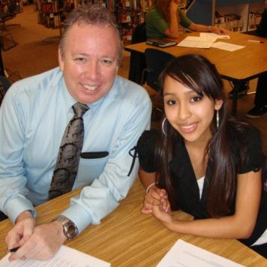
Final Steps:
AOB Mentor Contract
School Volunteer Application
Live Scan: Request to Conduct Volunteer Screening Form
Notecard for Matching
Student Preferences (Optional)

Slide 34
LiveScan Screening
OPTION 1:
To complete through the SDUSD Police Services LiveScan Department :
* Cleared prior to first mentor-student meeting on Sept 27.
* (If LiveScaned by SDUSD in last year, or employee, info should be on file.)
* No Fee
* SDUSD Police Services Office in University Heights, 4100 Normal St.
* Mon – Fri, Walk-ins: 8:30 am – 1pm / Appts.: 2 - 4:00 pm
* Take proper form of ID and Request to Conduct Volunteer Screening Form. To properly fill out this form:
Check “CATEGORY D – Volunteer Fingerprint” at the top
For “REQUESTING SCHOOL” write “Clairemont High”
For “VOL. COORDINATOR,” write “Liz Rush.”
* Say from “Liz Rush’s Mentor Program at Clairemont High”
* Helen Elhard, LiveScan Supervisor: helhard@sandi.net

Slide 35
LiveScan Screening
OPTION 2:
To complete through alternate LiveScan facility:
* Cleared prior to first mentor-student meeting on Sept 29.
* Fee varies according to facility
* Take proper form of ID and Request For LiveScan Form
* Use pre-filled form
* Return completed form to SDUSD Fingerprinting Office immediately upon completion so they finish the clearance process.
* Helen Elhard, LiveScan Supervisor: helhard@sandi.net

Slide 36
Thank You, Mentors!
It’s going to be a great year!
See you on Thursday, Sept. 27.

