Slide 1

M.U.S.E.
(Making use of student experience)
Canyon Springs High School

Slide 2
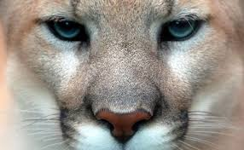

M.U.S.E.
Canyon Springs High School Business Academy Faculty
Willene Biere – Business Academy Director
Katie Beaman – Sr. English Teacher
LeAnn Duong – Jr. & Soph. English Teacher
Sharon Mendonsa – Science Teacher

Slide 3
M.U.S.E.
CSHS Business Academy Structure
19 years (not all CPA)
Sophomores – job interviews, marketing, public speaking
Juniors – entrepreneurship projects , marketing, advertising
Seniors – Virtual Enterprise, Business Communication
Student Store
Basketball snack bar

Slide 4
M.U.S.E.
One of the major components of the CSHS Business Academy is student-student mentorship
The Academy is designed to make use of student experience by facilitating peer mentorship in several ways
Alumni – Seniors
Seniors – Juniors
Juniors – Sophomores

Slide 5
M.U.S.E.
Collaboration Exercise #1
With a partner, discuss the following and prepare to share out.
How do you make use of student experience within your classroom, school, or area of expertise? Current and/or former?

Slide 6
M.U.S.E.
At Canyon Springs High School -
Business Academy prides itself on the use of student-student mentorship to foster collaboration, self-reflection, critical thinking, and networking
Upperclassmen mentor underclassmen in a variety of ways
Former students also return to mentor current students
We make use of student experience as both a teaching method and a source of motivation for students

Slide 7
Alumni as mentors
Former Students -
meet at colleges
mentor seniors for trade shows and competition
serve as guest speakers
conduct mock interviews (final)

Slide 8
Students as mentors
Seniors -
provide feedback during mock interviews
model trade shows
help with and work in student store
talk to juniors about how to form a successful business
give advice to sophomores on brochures
provide job shadowing at the student store
mentor freshman Business Algebra students
interview juniors for next position
help with Academy recruitment
work as ambassadors for school Career Fair

Slide 9
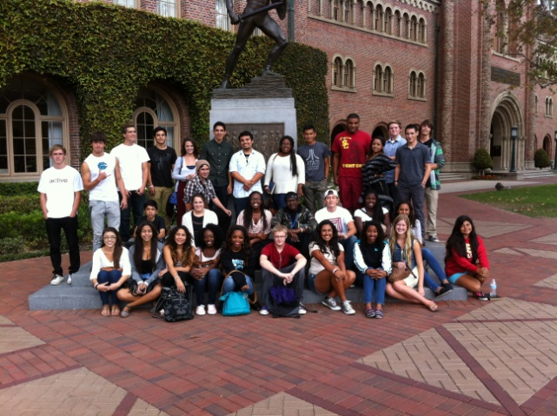
Students as Mentors
Juniors –
provide feedback on trade shows
mentor sophomores with student store
participate in recruitment of freshmen
Sophomores -
mentor each other on projects
conduct collaborative conversations

Slide 10
Tips for fostering Mentorship
(what works for us)
Suggestions for creating a system that fosters mentorship within your program -
Index File System
Cataloging College Attendance
Standing invitation for Alumni (texting)
Fostering a positive and communal learning environment
Teaching Networking
Building Relationships with Parents
Keeping it in the Family

Slide 11
Benefits of mentorship
Why peer mentorship is valuable for students -
Students are honest and understand what is like to be in certain positions
Understand how school can be and are there to help
Create a family within the students and school
Support within the school
Know how to succeed on projects and can help others succeed
Students are more open to other students then adults
Creates an atmosphere of collaboration, similar to the modern workplace
Gives students a voice
Models practice of giving back to the community

Slide 12
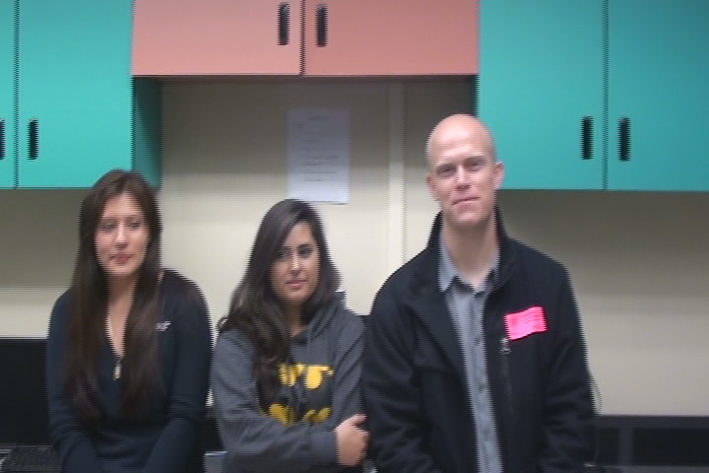
Feedback from students

Slide 13
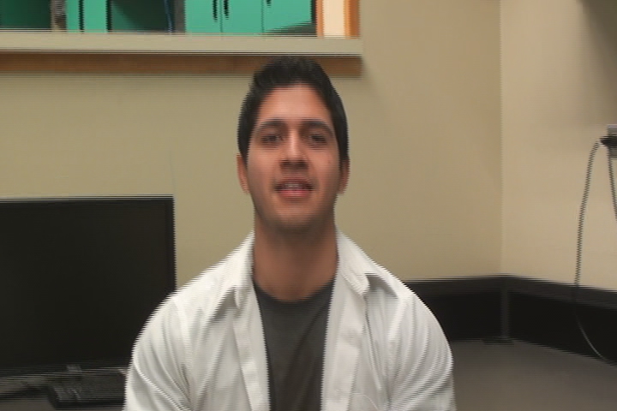
Feedback from students

Slide 14
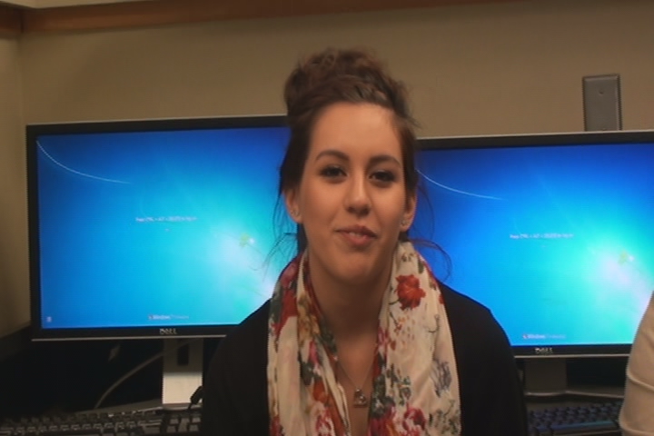
Feedback from students

Slide 15
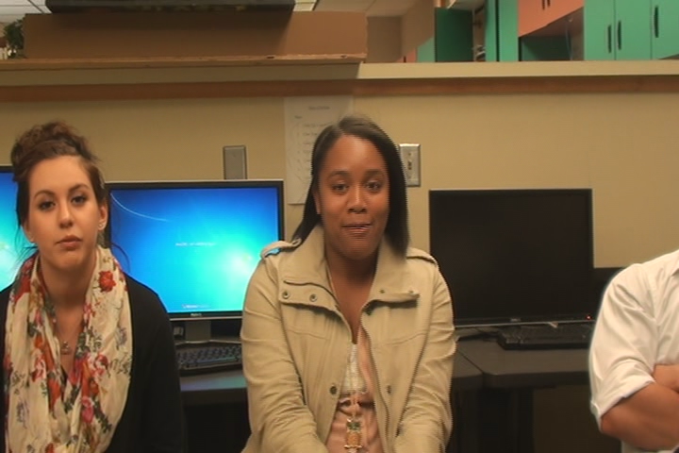
Feedback from students

Slide 16
Benefits of mentorship
Why peer mentorship is valuable for your Academy program –
Alumni counts as matching in your final report
Useful resource if you have limited access to industry sector mentors
Alumni often have more availability than industry sector mentors due to more flexible schedules
Helps to establish an Academy that feels like a family
Builds a support network for students and Academy teachers

Slide 17
How might this look at your school?
Collaboration Exercise #2
Within a small group, discuss three ways you might be able to foster student-student mentorship at your school, or within your program
Following discussion, we will share out

Slide 18
Other ideas to consider…
Feedback from the Round Table sessions –
Take student-student mentorship into the middle schools
Create an online network for students to connect to alumni, and stay connected with the Academy after graduation
Hold monthly meetings to foster one-on-one mentorship between students
Create an after school mentorship club
Develop an alumni directory on your Academy website
Academy Anniversary events

Slide 19
Contact information
wbiere@mvusd.net
  Direct Line – (951) 571-4779
kbeaman@mvsd.net
smendonsa@mvusd.net
lduong@mvusd.net

