Slide 1
Taming the Master Schedule
Patricia Clark and Phil Saroyan
CCASN – College & Career Academy Support Network/ U.C. Berkeley

Slide 2
Objectives
To increase our own expertise, efficiency, and effectiveness in building a successful Master Schedule
To acquire valuable master scheduling tools, strategies and resources
To share our own scheduling best practices, challenges and solutions

Slide 3


Slide 4


Slide 5
The Perfect Master Schedule
A schedule in which ALL students and teachers are successfully cohorted in their respective pathways; where each pathway team (or grade level pathway team or upper/lower division pathway team) of teachers shares common planning time; and where every student is supported to successfully complete a challenging, interdisciplinary program of study that results in her/him graduating college- and-career-ready.

Slide 6
So... If you are the person/s or team who has ultimate responsibility for the master schedule, what is one indicator that you have done a good job?

Slide 7
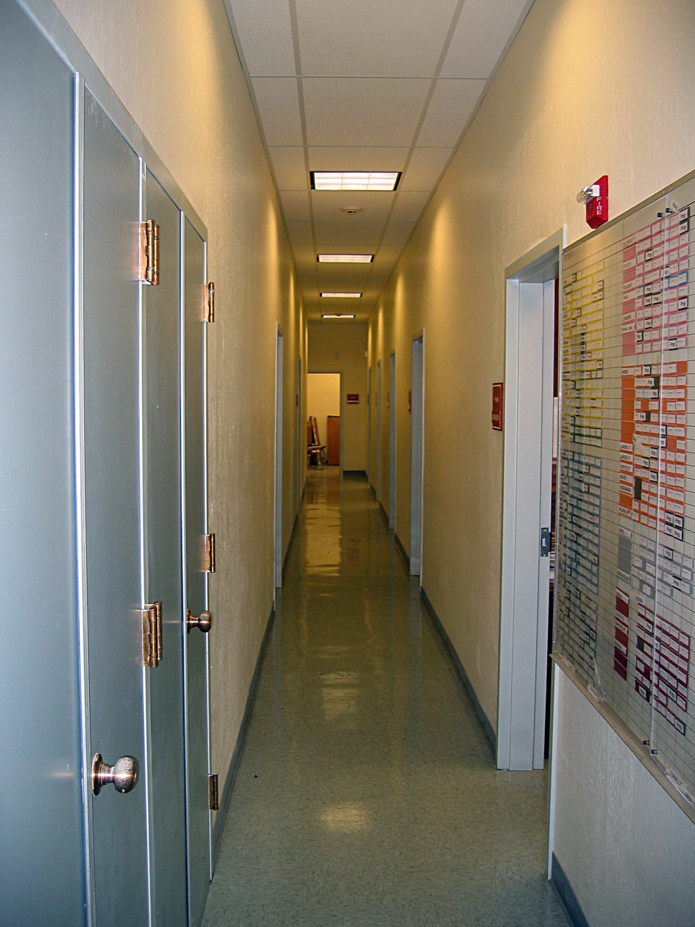
The Counselors’ Hall…
…10 minutes after the beginning of 1st period on the 1st day of school.

Slide 8
Scheduling with a Pathway Lens
Student recruitment/selection involves high expectations for all; heterogeneous grouping with each pathway reflecting the diversity of school/district
* SLCs: interdisciplinary Pathway Programs of Study
Cohort Scheduling
Common planning time/community of practice
Pathway Lead’s Coordination Time
Partnerships with Business, Postsecondary, Government, and Community

Slide 9
Scheduling with a Pathway Lens
College and Career Readiness (including, all students have access to advanced courses, access to CTE)
Work-based Learning (internships, practica)
Student Support

Slide 10
Stages of Master Scheduling
  Planning, Designing, Preliminary Tasks
  Student Pathway Program of Study Selection; Elective Course Selection; Tallies
  Building the Master Schedule
  Analysis and Adjustment; Distribution of Student & Teacher Schedules
  Fine-tuning, Readjustment, and Assessment (begin the cycle anew)

Slide 11
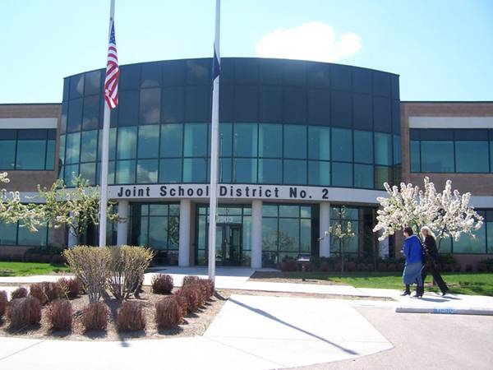
The Role of the District in Supporting Effective Scheduling

Slide 12
Stage 1: Planning
Assemble Master Schedule Team
Establish set of Guiding Principles
Identify and address any scheduling opportunities, needs, or constraints
Dialogue/Communicate w. all Stakeholders
Develop/Disseminate Master Schedule Plan, Process, and Timeline
Review/Update Curriculum & Courses
Develop Pathway & Course selection process and materials
  Tips: Involve stakeholders early; Use visual representations

Slide 13
Stage 2: Pathway/Program of Study and Course Selection; Tallies
Disseminate Selection/Registration materials (increasingly this is done on line)
Make multiple presentations to students/parents
Assure every student is supported by an adult advocate to make informed choices
Complete Pathway recruitment and selection process (pathway showcase, visits, etc.)
Check and Verify Everything: Accuracy is Critical

Slide 14
POS/Course Selection & Tallies
Balance student choice with equity (each pathway reflecting the diversity of the school as a whole)
Use course tallies to determine final course offerings & number of course sections

Slide 15
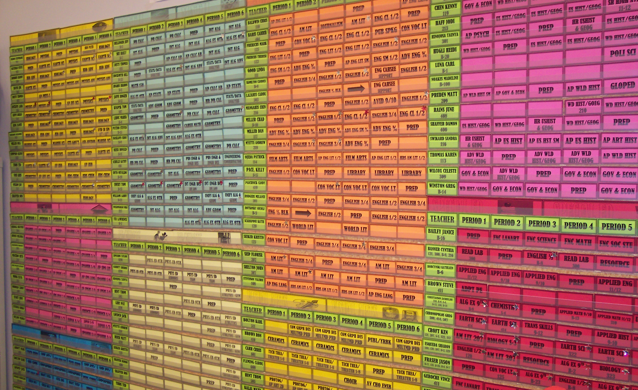
Stage 3:
Building the Master Schedule

Slide 16
Common Planning Time
The Linchpin of Linked Learning
Professional Development
Integrated, Thematic Curriculum Development
Course Development
Meetings with Business Partners
Student Counseling/College & Career Planning

Slide 17
Making it Happen
Not an easy task especially as the number of Cohorts increases
Influenced by school structure
  School Size
  Number of teachers
  Number of periods each teacher is assigned
  Maximum class size
  Maximum case load
There is a limit

Slide 18
Common Planning Time Limit Calculation
Example:
Total number of students – 1500
Total number of teachers – 56
Number of periods an individual teacher is assigned – 5
Maximum student case load for a teacher – 165
Maximum class size – 32
Limiting divisor – case load or maximum class size?
165 / 5 = 33 -vs- Maximum class size of 32
1500 / 32 = 47 (rounded up)
56 – 47 = 9 – Total number of preps per period
Possible Exceptions: Multiple Lunch Periods
Stacking of larger class size classes (Physical Education
Periods designed for fewer students – optional periods
Tool: Common Planning Time Estimator – Excel Spreadsheet

Slide 19
Sample Conflict Matrix
Calculus – 32 Requests
Course Title Number of Requests
Advanced Band | 3
Art Design | 2
Biology | 22
Chemistry | 2
English | 32
Filipino | 3
French | 7
Government/Econ | 32
Journalism | 2
Leadership | 2
Marching Band | 10
Physics | 13
Spanish | 12
Studio Art | 1

Slide 20
Conflict Matrix Considerations
Placement Order
Mandatory Placements
Pathway Courses
Special Education
English Language Learners
Singletons
Doubletons
Tripletons
Conflict Totals Per Period
Hyperdispersion

Slide 21
Pathway with 120 students
(Each Letter Represents a Group of 30 Students in this Pathway)
Aspects of this structure:
Common prep
Teachers teach one period out of the academy
Students take 4 classes in academy and 2 out
Students in academy can go out for classes during period 1 & 6
Academy field trips complicated by 6th period outside class (students in academy periods 3-6 improves the ability to take field trips)
 | Per 1 | Per 2 | Per 3 | Per 4 | Per 5 | Per 6
Course 1 | PREP | A | B | C | D
Course 2 | PREP | B | C | D | A
Course 3 | PREP | C | D | A | B
Course 4 | PREP | D | A | B | C
A
A
B
B
C
C
D
D
Now let’s see what happens with 30 more students
Notes:
This is a note

Slide 22
Pathway with 150 students
(Each Letter Represents a Group of 30 Students in this Pathway)
Aspects of this structure:
Common prep
Teachers teach all 5 periods in the academy
Students take 4 classes in academy and 2 out
Students in academy can go out for classes during any period 1 – 6 (a student can change group to go out any period)
Academy field trips complicated by students taking classes outside of the academy during all periods of the day
 | Per 1 | Per 2 | Per 3 | Per 4 | Per 5 | Per 6
Course 1 | PREP | A | B | C | D | E
Course 2 | PREP | B | C | D | E | A
Course 3 | PREP | C | D | E | A | B
Course 4 | PREP | D | E | A | B | C
A
A
B
B
C
C
D
D
E
E
Now let’s see what happens with 300 students

Slide 23
Pathway with 300 students
(Each Letter Represents a Group of 30 Students in this Pathway)
 | Per 1 | Per 2 | Per 3 | Per 4 | Per 5 | Per 6
English | Prep | A | B | C | D | E
English | Prep | F | G | H | I | J
History | Prep | B | C | D | E | F
History | Prep | G | H | I | J | A
Science | Prep | C | D | E | F | G
Science | Prep | H | I | J | A | B
Tech | Prep | D | E | F | G | H
Tech | Prep | I | J | A | B | C
 | All Out | E & J | A & F | B & G | C & H | D & I
 | Band | Alg 1 Alg 2 Geom | Chem Physics Alg 2 | AP Course World Language | AP Course World Language | AP Course World Language

Slide 24
Pathway with 300 students

Slide 25
The Golden Numbers
How do you know the best configuration of a Linked Learning Cohort?
Number of teachers
Number of periods
Number of students
Tool: Cohort Size Calculator – Excel Spreadsheet
Fill in the 5 values and a chart on the spreadsheet will show you workable configurations

Slide 26
Tally & Section Allocation
44 Total Sections

Slide 27
40 Total Sections

Slide 28
Seat Balancing
Student Counts from Course Request Tally
Teacher
Course
Room #

Slide 29
Balanced!!

Slide 30
Making a Room Assignment
6 Rooms, 6 Teachers, No sharing
6 Rooms, 7 Teachers, Sharing
 | Per 1 | Per 2 | Per 3 | Per 4 | Per 5 | Per 6
Rm 1 |  | X | X | X | X | X
Rm 2 |  |  | X | X | X | X
Rm 3 |  |  |  | X | X | X
Rm 4 | X | X | X |  | X | X
Rm 5 | X | X | X | X
Rm 6 | X | X | X | X | X
X
X
X
X
X
X
X
X
Just one room change for each sharing teacher with the move following a prep period.

Slide 31

Now you are ready to enter the master schedule into your student information system.
Remember the Tags
Do a Simulation (Sim) Run
Analyze Results
Make Adjustments
Finalize the Master Schedule

Slide 32
Stage 4:
Analysis, Adjustment, Distribution
Run Scheduler- identify percentage of success
Complete a Careful Analysis
Make further adjustments as needed
Distribute student/teacher schedules
Tip: Year to year tracking of scheduling conflicts, challenges, and solutions is important

Slide 33
S5: Fine-tuning, Readjustments & Assessment
Adjustments for new/transfer students
Adjustments for students who withdraw/ transfer
Adjustments for student credits earned over the summer/grade changes, etc.
Adjustments in teaching personnel
Adjustments for changes in FTE
Coordination/support new and returning student induction
Distribution (redistribution) of schedules

Slide 34
Assessment
Looking at results
Internal Assessment – Learning from those involved in the process
External Assessment – Learning from those effected by the results
A cycle of improvement

Slide 35

Inviting your Brilliance and Wisdom

Slide 36
Coming Very, Very Soon – CCASN Online Master Scheduling Guide
Focus on Effective Scheduling for Linked Learning Pathways and Academies
How you, your District, site, and Pathway might help….
How you, your District, site, and Pathway might benefit ….
Blessed are those who share.

Slide 37


Slide 38
Thank you for your participation.

Slide 39
Staying Connected
Patricia Clark patricia510@gmail.com 510.504.3826
Phil Saroyan jp9@jps.net 707.246.2076
College and Career Academy Support Network (CCASN) - University of California Berkeley Graduate School of Education http://ccasn.berkeley.edu

