Slide 1
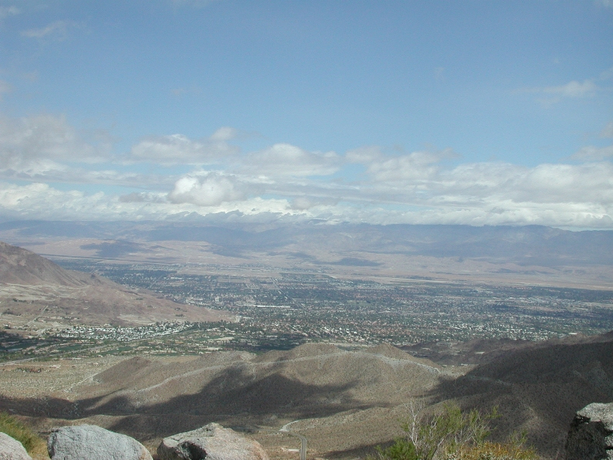
Creating CTE Academies that Prepare Students for College & Career March 3 & 4, 2014 Educating for Careers Conference Diana LaMar, Ed.D. Director Linked Learning, PSUSD Kim McNulty, Director Next Generation Learning, CVEP

Slide 2
Shared Vision
In 2008 Public and Private sector leaders in the Coachella Valley recognized the need for a Shared Vision to address the regional economic development and education issues impacting our Valley
The Outcome:
Economic Blueprint
A Regional Collaborative
advocating message that
“Education is Economic
Development”
Notes:
2

Slide 3
Common Focus
Today, 18 career academies (15 CPAs) at 8 high schools serve 2,800 students across three K-12 districts and the Coachella Valley Regional Plan for College and Career Readiness guides collective efforts.
The Outcome:
Student Success
* Higher graduation rates
* Higher CAHSEE pass rates
* Higher attendance
* Higher college going rates
Notes:
3

Slide 4
Where do you begin?
Look at the facts and data…

Slide 5
Each day, 7,000 students drop out, one every 26 seconds
SOURCE: Excerpted from ConnectEd Presentation.

Slide 6
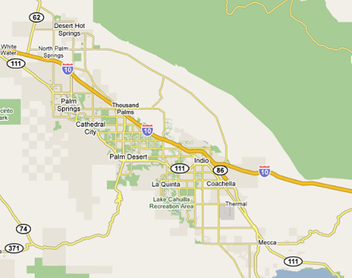
Our Future Workforce: By the Numbers – 2012/2013
Coachella Valley, California
71,454
K-12 Students
Palm Springs USD
23,575 students
7,209 High School
Dropout Rate: 13%*
UC/CSU Ready: 22%
Hispanic: 74%
English Learners: 30%
F&R Lunch: 83%
Coachella Valley USD
18,720 students
5,130 High School
Dropout Rate: 24%*
UC/CSU Ready: 29%
Hispanic: 97%
English Learners: 51%
F&R Lunch: 80%
Desert Sands USD
29,159 students
9,399 High School
Dropout Rate: 16%*
UC/CSU Ready: 31%
Hispanic: 71%
English Learners: 23%
F&R Lunch: 68%
71,454 Total Students
21,738 High School Students
Lifetime cost
per dropout
to community:
$292,000
Source: CA Dept. of Education
2012-2013 Data
*Dropout Rate 2010 data
School Data Source: CA Dept of Ed/www.cde.ca.gov

Slide 7
Take an inventory…
What do you have?

Slide 8
Take an Inventory…. What do you have?
What are your drop out rates, graduation results?
What CTE programs are currently taught at the high schools?
What are the current workforce needs in the community?
What is community college offering?

Slide 9
What are the desired results?
Are they connected to higher wage jobs in the region?
Are the courses articulated with the Community College?
Are the high school pathways/academies structured?
Are the courses linked to feeder middle schools?

Slide 10
How will you structure the program?
Our region supports the Linked Learning approach:
Integration of rigorous core academics
Real-world technical skills
Work-based learning opportunities
Personalized support

Slide 11
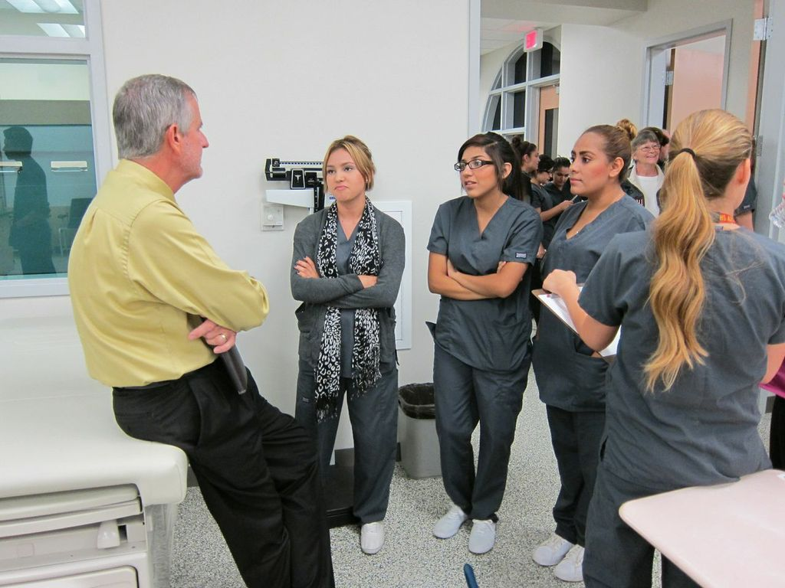
We also support the CPA model
15 CPA academies linked to workforce needs
50% of all CPA academies in Riverside County!

Slide 12
Who are Your Movers and Shakers?
Who makes the decisions?
K-12 School District Leaders
Community College Leaders
Board Members
Business Champions
County Office Leadership
State Decision Makers

Slide 13
Know Your Outcomes & Showcase Results

Slide 14
Determine Your Goals
Increase high school graduation rate?
Increase student attendance?
Prepare students for post-secondary?
Decrease suspension and expulsions?
Prepare students for work?

Slide 15
Who are your business
and community partners?
Get them involved!

Slide 17
“All students will graduate high school prepared for success in
College, Career and Life”

Slide 19
The Coachella Valley Regional Plan for College and Career Readiness
Technical Assistance from
The Ford Motor Company Fund:
Ford Next Generation Learning
Notes:
Susan

Slide 20
Leadership Engagement
K-12 Boards & Superintendents
Community College President & Deans
University Chancellors & Deans
Coalition of 400 Business and Community Partners

Slide 22
Our Strand 4
College and Career Readiness
Transforming Teaching and Learning
Transforming Secondary Schools
Transforming Business and Civic Engagement

Slide 23
Regional Plan 5 Strategic Outcomes
Increase high school graduation rates
Increase Career Readiness
Increase College Readiness
Increase College/Higher Skills Training Completion
Local Students in Higher Wage Jobs
Notes:
Susan

Slide 24
Regional Plan Target Outcomes:
30% of students enrolled in career-themed academy
80% of students have a personalized graduation plan
10% increase in high school graduation rate
Increase region’s FAFSA completion rate to 85%
10% increase in the college-going rate
Scholarship fund generating $1M annually
Notes:
Susan

Slide 25
Desert Healthcare
District
Irvine Foundation / Linked Learning Ford NGL
CVEP Board of Directors
Alignment USA College Access Foundation
CVUSD / DSUSD
PSUSD / RCOE
Workforce Excellence Oversight Committee
COD / CSUSB / UCR
Data
Regional Plan for College and Career Readiness
Academies
Education Engagement
Workforce Excellence
Work-Based Learning
Business Engagement
Committees
Programs
Industry Councils
Matching Partners
Paid Internships
Financial Aid/FAFSA
Scholarships & Student Support
Riverside County EDA/WIB
Health Career Connections

Slide 26
What are the business and community partners responsible for?

Slide 27
Powerful CTE Programs Provide Work-based Learning Opportunities
Whose job is this?
……Hint: One person cannot do it all
Linked Learning = distributive leadership
How can you work with others?

Slide 28
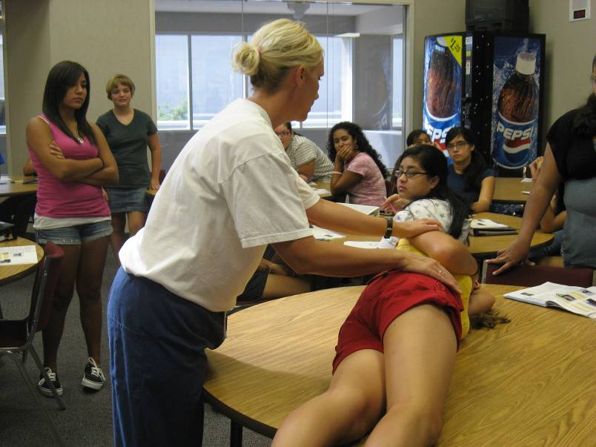
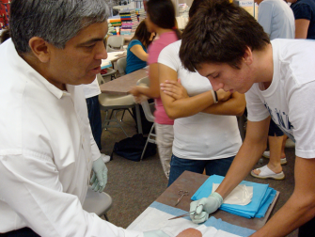
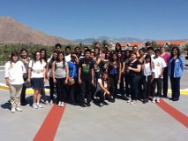
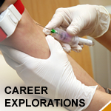
In 2013
11,000+ hours
of
Work Based Learning
was
Provided by
Coachella Valley Employers

Slide 29
What is an Industry Council?
Professional Learning Communities where teachers from all districts have opportunity to come, collaborate, share ideas with business partners in a particular industry sector and get real-time support
Coachella Valley has 3:
Healthcare // Advanced Technology // Arts Media Entertainment

Slide 30
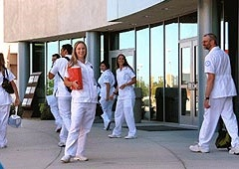
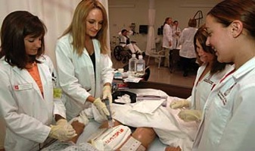
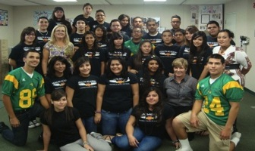
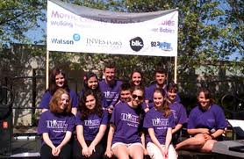
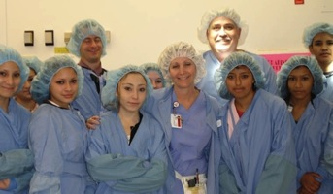
Preparing the Pipeline in a K-12 District
The Arts, Media, Entertainment Industry
Performing Arts
Jobs
Trained Employees for the Coachella Valley
College of the Desert
Colleges and Universities
High School Performing Arts
Programs
Internships
Work-based Learning
Middle School Programs &
Career Explorations

Slide 31
Where does the money come from?
There are no silver bullets, but there are lots of sources…

Slide 32
Potential Funding Sources
Existing District Resources
Local Control Flexible Spending
CPA Funding
ROP Funding
Secondary Specialized Program Funding
Carl Perkins Funding
CA Pathways Trust Grant Funding
Business and Community
Local Grants

Slide 33
Congratulations ~
Your Career Academy
Students Graduated!
….now what?

Slide 34
College and Career

Slide 35
Pathways to Success in the Coachella Valley
Provides scholarships to students when they graduate
Provides ongoing support to students while in two-and four-year colleges and universities
Funds are matched by local business and industry partners

Slide 36
Supporting Student Success
Student Tracking
● Housing & Enrollment
● Financial Aid
● Transportation
● Campus Navigation
● Academic Guidance
● Course / Major Selection
● Time Management
● Goal Setting
● Analytical Reading
● Note Taking
● Stress Management
● Finals Preparation
● Active Reading
● Core Writing
● Financial Management
● Academic Performance
● Persistence to Degree
Student Networking
Work Based Learning
● Online Social Networking
● Peer Counseling / Posse
Counseling & Advising
Workshops
● Mentoring
● Internships
● Job Shadowing

Slide 37
Students Provided Scholarships by Industry Cluster: 2009-2012 Approx. $1.7 M Annually (change Clean Tech – Energy, Engineering and Design)
*Student data is in the process of being collected for 159 scholarship recipients for 2012.
Notes:
Ernie update

Slide 38
Diana LaMar, Ed.D. Director of Linked Learning Palm Springs Unified School District 760-416-6073 dlamar@psusd.us Kim McNulty Director Next Generation Learning Coachella Valley Economic Partnership kmcnultyps@aol.com
THANK YOU!

