Slide 1
Energy Education Resources for Green Academies
Resources for teaching fundamentals of:
Energy Science, Energy Sources,
Energy Efficiency and Conservation
Barry Scott
Educational Consultant
bscott@need.org
(209) 464-5663
March 4, 2014

Slide 2
Signature NEED Programs:
ConocoPhillips
EIA Energy Kids
FPL Solar Stations
Hawaii Energy
National Fuel Energy Detectives
New Orleans Solar Schools Initative
Pacific Gas & Electric
PECO Energizing Education Program
Phillips 66
TXU Energy Solar Academy
Walmart Solar Schools

Slide 3
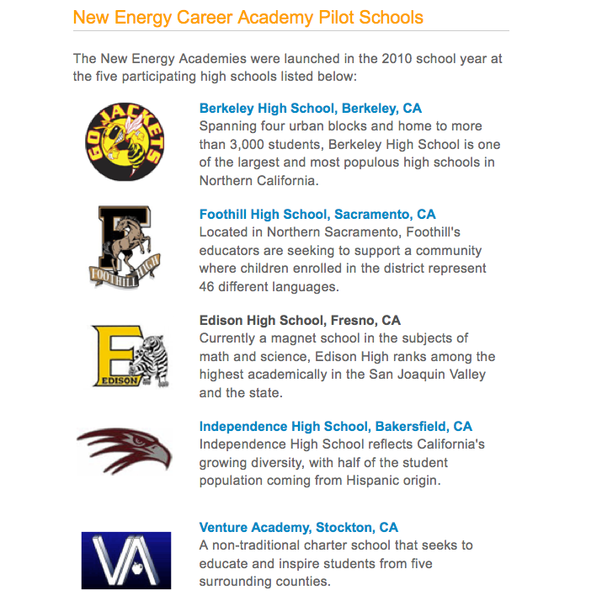

Slide 4
About the NEED Project:
National Non-profit Organization founded 1979
Active in all 50 states, 4 territories, and abroad
Teacher network, peer reviewed
K-12 material, free online curriculum, affordable kits
Our sponsors provide free workshops, kits, grants
We have a presence in the industry and public sector
Ongoing support via home office and state coordinators
How does Energy fit into various subject matter areas?

Slide 5
Integrating Energy Education:
History and SS: Energy is in every historic era.
Wars are largely fought and won over energy matters.
Economics are increasingly energy dependent.
Our food water mobility, communications…
Math and science connections are self-evident.
Environmental sciences, climate change? Energy.
Careers. More than ever, careers in and around energy.
Where does Energy Education Fit in CTE Sectors?

Slide 6
Industry Sectors:
Agriculture and Natural Resources ✔
Arts, Media and Entertainment
Building Trades and Construction ✔
Education, Child Development and Family Services
Energy and Utilities ✔
Engineering and Design ✔
Fashion and Interior Design ✔
Finance and Business ✔

Slide 7
Industry Sectors:
Health Science and Medical Terminology
Hospitality, Tourism and Recreation ✔
Information Technology
Manufacturing and Product Development ✔
Marketing, Sales and Service ✔
Public Services ✔
Transportation ✔
Challenges and benefits of teaching more about energy?

Slide 8
Implementing Energy Ed
Challenges at the curricular level:
Energy topics dispersed across K-12 grades
Need for connection to real world applications
Need for connection to humans’ lives (see EEI)
Need to connect to the growing number of careers
General failure to prepare students for the workplace
Energy education for energy sector careers only?
Energy is a topic ALL citizens should understand.

Slide 9
The NEED Project
Characteristics of effective energy curricula:
Unbiased, scientifically sound and research-based
Input from a broad cast of contributors
Integrated, project-based, hands-on
Connected to students’ lives
Provide opportunities for student leadership
Easily accessible, correlated to standards
Effectively distributed
Meaningfully supported

Slide 12
The NEED Project
Steps in an EE Program:
Science of Energy (forms and transformations)
Sources of Energy (renewable and nonrenewable)
Electricity and Magnetism
Transportation (increasingly tied to the grid)
Efficiency and Conservation
When time allows:
Synthesis and Reinforcement
Service Learning
Recognition (celebration, leadership, outreach)

Slide 13
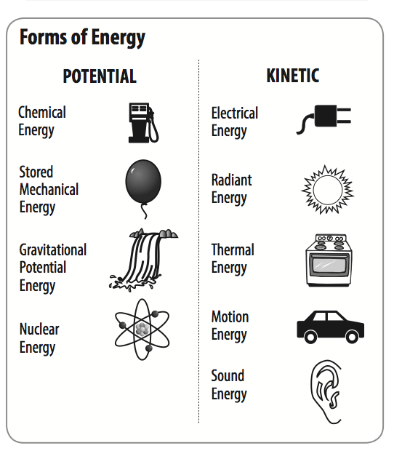
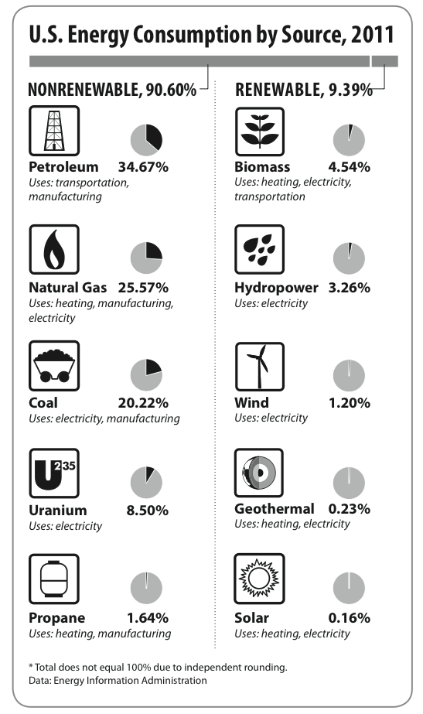

Slide 14
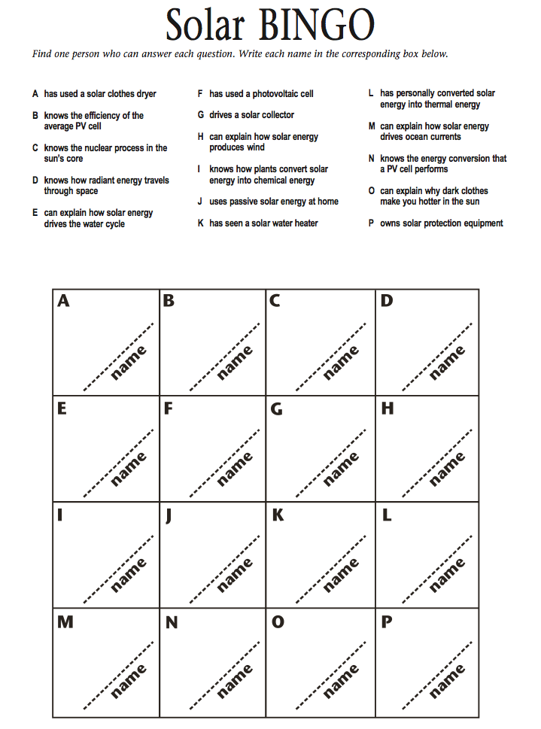

Slide 15
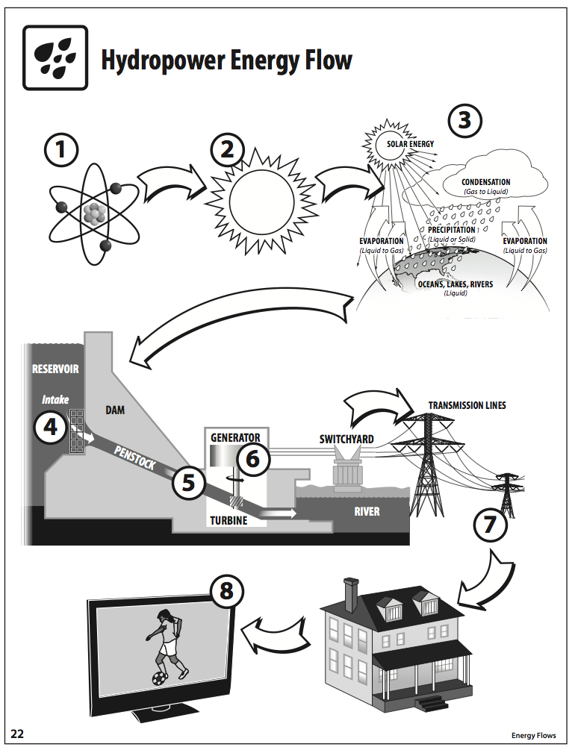

Slide 16
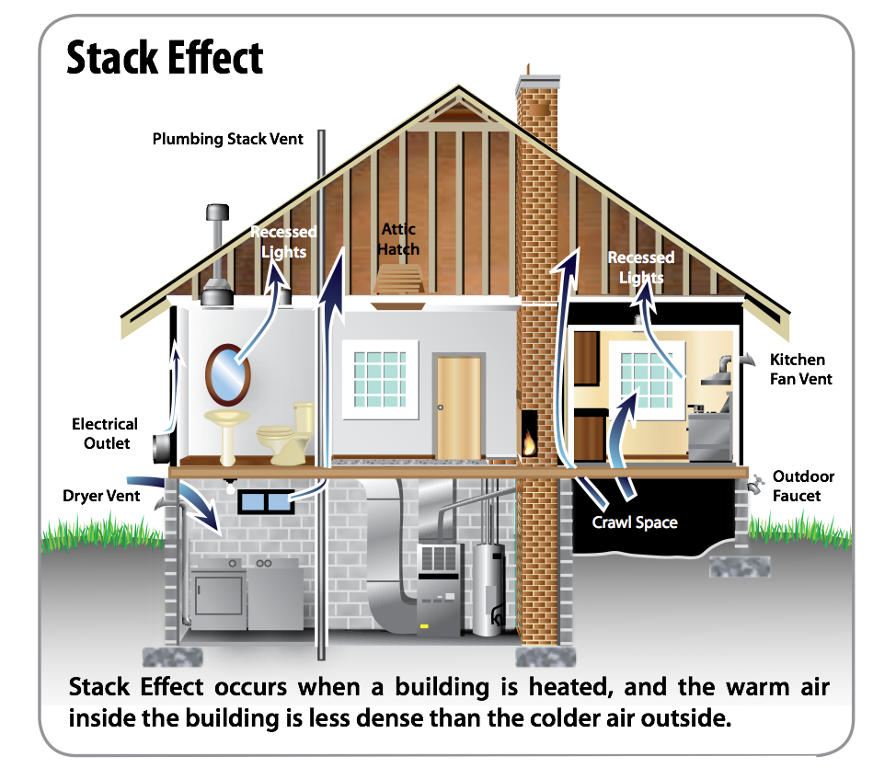

Slide 18
CAISO
California Independent System Operator
http://www.caiso.com

Slide 19
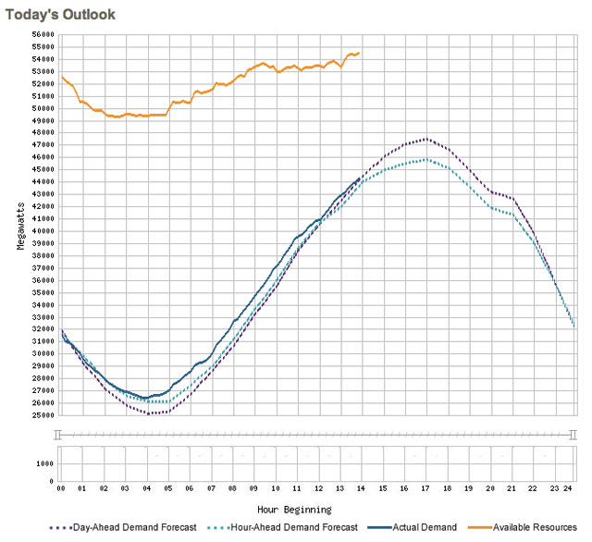

Slide 20
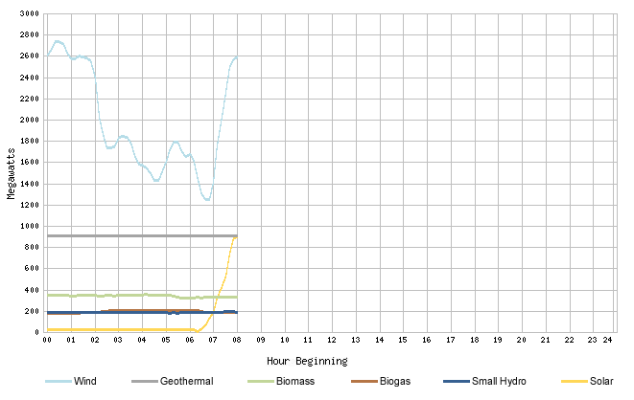

Slide 21
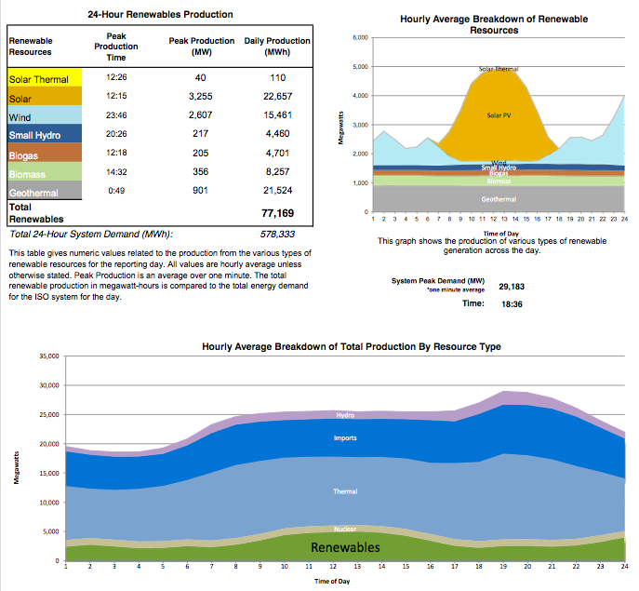

Slide 22
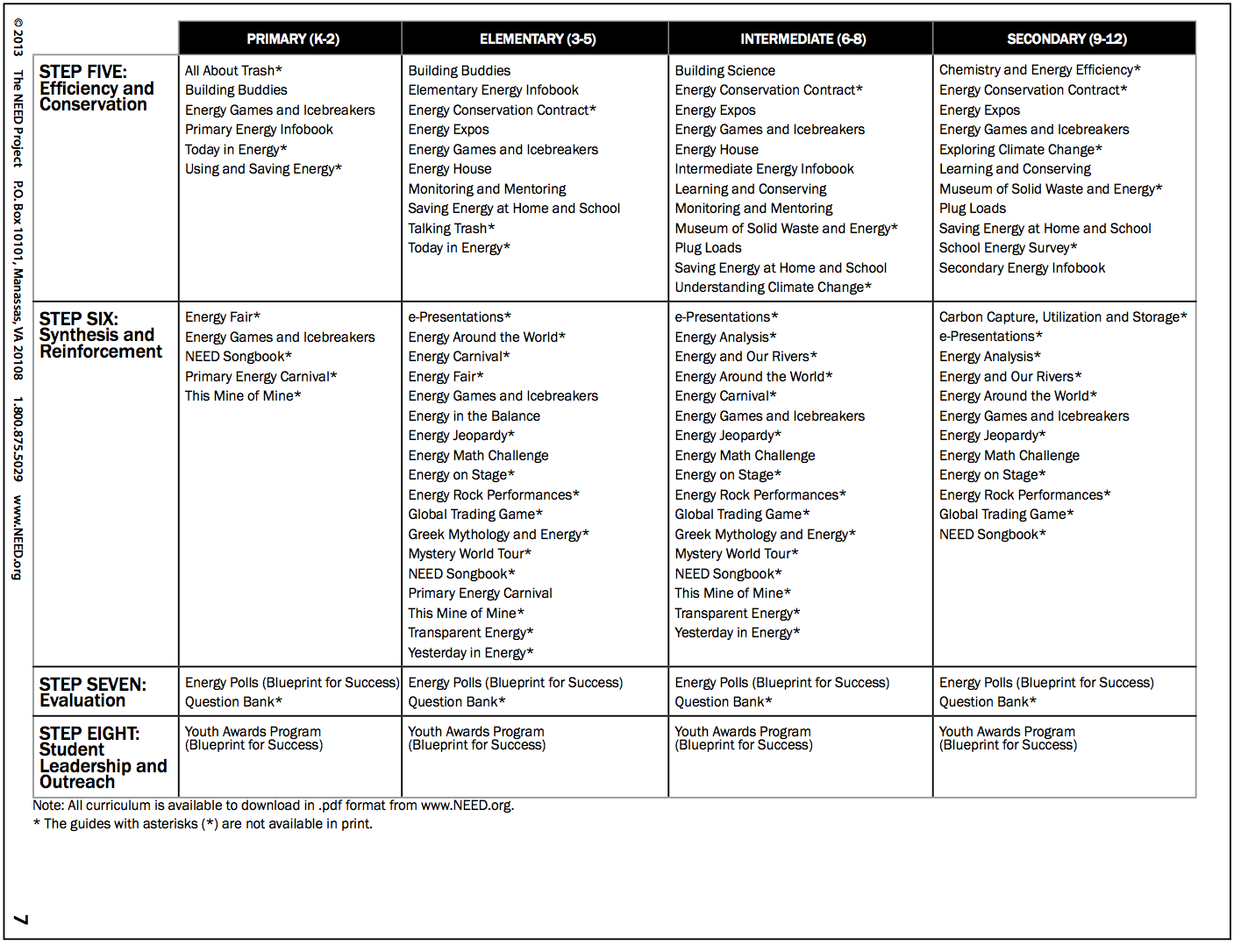

Slide 23
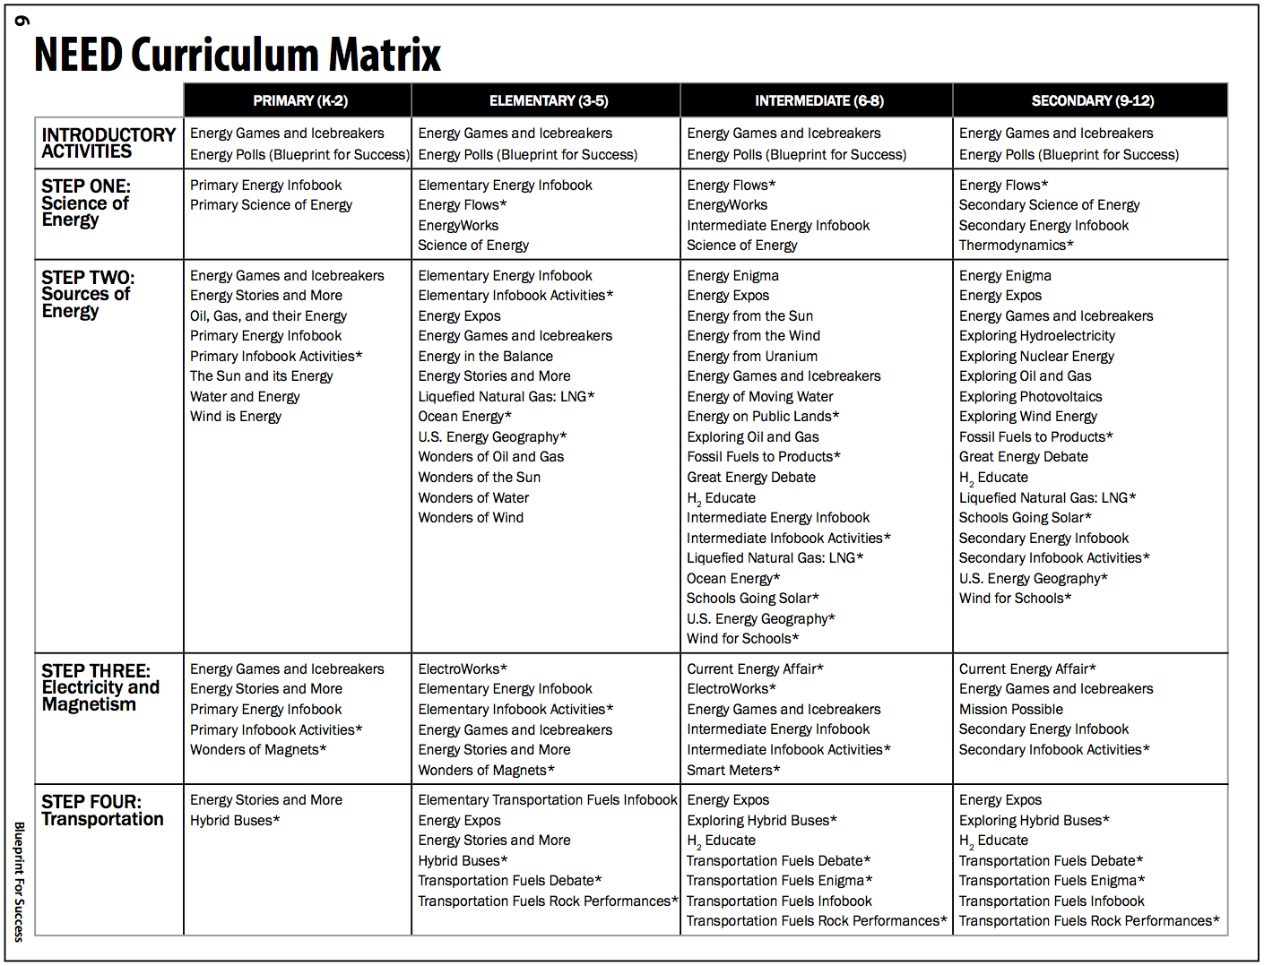

Slide 24
http://pge.need.org

Slide 25
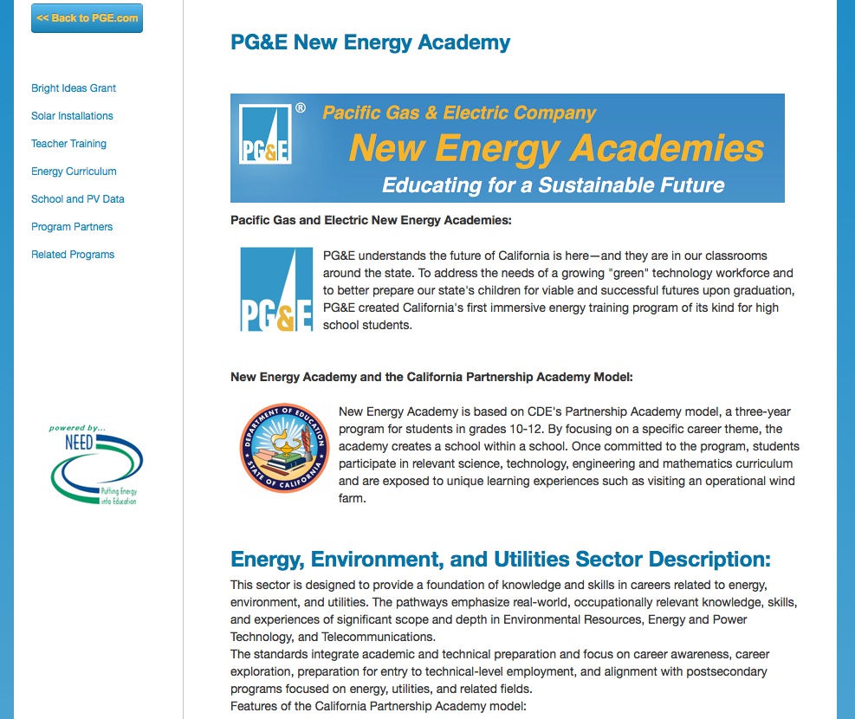

Slide 26
Industry Certification
Recommendations- Pearson NCCER:
National Center for Construction Education and Research
Global : Bechtel, Pacific Gas and Electric
Offers certification and testing across a variety of crafts
Trainee’s certifications are portable, globally recognized
Core curriculum treats universally important skills
Comprehension level is appropriate to at-risk learners
Combination of written exams and performance tests
Titles are available in Spanish
nccerpearsonconstructionbooks.com

Slide 27
Industry Certification
NCCER Core Curriculum modules:
Basic safety
Construction math
Hand tools
Power tools
Construction drawings
Basic communication skills
Basic employability skills
nccerpearsonconstructionbooks.com

Slide 28
Industry Certification: Additional NCCER titles and Certifications:
Alternative Energy
Solar Photovoltaics
Wind Energy
Sustainable Construction
Weatherization
Power Generation certifications
Distribution, Transmission, and Substation
Management and Safety certifications
Your Role in a Green Environment

Slide 29
Energy Industry Certification
Recommendations- CEWD:
Center for Energy Workforce Development
Comprehensive and nationally recognized
Power generation, Transmission, & Distribution
Certifications are provided for module completion
Text based and online modules, written exams only
Most appropriate to dedicated post-secondary programs
Module One- History of the Power Industry (OK for HS)
Module Six- Career Exploration (online, useful for HS)
Module Seven – Hot Topics (online, useful for HS)
www.cewd.org

Slide 30
High School Resources
Conclusions:
NEED Project materials for motivation and background, hands-on energy science, K through 12;
NCCER for a variety of certifications upon graduation, appropriate to high school or community college;
CEWD for in-depth dedicated energy programs; more appropriate for community college level.
Used alone on in combination, all have value in EE!

Slide 31
Upcoming workshops
March 22, 2014
Wind Energy Workshop - Mojave, CA
March 27, 20142014 Energy Education Workshop for Teachers - Carson, CA
April 3, 20142014 Energy Education Workshop for Teachers - Santa Maria, CA
www.need.org

Slide 32
High School Resources
Thank you.
☺
Questions?
Barry Scott
bscott@need.org
Mobile: 209.482.5663

