Slide 1
CALIFORNIA COMMUNITY COLLEGES
CHANCELLOR’S OFFICE
Strategic Framework
Presenter: Maureen White, M.A., Ed.D., SPHR
Division of Workforce and Economic Development
California Community Colleges, Chancellor’s Office
State of California
Version 36 as of September 2013
Notes:
Last time I presented to ASTD was at the peak of the recession in 2009, and it was entitled: Being Resilient in a Recession.
My article on Creating A Career and Making Ends Meet (2009) is archived on ASTD website
Disclaimer: this is NOT a training; this is information that can help you navigate & strategize your T&D expertise
PPT on ASTD website – handouts for exercise
YouTube Social Media Right Here, Right Now: as workplace learning experts, we need to be current on popular culture
What happens in Vegas, stays on ____________________
What is blamed on Facebook? Divorces
Who considers email passe? Gen X & Gen Y
What is the second largest search engine in the world? YouTube
What is “socialnomics?”
Ten top demand jobs did not exist in 2004
50% of workers have been with their companies: less than 2 years
Technical information is multiplying: twice each year
More people own a mobile phone than a toothbrush
What does this YouTube video relate to community colleges? Digital Media is one of our top ten hiring sectors in California

Slide 2
CALIFORNIA COMMUNITY COLLEGES CHANCELLOR’S OFFICE Agenda
Overview: sector & regional strategy
Funding “streams” – federal and state
California’s Workforce System & Partners
Doing What MATTERS ™ Framework
2013-2014 priority hiring sectors
Technical Assistance/Expertise
So, what does this mean for YOU? (WIIFM)
Appendix: Sacramento priority sectors = your priority work strategies
Notes:
2010-2013 Oversee statewide Career Development & Work-Based Learning Advisories;
2013-2014 Oversee Small Business Sector
2010-2014 Support LACCD – second largest college district in the nation!
Sacramento Workplace Learning Professionals

Slide 3
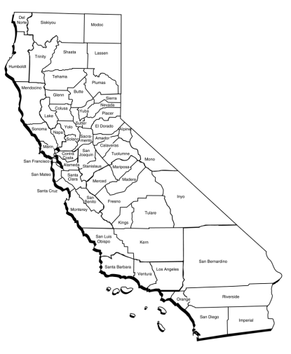
The call to action
Collective need
Unemployment rate
2M+ out of work
67% voters focused on jobs and economy
Skilled workforce by sectors
California Community Colleges – Chancellor’s Office | 112 Colleges | 72 Districts | 2.6 Million Students
Notes:
PPIC research/survey
Unemployment is not calculating those who have given up; retired earlier; part time jobs; under-employed
Skills Gap: controversy - employers are concerned due to: healthcare mandate; affordability of training; can ask for everything in a job description

Slide 4
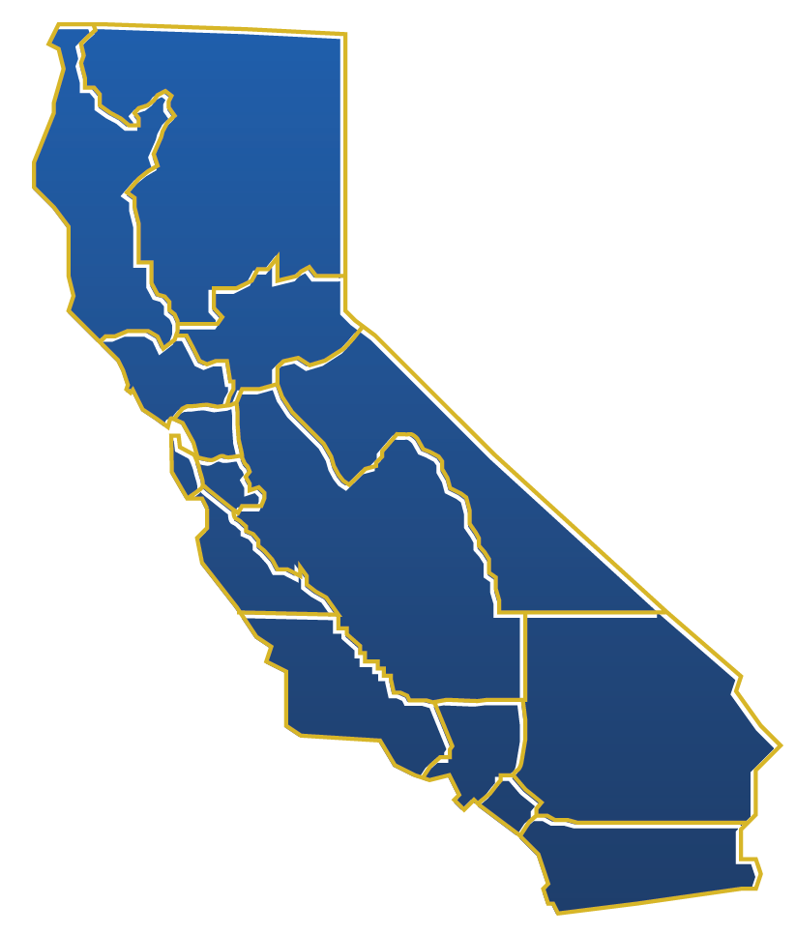
California’s reality: many regional economies
San Diego/Imperial
-----
Los Angeles
Orange County
-----
East Bay
North Bay
SF/Mid Peninsula
Silicon Valley
Santa Cruz/Monterey
-----
Inland Empire/Desert
-----
Greater Sacramento
Northern Inland CA
Northern Coastal CA
-----
South Central
-----
Central
Mother Lode
Notes:
Q3: Rescope activities of Perkins-funded
Regional Consortia to strengthen regions: data mining, convening, technology, and curriculum.
Q1: Support with labor market demand data provided by EWD Center of Excellence, CWIB, EDD’s labor agency, etc.
Q3: Align pathways of SB70-funded high school academies.
Objections: data?
Role of IDs (initiative directors)
Region County(s)
Inland Empire Riverside, San Bernardino
San Diego/Imperial San Diego, Imperial
Los Angeles/Orange Los Angeles, Orange
East Bay Alameda, Contra Costa
North Bay Solano, Napa, Sonoma, Marin
Silicon Valley Santa Clara
South SF Bay Santa Cruz, Monterey
San Francisco San Francisco, San Mateo
Greater Sacramento Sacramento, El Dorado, Placer, Yolo, Sutter, Yuba, Nevada
Northern Inland CA Butte, Colusa, Glenn, Lassen, Modoc, Plumas, Shasta, Sierra, Siskiyou, Tehama, Trinity
Northern Coastal CA Del Norte, Humboldt, Lake, Mendocino
South Central San Luis Obispo, Santa Barbara, Ventura
Central Merced, San Joaquin, Stanislaus, Tulare, Fresno, Kern, Kings, Madera, San Benito
Mother Lode Mariposa, Mono, Tuolumne, Alpine, Amador, Calaveras, Inyo

Slide 5
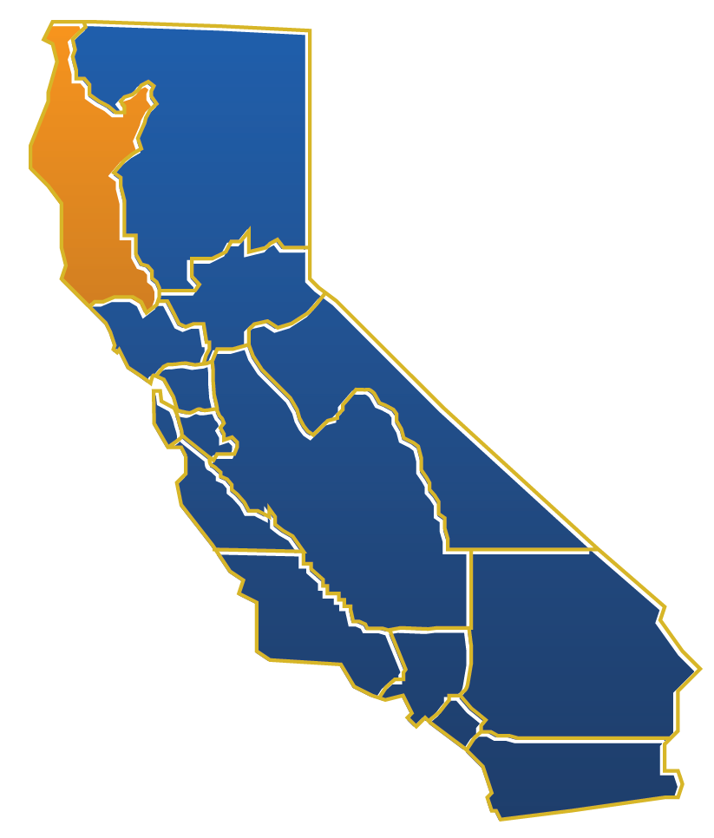
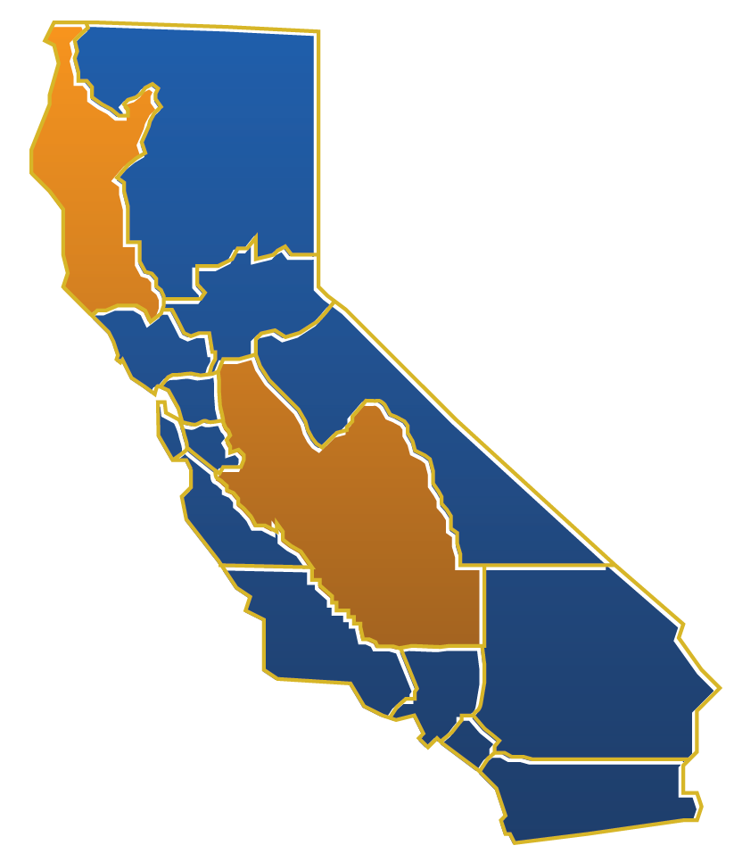
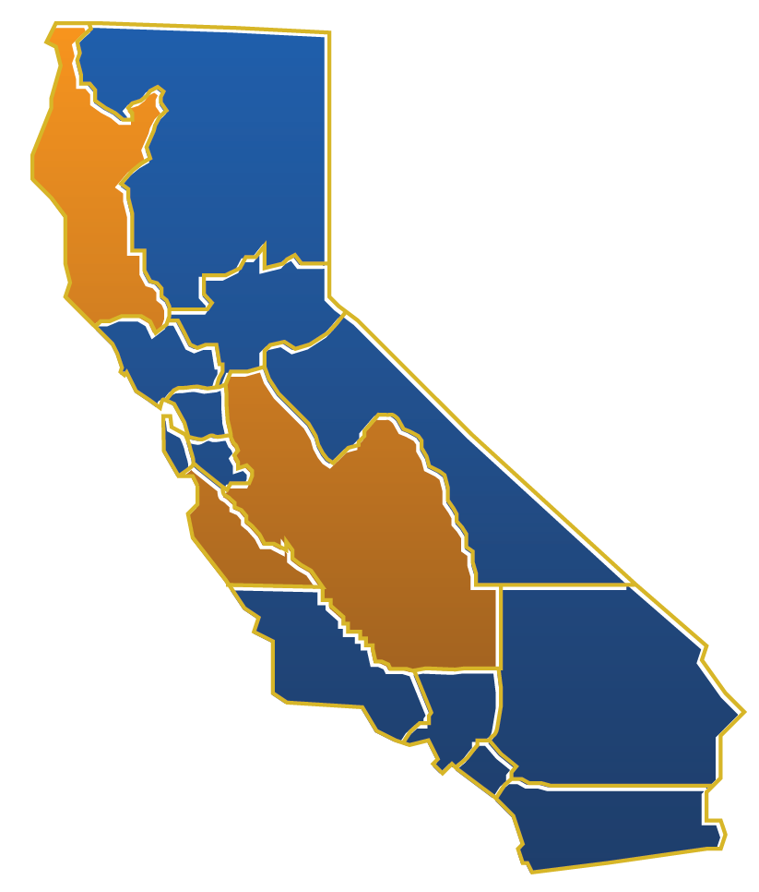
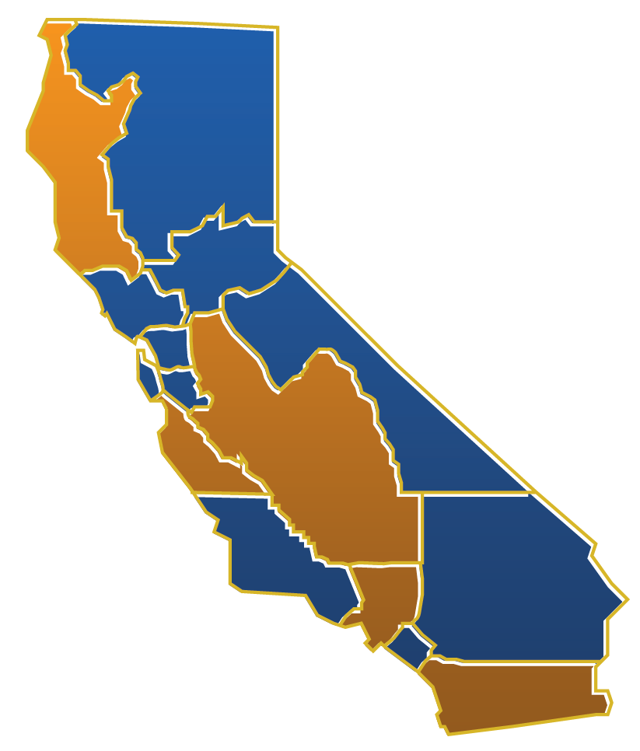
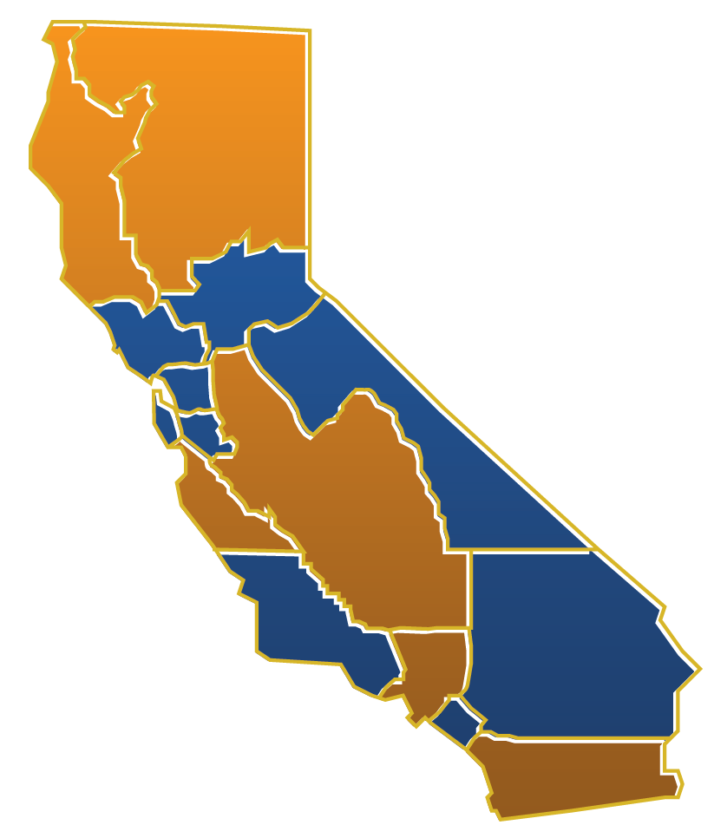
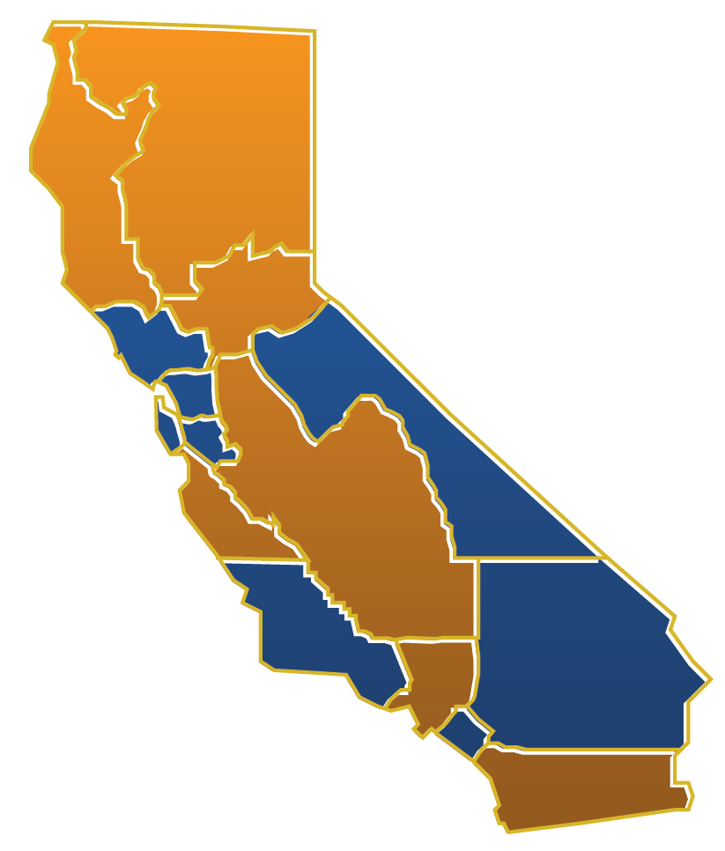
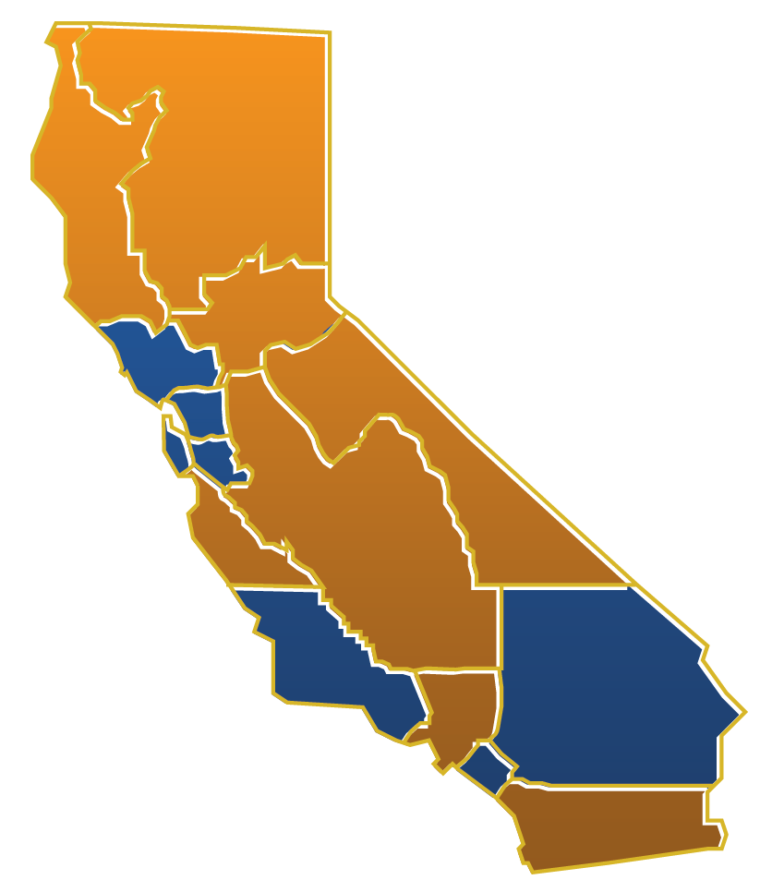
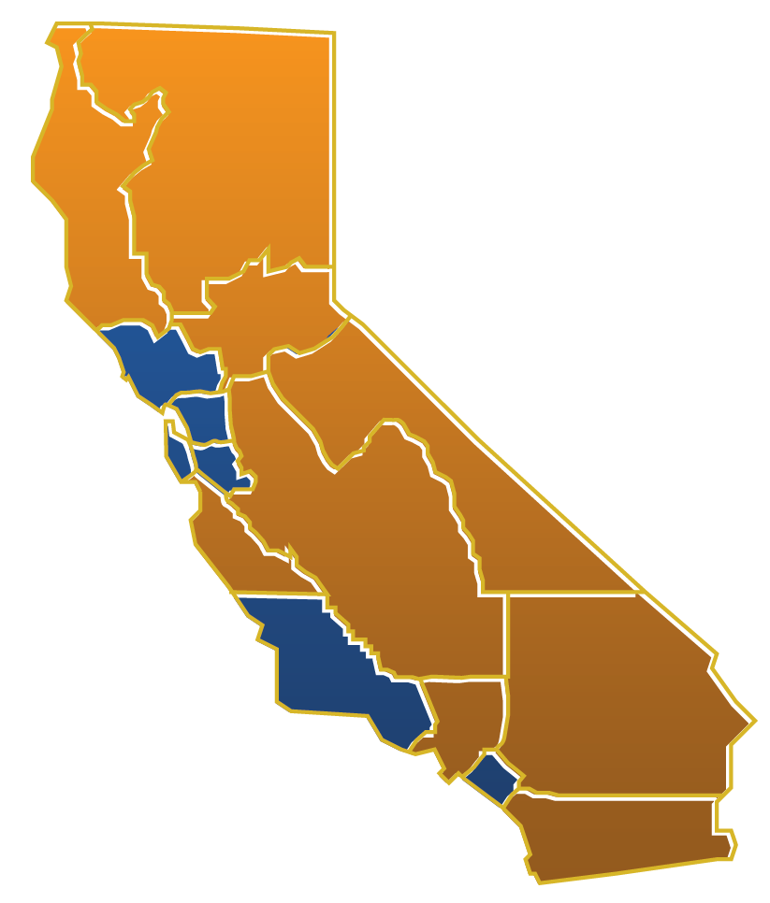
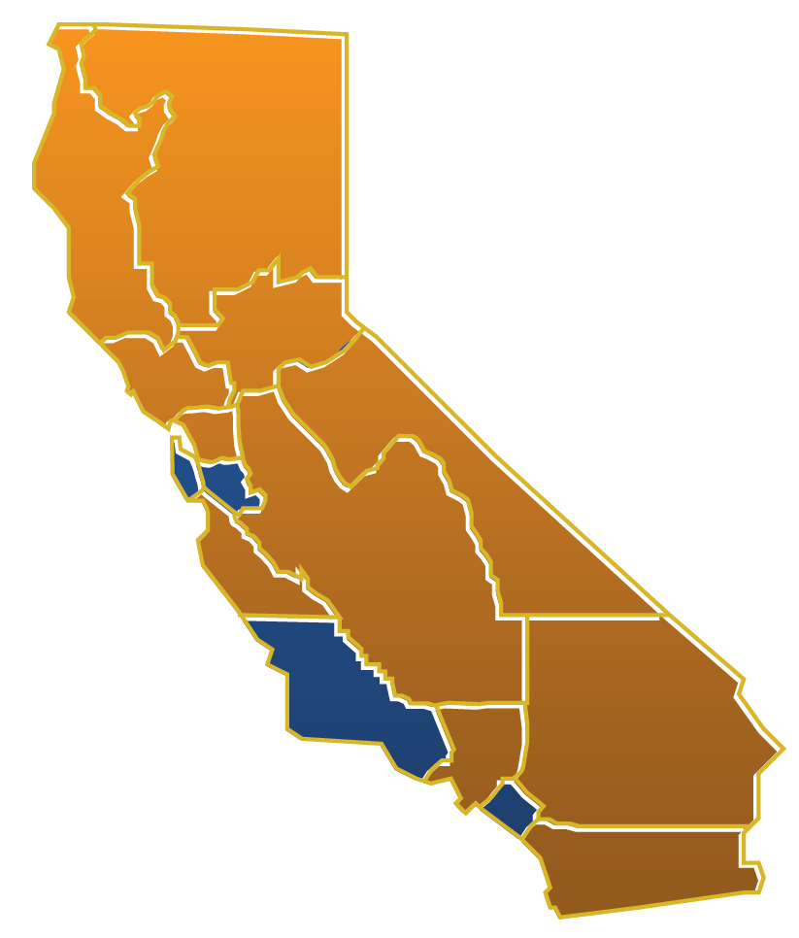
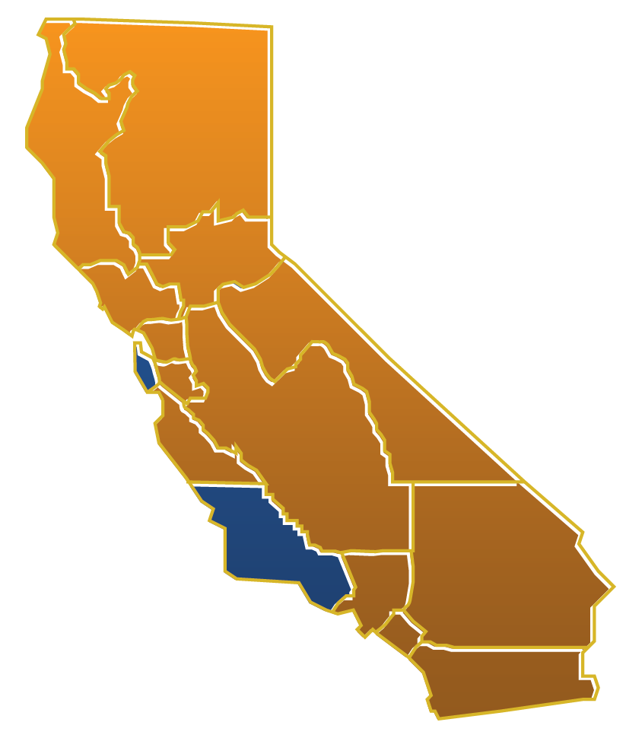
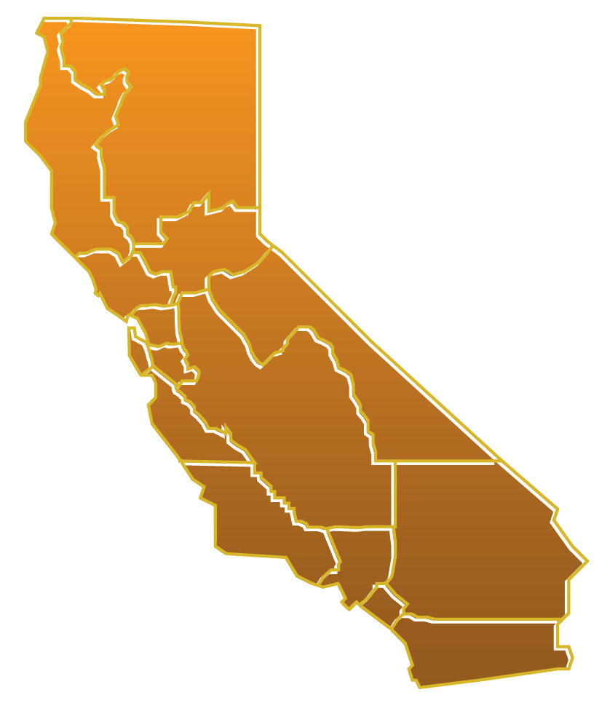
WHAT IF?
TARGET investments
By REGION
At SECTORS
Priority
Emergent
California Community Colleges – Chancellor’s Office | 112 Colleges | 72 Districts | 2.6 Million Students

Slide 6
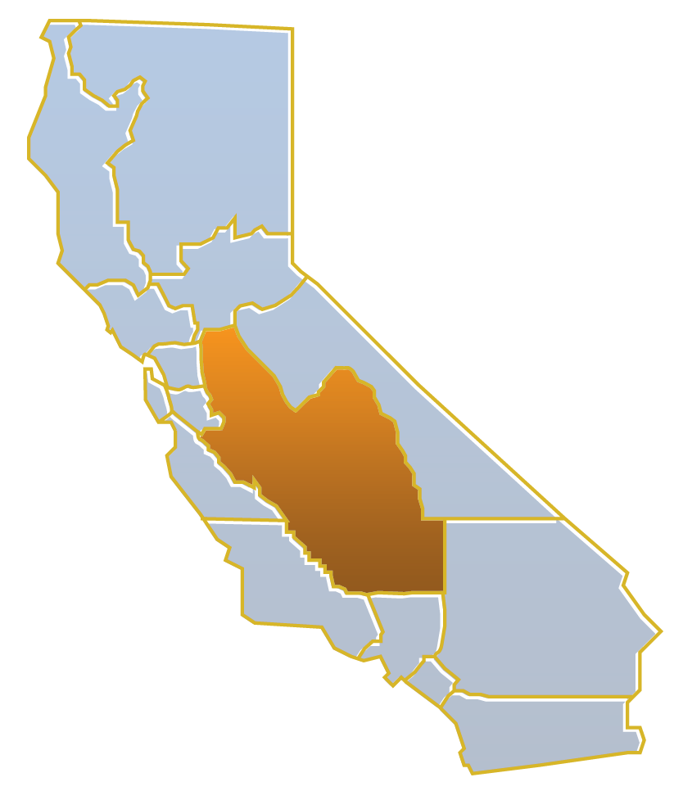
WHAT IF? Braid funds
State Chancellor’s Office workforce funds
EWD
SB70
Perkins 1B
Other resources
Private
Public
Foundation
Federal, state, regional, local
The feds are already doing it.
California Community Colleges – Chancellor’s Office | 112 Colleges | 72 Districts | 2.6 Million Students
Notes:
Some funding will end in 2-3 years; must prove sustainability to re-authorize funding

Slide 7
California comeback
Thriving regions
Thriving state
Notes:
George Shultz comment: feds in world of hurt, state in world of hurt, action will be at with the regions. Your backyard. Your families, neighbors, communities, employers, and institutions. CCs are your COMMUNITY institutions

Slide 8
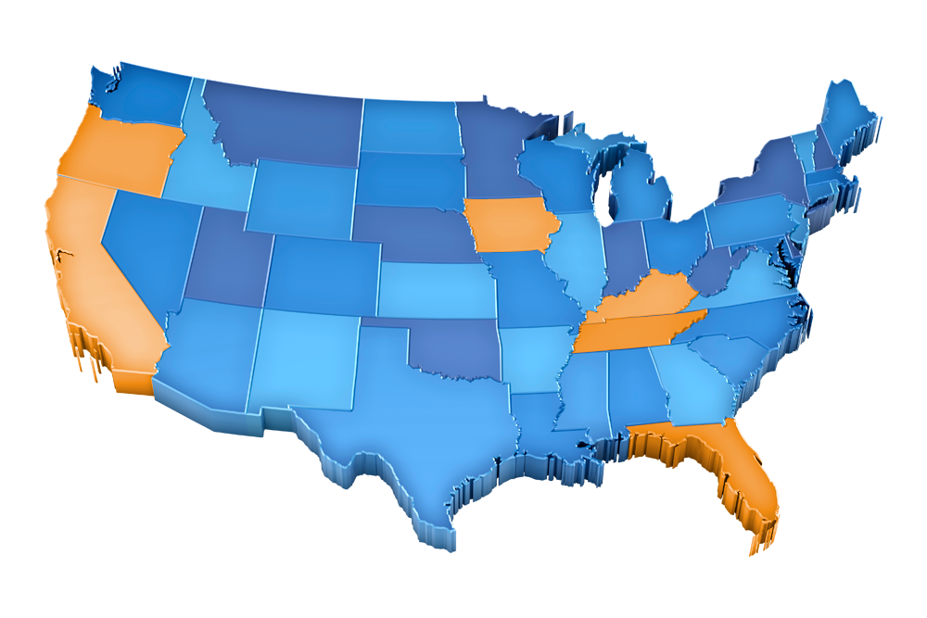
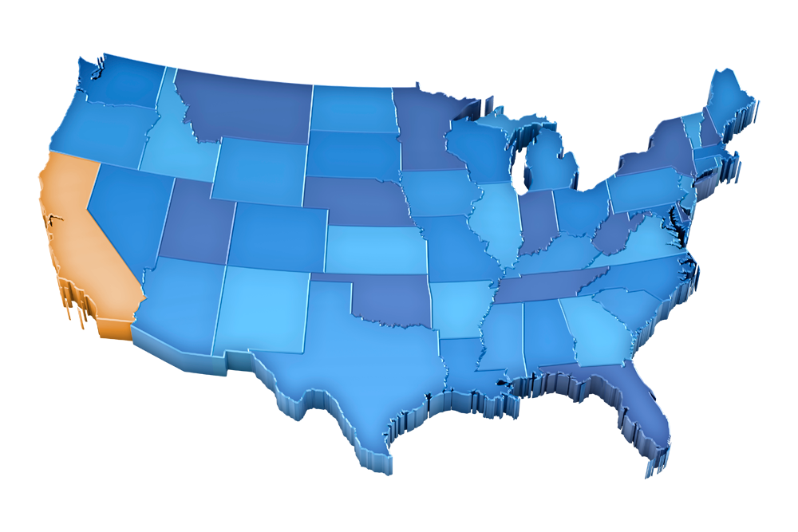
Not IF? But HOW.
Thriving state
A more competitive nation
Other states are no longer debating.
Notes:
College System Aligns Curriculum with Industry Needs
The North Carolina Community College System (NCCCS) recently announced its effort to meet the state's industry needs by consolidating 80 curriculums down to 32 as part of the college system's Code Green Super Curriculum Improvement Project (CIP).
The State Board of Community Colleges worked with area employers to identify five fields critical to advancing the state's economic growth: energy, building, environment, transportation, and engineering technology.
The Board and college system leadership believe that grouping like majors together will allow students to gain a solid foundation of general skills before they move on to more specific coursework that will prepare them for the workforce.

Slide 9
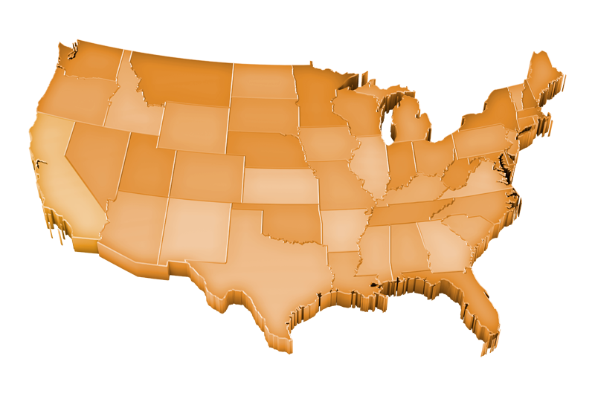
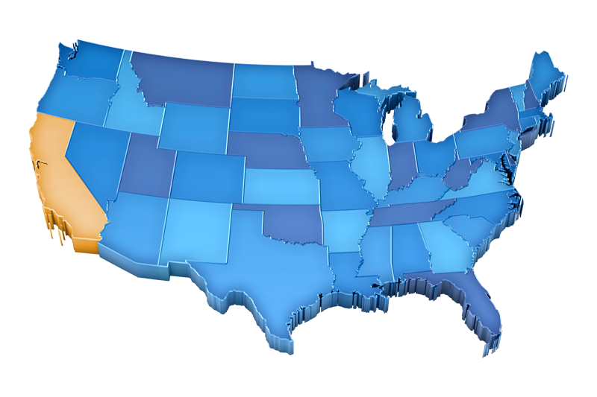
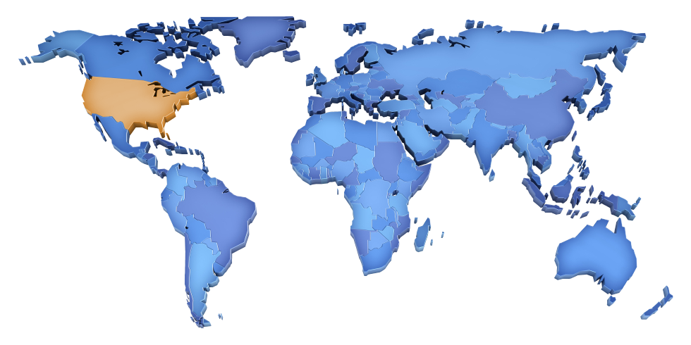
America comeback
A more competitive nation
In a global economy
NY Times Tom Friedman: “Average is over.”

Slide 10
California’s workforce system refocusing to train by sector by region.
Governor
California Workforce Investment Board (CWIB) State Leadership Body
CWIB, Labor Agency, CCCCO, ETP, EDD, DAS, CDE’s Adult Ed, HHS, GoBiz, and others
Regional Workforce & Econ Dev Network(s)
Regional Workforce & Econ Dev Network(s)
Regional Workforce & Econ Dev Network(s)
Sector
Partnership
Sector
Partnership
Sector
Partnership
Sector
Partnership
Sector
Partnership
Sector
Partnership
Sector
Partnership
Sector
Partnership
Sector
Partnership
Develop shared goals for the system;
Align and repurpose resources to achieve those goals;
Establish metrics for success and develop “integrated” data collection system;
Establish statewide communities-of-practice and support technical assistance (TA) to regions;
Work together to develop an effective system of actionable labor market information; monitor progress; course correct.
Notes:
DAS: Department of Apprenticeships
CalWIB: re-branding from One Stop Career Centers to AJCC – America’s Job Centers of California

Slide 11
Community colleges refocusing to train by sector by region.
Jobs & Economy Goals:
Supply in-demand skills for employers
Create relevant pathways and stackable credentials
Get Californians into open jobs
Promote student success
California Community Colleges – Chancellor’s Office | 112 Colleges | 72 Districts | 2.6 Million Students
11
Notes:
CCs are vital to jobs and economy
Student Success Act (2012) – priority registration for focused sectors and completion (degree, transfer, certificates)
Chaos. Now is the time to engage and not pull back. What do you need from your cc’s.

Slide 12
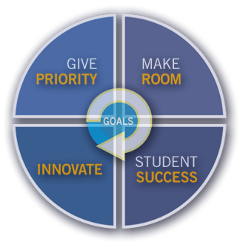
Doing What MATTERS for Jobs & the Economy
Framework for California’s community colleges
GIVE PRIORITY
1A. Consider labor market needs when making local decisions: budget, courses, programs.
1B. Decide on program capacity as a region.
MAKE ROOM
2. Retool programs that are not working or not meeting a labor market need so that students can study what matters.
INNOVATE
4. Solve a complex workforce training need so that our system can better deliver for employers and sectors.
STUDENT SUCCESS
3A. Braid funding and advance common metrics in CCCCO RFAs.
3B. Strengthen regions with four skillsets: data mining, convening, technology, and curriculum approval.
Notes:
- Curriculum development for specific sectors and jobs
Lots of field input
Q4: footprint issue. Microcrendentials.
For example: If we were going to push this initiative forward, what are the steps we will need to take over the next year? Who are the people that will need to be involved? What are the challenges ahead that we need to prepare for? What might be the measureable objectives that will allow us to know that we have made progress? What are the talking points we might use?
Sub-teams will work for a period of time to complete what they can. Then each will report out to the larger group and the whole team will help fill in any missing pieces or refine what has been done. Then Catherine/Linda will lead a similar exercise for the whole group on the 4th initiative.

Slide 13
Give us your feedback. Visit doingwhatmatters.cccco.edu.

Slide 14
Braid State Chancellor’s Office workforce funds to target investment. Proposal for 2013-14.
Regions
Consortia Chair/Co-Chairs
Collaborative Communities
Mini Grants
Sectors – Priority & Emergent
Sector Navigator
Collaborative Community
Mini Grants
Programming
Technical Assistance (TA) [CoE, Contract Ed.]
TA Expertise procured to support field’s attainment of regional sector priorities
California Community Colleges – Chancellor’s Office | 112 Colleges | 72 Districts | 2.6 Million Students
Notes:
Before I share this slide. Some of you elated:
State is coordinating
Giving you more flex to target investment
Some filled with dread and sitting on your hands.
Will I have a job
How will my job change
If we can pull off fwk, more support for cc’s. More suppport for the CTE mission. May ask that you shift how you do your work 10, 45, 90, 180 360 percent, but there is opportunity created in this fwk

Slide 15
Investments in sectors. Proposal for 2013-14.
Resourced with Sector Navigator + Collaborative Community + Mini Grants + Programming
Advanced Manufacturing
Advanced Transportation & Renewables
Agriculture, Water & Environmental Technologies
Energy (Efficiency) & Utility
Health
Life Science/Biotech
Information & Communication Technologies (ICT)/Digital Media
Trade Export & Logistics
Small Business
Retail/Hospitality/Tourism “Learn-and-Earn”
California Community Colleges – Chancellor’s Office | 112 Colleges | 72 Districts | 2.6 Million Students
Notes:
Data driven
Each with a Sector Navigator – like a specialist doctor to bring SME

Slide 16
Investments in Technical Assistance (TA). Proposal for 2013-14.
TA Expertise procured by CCCCO to support field’s attainment of regional sector priorities
Labor market information (e.g., Centers of Excellence)
Navigating contract education (aka., Catherine Swenson)
Enrollment management, data and accountability tools (e.g., Veratac, DCS)
CACareerCafe.com toolkits
Veteran’s pathways; work-based learning
Perkins special pops and non-traditionals
With CCCAOE, Leadership Program on CTE/EWD/Perkins fundamentals
With ASCCC, resources and professional development in instructional design & curricular approval
With Basic Skills Initiative, resources and professional development contextualized basic skills
Others
As is prioritized by regions, sectors and funding
California Community Colleges – Chancellor’s Office | 112 Colleges | 72 Districts | 2.6 Million Students

Slide 17
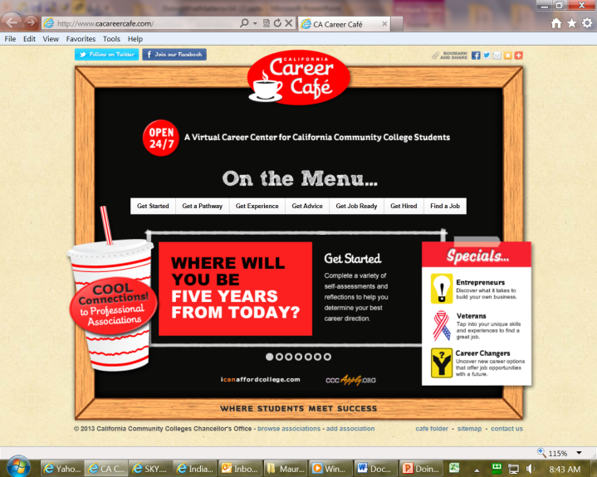
CALIFORNIA COMMUNITY COLLEGES
CHANCELLOR’S OFFICE
Notes:
NING for community of practice for career professionals, by region

Slide 18
Thank you!
Resources
www.doingwhatmatters.cccco.edu
http://doingwhatmatters.cccco.edu/ResourceMap.aspx#gsacbox
Twittter @WorkforceVan
www.CaCareerCafe.com
mwhite@cccco.edu

Slide 19
APPENDIX

Slide 20
http://bit.ly/18xCjSA

Slide 21
Common Metrics & Accountability
http://bit.ly/1eMwuSU
More on outcomes,
less on activities and outputs
Common menu
Selectively applies depending on funding stream & RFA scope
Advised by CalPASS, RP Group, WestEd, CCCCO TRIS, ARCC 2.0, field
Launchboard: tools to automate data collection and deliver data
“Moving the Needle”
SB 1402
SB 1070
Perkins 1B
A. Student Momentum Points
B. Leading Indicators of Curriculum Alignment to Workforce Needs
C. Quality of Service Measures
Notes:
Go over the legislative imperative for common metrics.
Introduce Omid – embed field perspective up front in process

Slide 22
A. Student Momentum Points
http://bit.ly/1eMwuSU
SB 1402
SB 1070
Perkins 1B
Middle School cluster
Transition from Middle School to High School cluster
High School cluster
Transition from High School to College cluster
Community College cluster
General Education and Transfer Progress cluster
Community College Transition to Workforce cluster
Workforce Progress cluster
X
X
X
X
X
X
X
X
X
X
X
X
X
X
Notes:
Omid, the 3 funding streams have scope beyond the time period in which students are touching our campuses…backwards into middle school….and forward into the workplace. Walk us thru the clusters of momentum points that colleges can target their funds. Can you give some examples of how the sector prioritization ties in (use the middle school example)? How do we deal with the worry that workforce programs tracks students - how do these momentum points count students who successfully transfer if that is what is right for them?

Slide 23
B. Leading Indicators of Curriculum Alignment
http://bit.ly/1eMwuSU
Occurrences of the following:
Alignment of skillsets within a program (or set of courses) to the needs of the industry in a particular occupation and the needs of the labor market
Regionalization of stackable certificates aligned with a particular occupation ladder
Alignment of a certificate with state-, industry-, nationally-, and/or employer-recognized certification
Movement of a certificate from non-credit to credit
Curriculum articulation along a career or multi-career educational pathway
Updating skills of faculty, teachers, counselors, and/or ‘supporting staff to student’ to reflect labor market needs
SB 1402
SB 1070
Perkins 1B
X
X
X
For each, grantees shall provide evidence in the form of a rating by the employers/advisory body,
on a scale of 0-5.
5 = exceeds expectation
4 = meets expectation
3 = almost meets expectation
2 = below expectation
1 = does not meet expectation
Notes:
Question to Omid: We call is second list the leading indicators. What is the relationship between leading indicators and student momentum points? <Emphasize that these are hard to do hence we want to credit to those who work to move the needle on these>

Slide 24
http://bit.ly/1eMwuSU

Slide 25
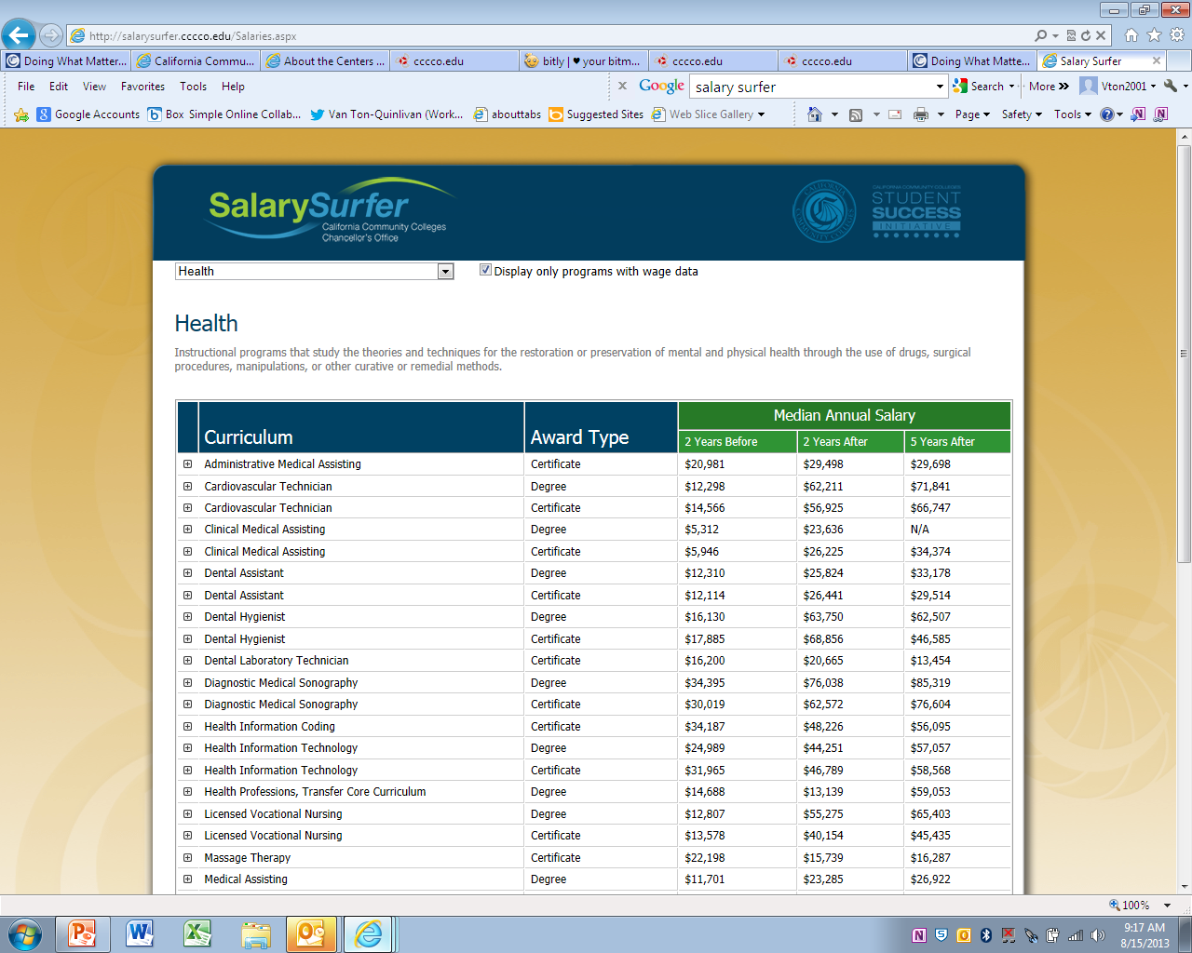
http://salarysurfer.cccco.edu/SalarySurfer.aspx

Slide 26
Key integration points for the $250M
Use the same/similar common metrics (at http://bit.ly/1eMwuSU) from middle school thru post-sec and then workplace that was developed for SB 1070 based on learnings from SB 70
To minimally include the regional sector priorities as mapped by the community colleges which is consistent with the mapping of the local WIBs instead of starting anew (see doingwhatmatters.cccco.edu’s http://bit.ly/14j8Ol4 or http://bit.ly/18xCjSA)
And, to have grantees enter their data into the same data collection system run by Cal-PASS Plus, which is the vendor already tying together K-12 data with the community college datamart so that we have visibility into student progress (see http://salarysurfer.cccco.edu/SalarySurfer.aspx)

Slide 27
Is our system trending the right way?
10 year decline in “CTE as a % of FTES”
Source: CCCCO MIS

Slide 28
State apportionment not proportionally being used on CTE.
FTES
Source: CCCCO MIS
California Community Colleges – Chancellor’s Office | 112 Colleges | 72 Districts | 2.6 Million Students

Slide 29
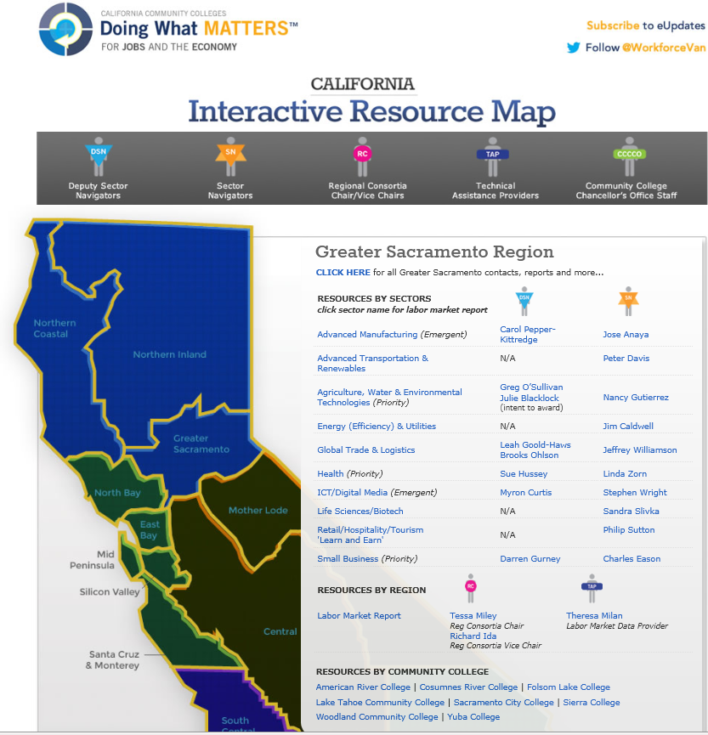
Greater Sacramento Region & Sectors Contacts

Slide 30
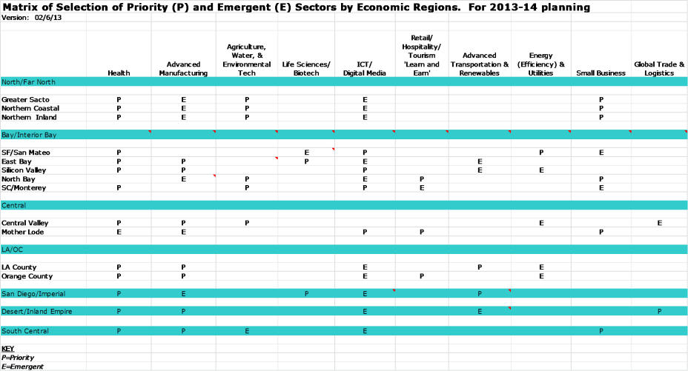
Recap Consolidation of regional submissions
Notes:
This is a rollup of the priority and emerging sectors identified by each region.
The blue lines are the super-regions, which align with the regional consortia structure. These are the bodies that convened stakeholders to determine the sectors.
What’s under the blue lines represent the economic regions—the 15 that were used for the economic profiles done earlier this year. Note that San Diego, Desert, and South Central were each one economic region that corresponded with the super-region title.
Each super-region was tasked with identifying 3 priority and two emerging sectors for each economic region. The super-regions and economic regions are what you see on the horizontal axis.
The vertical access is the sectors. P stands for priority, E for emerging. Regions were given definitions from the legislative language on the meanings of sectors, and clusters but were given flexibility.
Regions used a variety of approaches to determine their sectors. In fact, some are actually clusters rather than sectors. For example, several regions pulled a lot of labor market data to guide their choices. Another region defaulted to the same sectors as a large eocnomic collaborative in their region, so that they could leverage existing efforts. Yet another aligned their choices with what their regional WIBS were investing in. We want to thank the regions for their role in this undertaking and the seriousness in which they approached the task.
Now let’s look at the vertical access. You can see that 13 of the 15 economic regions chose health. Specifically what health professions are in some cases yet to be defined and will require a deeper look at the labor market and the major employers. 14 of the 15 regions identified ICT. Here is an instance where we may need to increase the investment in this area beyond what it is now.
Eleven regions prioritized advanced manufacturing, a number of them as a cluster like food processing, machine maintenance, and food distribution.
Half the regions prioritized three other sectors----agriculture, water, and the environment totals 8, as does advanced transportation/renewables (mostly on the side of renewables) and small business/entrepreneurship.
Finally, four sectors---biotech/life sciences, energy and utiliities, retail/hospitality/tourism, and global trade/logistics were less frequently identified as regional priorities. If funding follows priority sector selection, we might expect to see less investment than, for example, health or ICT.
A template for each of the15 economic region backs up this aggregate table. Are there any questions of the chairs or about this process?

