Slide 1








Slide 2







“
The skills gap is our
#1 national security risk.
”
Arne Duncan
United States Secretary of Education
Jeb Bush Education Foundation (2011)

Slide 3

More than 50% of today’s jobs require some technology skills, and experts say that percentage will increase to 77% in the next decade
77%
60%
Within ten years, 60% of the jobs that will be available do not currently exist
In a national survey done by McKinsey/Manpower, 50% of employers reported that they are unable to fill job openings with qualified workers
50%

Slide 4
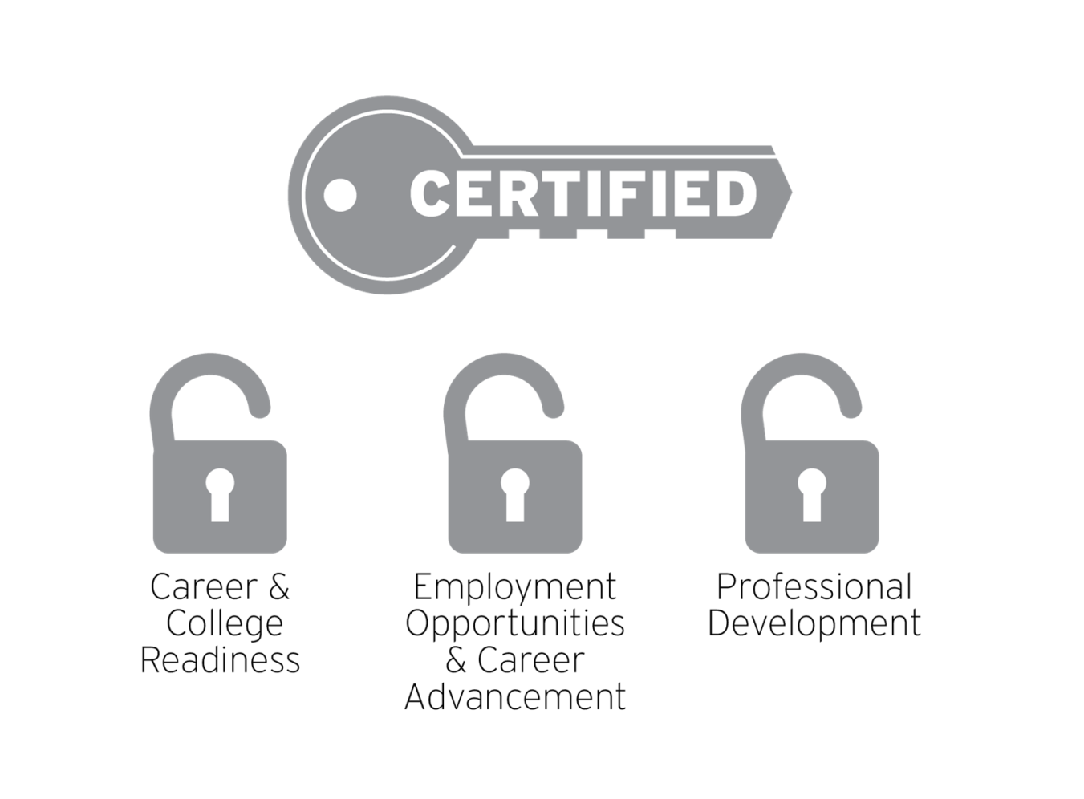
Industry-based certifications are the key to a more secure future.

Slide 5
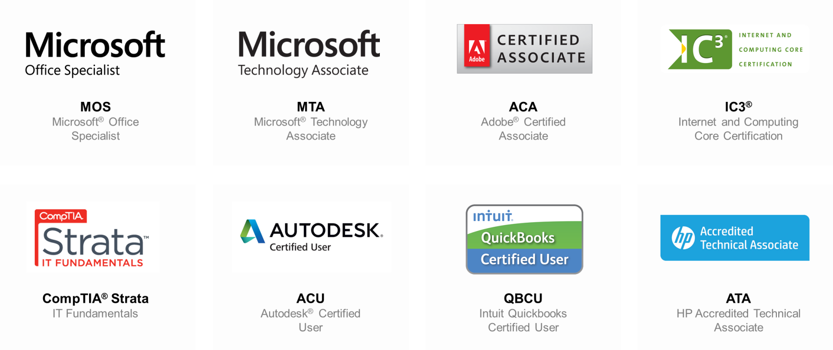
Certiport offers official, recognized certifications.

Slide 6
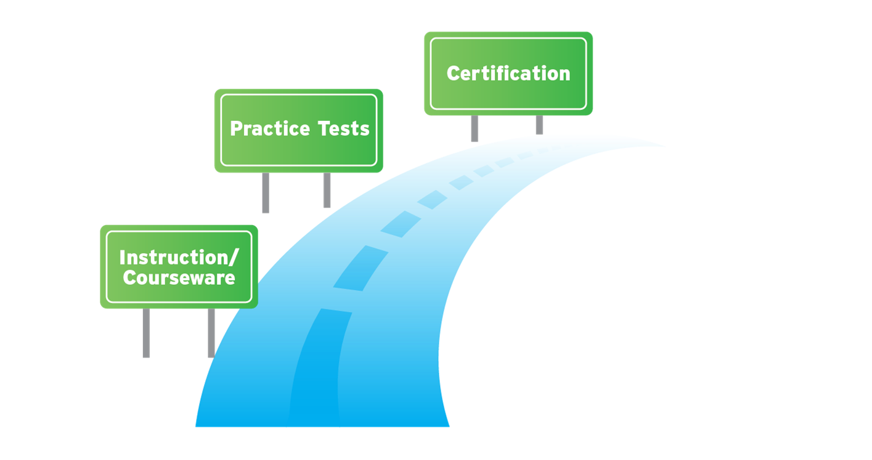
Certiport provides a roadmap for success.

Slide 7

Certiport provides a three-step formula for success.
LEARN
PRACTICE
CERTIFY

Slide 8




Slide 9

Global trends in certification training.
+11%
Those who engaged in training were twice as likely as the overall average to see a raise of 11% or higher, and raises were more pronounced for those who had completed a new certification within the prior 12 months.
2013 IT Skills and Salary Report, www.globalknowledge.com, January, 2013
89%
of IT hiring managers say that IT certifications help confirm subject matter knowledge and expertise.
84%
of IT hiring managers say that IT certifications are used as a measure of a person's ability to work hard and achieve goals.
CompTIA, Employer Perceptions of IT Training and Certification, Jan 2011
80%
of IT managers believe effective training is
critical to the success of a project.
IDC MarketScape, Worldwide IT Education and Training 2012 Vendor Analysis, Feb 2012

Slide 10










Certiport offers learning materials from leading curriculum vendors.
Certiport Approved Courseware
Pearson Learning Courseware
CCI Learning Courseware
WileyCourseware
uCertify Online Courseware
HP ATA Curriculum / HP Certified Educator Program
Adobe-built
Course Materials
Global eTraining Courseware
Autodesk Digital STEAM Workshop
Autodesk Certified User Digital Skills

Slide 11



Slide 12









Certiport offers practice tests and assessments for complete exam preparation.
QBCU Practice Tests Included in Classroom License
Certiprep IC³ Practice Tests
IC³ Benchmark, Mentor, & Fast Track
MeasureUp
Practice Exams
Certiprep Practice Tests for MOS
HP Remote Labs Hands-on Experience
Certiport ACA Practice Tests
Gmetrix
Practice Tests
MTA Prep Guides and Learning Plans
ACU Practice Exams

Slide 13
“
In Practice Mode if you get a question wrong you get citations for the correct answer so you can understand the principles instead of just memorizing them. MeasureUp helps you feel more comfortable and ready to take the certification exams.
”
Alex Carey
Vision Workforce Skills student
IT Apprentice at CDL, UK

Slide 14



Slide 15




Industry-recognized certifications provide college and career readiness for business career clusters
Business
Professionals
Academia Professionals
Marketing
Finance
Accounting
Office Mngmnt
Potential
Career
Path
Certification
to prove competency
Microsoft Office Specialist
QuickBooks Certified
Foundational Knowledge
Internet and Computing Core Certification (IC³)

Slide 16

Industry-recognized certifications provide college and career readiness for design career clusters
Web Technologies
Print, Graphics, and Media
Engineering
Construction
Potential
Career
Path
Certification
to prove competency
Adobe Certified Associate
Autodesk Certified User
Foundational Knowledge
Internet and Computing Core Certification (IC³)

Slide 17

Industry-recognized certifications provide college and career readiness for IT Pro career clusters
IT and Network Administrators
Systems Engineers
Systems Administrators
Solution Architects
Support Technicians
IT Professional
Database Administration
Software Development
HTML / Gaming
Potential
Career
Path
Certification
to prove competency
HP Accredited Technical Associate
Microsoft Technology Associate
Foundational Knowledge
Internet and Computing Core Certification (IC3)

Slide 18
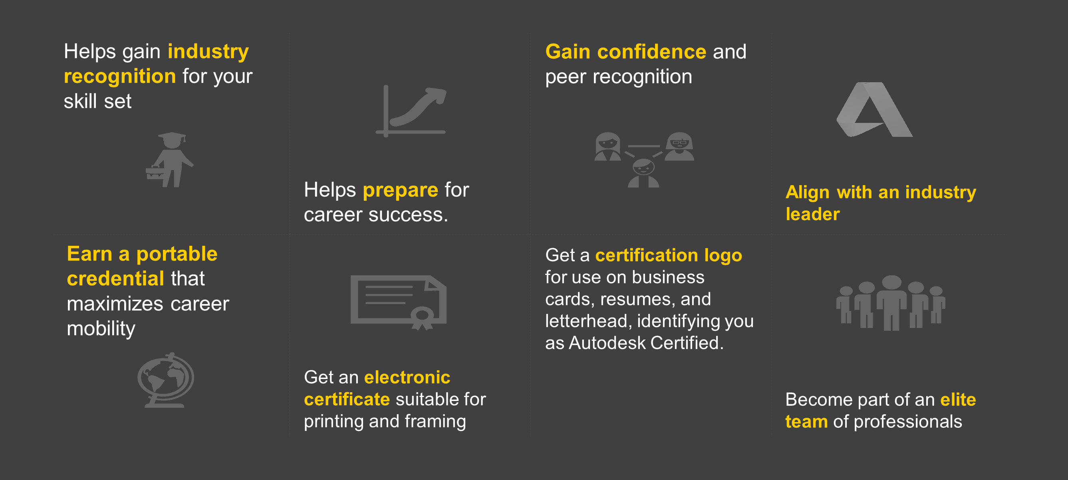
Certification benefits for students.

Slide 19
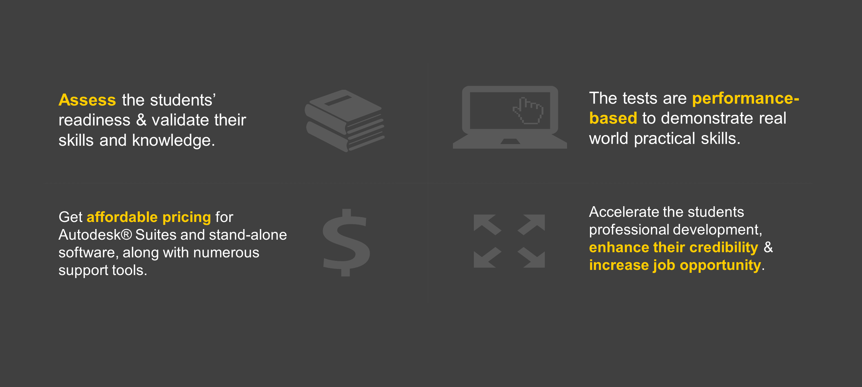
Certification benefits for institutions.

Slide 20
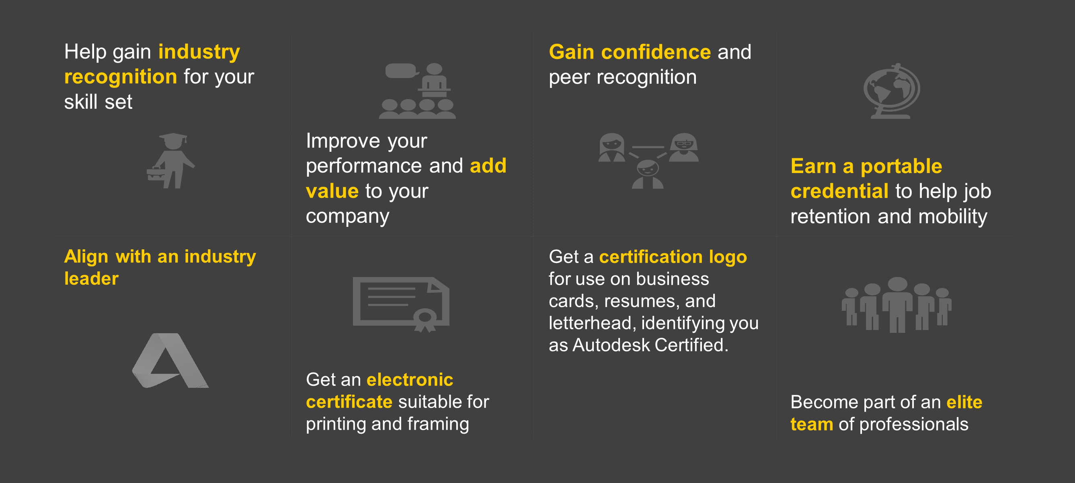
Certification benefits for individuals.

Slide 21
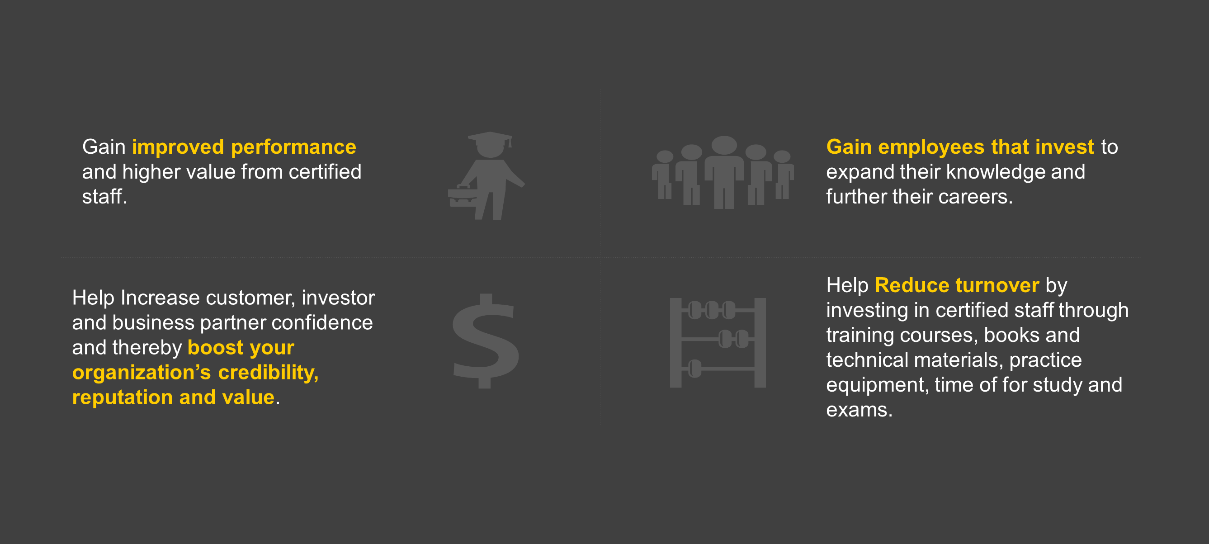
Certification benefits for employers.

Slide 22
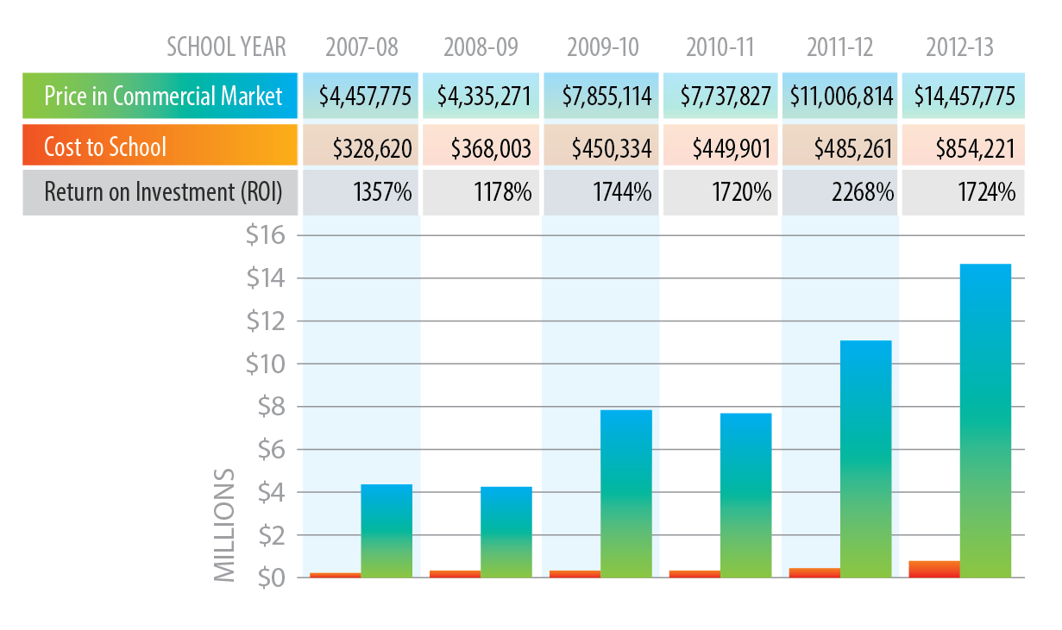
Certification provides real value in Virginia
$2,774 in market value for every $100 invested
Note: The “price in the commercial market”, or market value, is the price of a certification prep course offered at a commercial training center plus the cost of a certification exam. Prices for certification prep courses were obtained from various commercial training centers .

Slide 23
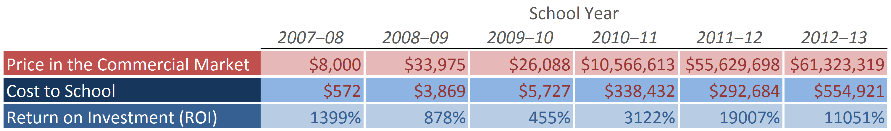
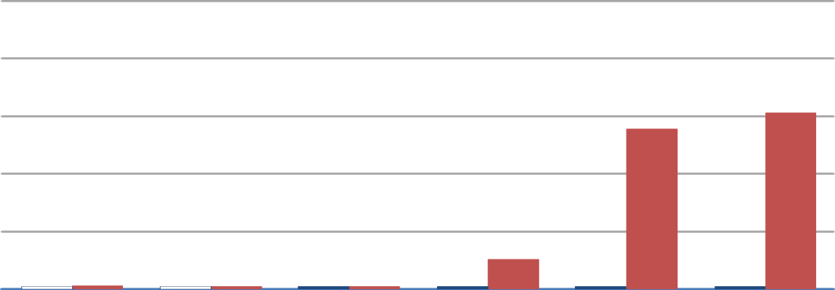
Certification provides real value in North Carolina
$11,051 in market value for every $100 invested
$100
Millions
$80
$60
$40
$20
$0
Note: The “price in the commercial market”, or market value, is the price of a certification prep course offered at a commercial training center plus the cost of a certification exam. Prices for certification prep courses were obtained from various commercial training centers .

Slide 24
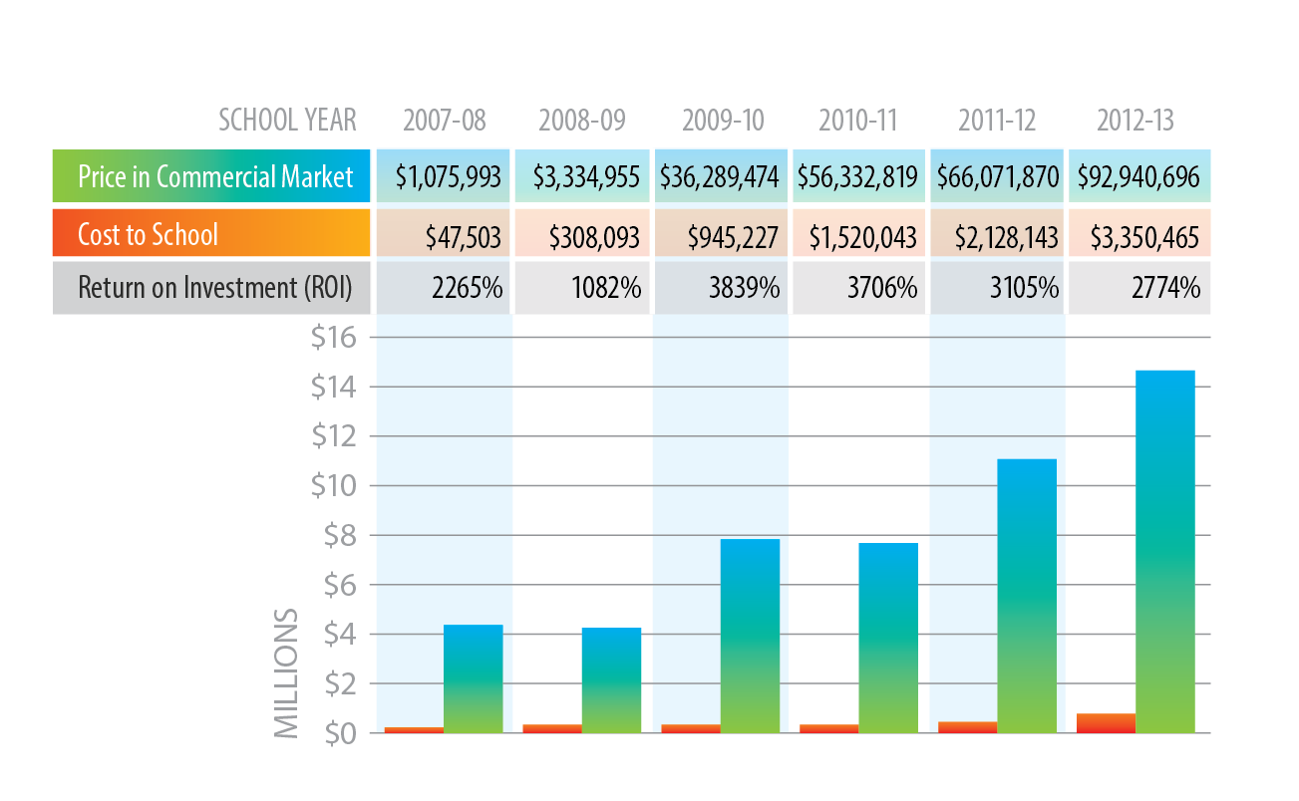
Certification provides real value in Florida
$1,724 in market value for every $100 invested
Note: The “price in the commercial market”, or market value, is the price of a certification prep course offered at a commercial training center plus the cost of a certification exam. Prices for certification prep courses were obtained from various commercial training centers .

Slide 25


Certification provides real value to students
Student | Career Cluster | Grade Level | Certification Obtained | Market Value
Luis (age 18) | Information Technology | 10 | MTA: Networking Fundamentals | $1,194.00
 |  | 11 | MTA: Security Fundamentals | $1,194.00
 |  | 12 | HP ATA: Network Solutions | $5,039.00
Total IT Pro Cluster Benefit: |  |  |  | $7,427.00
Reyna (age 16) | Business, Management, and Admin | 9 | MOS: Word | $646.00
 |  | 10 | MOS: PowerPoint | $623.00
 |  | 11 | MOS: Excel | $894.00
Total Business Cluster Benefit: |  |  |  | $2,163.50
GRAND TOTAL: |  |  |  | $9,590.50
State of Florida – Market Value Study

Slide 26

The Lee County School District in Florida put together a program that made a standard for how they implement industry certification. With certifications like the
Microsoft Office Specialist and Adobe Certified Associate programs, more kids are staying in school, are becoming more involved in developing better life skills and the district has actually seen graduation rates increase.
PLAY

Slide 27
Certification impacts performance in Florida study.
Performance Indicator | Non-CAPE | CAPE, No Certification | CAPE + Certification
Average Grade (GPA – scale of 4) | 2.46 | 2.58 | 3.00
12th Graders Earning Diploma (Graduating) | 73.9% | 85.9% | 96.1%
At Least One College Level Course | 22.9% | 25.4% | 41.2%
2007-08 Graduates Enrolling in Postsecondary Fall 2008 | N/A | 64.4% | 70.4%
2007-08 Graduates Found Employed Fall 2008 | N/A | 46.3% | 44.9%
Chronically Absent | 16.3% | 15.7% | 9.9%
At Least One Disciplinary Action | 20.6% | 20.5% | 10.9%
Dropout Rate | 2.1% | 0.9% | 0.3%
Performance Indicator
Non-CAPE
CAPE, No Certification
CAPE + Certification
Source: Career and Professional Academy Enrollment and Performance Report, 2010-11

Slide 28

Certiport is the one-stop, total learning solution for helping your students get certified and get noticed.
Achieve better grades
Improve graduation rates
Ensure college readiness
Open career opportunities

Slide 29
THANK YOU

